Slide 1

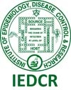

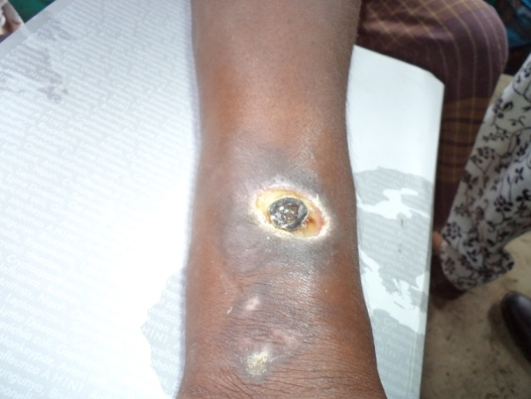
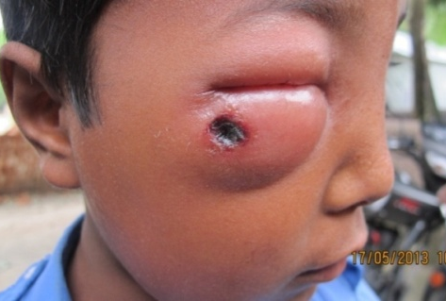
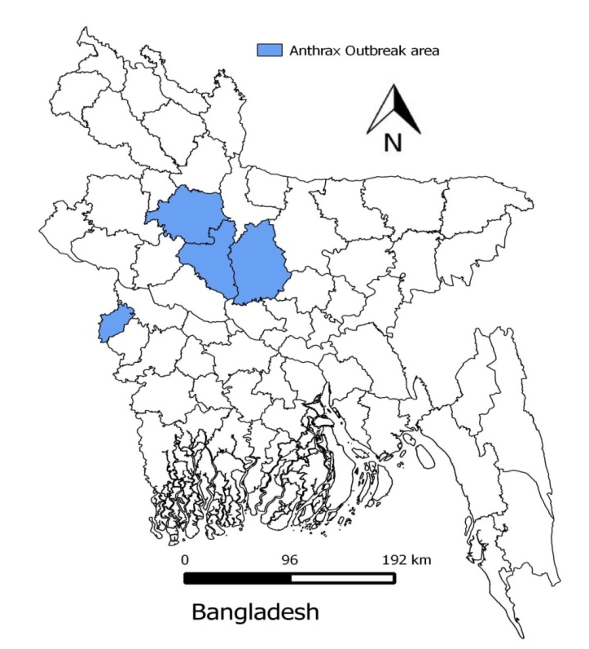
Outbreaks of Cutaneous Anthrax among Humans in Bangladesh:
Understanding the Risk Factors from a Case-Control Analysis
Farhana Haque^{1,2}, Md. Saiful Islam¹, Najmul Haider¹, Sean V. Shadomy³, Henry Walke³, Alex Hoffmaster³, Kate Hendricks³, Ashraful Alam², Mahmudur Rahman², Nordin S. Zeidner ^{1,3}, Stephen P. Luby^{1,4}, Emily S. Gurley¹, James D. Heffelfinger^{1,3}
¹International Centre for Diarrhoeal Diseases Research, Bangladesh (icddr,b), Dhaka, Bangladesh, ²Institute of Epidemiology, Disease Control and Research (IEDCR), Dhaka, Bangladesh , ³Centers for Diseases Control and Prevention (CDC), Atlanta, Georgia, USA, ⁴Centre for Infectious Disease and Geographic Medicine, Stanford University, California, USA
Introduction
Data collection and analysis:
  Multi-disciplinary teams (epidemiologists, medical officers, veterinarians,
  anthropologists and environmental staff) visited communities with reported outbreaks
  Trained data collectors searched communities using a contact tracing form to identify all persons exposed to infected animal(s) in the previous 2 weeks
  Using a structured questionnaire, team members interviewed, examined and collected swab and serum samples from identified cases who provided consent
  For the case-control studies, the team in addition to enrolling cases recruited one person who met the definition of a control from each of the four households nearest to but not in the household of an enrolled case
  Enrolled cases and controls were interviewed using the same structured questionnaire to collect clinical and exposure information
  Attack rates by exposure and odds ratios (OR) with 95% confidence intervals (CI) were estimated to determine the risk factors for cutaneous anthrax infection
    Using univariate and multivariate logistic regression
Limitations
  In Bangladesh, animal and human infections with Bacillus anthracis have been reported since 1986¹
  While outbreaks were consistently reported in animals since 1980s or before, only sporadic human infections were reported prior to 2009²
  Multiple outbreaks in both humans and animals have been reported each year since 2009^{3,4}
  Though exposure to infected ruminants has been identified as a major risk for cutaneous anthrax, factors influencing individual susceptibilities to infection have not been fully investigated⁵
Study findings are based on a small number of cases
  Enrolment of participants from future outbreaks may provide reliable inference
All controls enrolled may not be at-risk if already infected in the past
Inability to fully ascertain exposures for cases and controls
This retrospective observational study was subject to biases inherent in such designs
Figure 1. Cutaneous anthrax lesion on forearm
Number of cases
Conclusion
Raw meat exposure while slaughtering or butchering appears to be an important risk factor for cutaneous anthrax infection in anthrax outbreaks
Washing hands with soap and water after exposure to slaughtering or butchering animals appears to protect against infection
Findings that smoking and skipping meals may increase susceptibility to infection are novel
  May be due to reduced host immunity or another mechanism
Figure 2. Central black eschar of a periocular cutaneous anthrax lesion
Figure 4: Temporal distribution of cutaneous anthrax cases in relation to animal slaughtering over time in Bangladesh, 2012-2013
Objectives
Recommendations
  To identify the population at higher risk of acquiring anthrax infection
  To determine the factors associated with infection that could guide measures to prevent anthrax in humans
On bivariate analysis, compared to controls, cases were more likely to:
  Have had raw meat exposure while slaughtering or butchering (OR=36.0; 95% CI: 12.0-102.0)
  Have observed animals being slaughtered (OR=5.0; 95% CI:2.0-12.0)
  Have a cut injury on exposed body parts (OR=26.0; 95% CI:3.0-216.0)
  Have skipped ≥2 meals per week (OR=5.0; 95% CI:3.0-11.0)
  Be aged ≥18 years (OR=3.0; 95% CI:2.0-6.0)
  Have smoked tobacco (OR=7.0; 95% CI:3.0-17.0)
  Less likely to have washed hands with soap and water after raw meat exposure (OR=0.5; 95% CI:0.3-0.8)
Results
Ensure livestock vaccination to prevent anthrax in animals and subsequent transmission to humans
  − However, the resource-intensive nature of a national vaccination campaign along with additional barriers including shortages in vaccines and vaccinators and lack of community awareness on the necessity to vaccinate livestock make it difficult to accomplish in resource-poor countries like Bangladesh
Until a widespread and effective animal vaccination campaign is in place, design and implementation of a hand washing intervention may help identify a low-cost complementary solution to ameliorate risk of cutaneous anthrax in resource-limited settings, and should be evaluated
Methods
207 (15%) cutaneous anthrax cases
identified among 1,359 people exposed to a total of 34 affected ruminants in 7 outbreaks
Highest attack rates were for handling raw meat of slaughtered animals (40%) and butchering sick animals (22%)
72 cases and 244 controls were enrolled in the case-control studies
Study Period:
  2012 and 2013
Study design:
  Collaborative (IEDCR and icddr,b) investigations of 7 outbreaks in four districts (3 in 2012 and 4 outbreaks in 2013)
    A total of 6 outbreaks occurred in 2012 and 5 occurred in 2013
    Outbreaks investigated in this study were reported within four weeks from exposure to the suspected anthrax infected animal and onset of human illness
  Case-control studies in the four outbreaks investigated during 2013
Cutaneous anthrax case definition:
  Any person with an acute skin lesion developing from a papular through vesicular to central black eschar over 2-6 days who was exposed in the previous 2 weeks to raw meat, carcasses, body fluids or by-products of sick or dead ruminants with clinical and/or laboratory evidence of anthrax
Controls:
  All persons from an outbreak community who did not develop clinical illness within 2 weeks having similar exposure as the cases to raw meat, carcasses, body fluids or by-products of sick or dead ruminants with clinical and/or laboratory evidence of anthrax
Figure 3: Map showing the four districts in Bangladesh where 7 (black dot) reported anthrax outbreaks during 2012-2013 were investigated
Exposure variables | Adjusted odds ratio (AOR) | 95% CI | P value
Raw meat exposure while slaughtering or butchering | 38 | 5−314 | 0.001
Observed animals being slaughtered | 4 | 1−12 | 0.011
Smoking tobacco | 2 | 1.2−3.2 | 0.014
Skipping meals at least twice a week | 4 | 1.2−10.9 | 0.021
Washing hands with soap and water after butchering or observing animal slaughter | 0.5 | 0.3−0.8 | 0.005
References
  Samad, M.A. and M.E. Hoque, Anthrax in man and cattle in Bangladesh. Journal of Tropical Medicine and Hygiene, 1986. 89: p. 43-45.
  Islam, M.S., et al., Risk practices for animal and human anthrax in Bangladesh: an exploratory study. Infect Ecol Epidemiol, 2013. 3.
  WHO, Anthrax in humans and animals, in WHO Press, World Health Organization. 2008, WHO Library Cataloguing-in-Publication Data: Geneva. p. 117-170
  Interim report: Anthrax Outbreak in Bangladesh: 2012-2013, IEDCR, January 2014
  Chakraborty, A., et al., Anthrax outbreaks in Bangladesh, 2009-2010. The American journal of tropical medicine and hygiene, 2012. 86(4): p. 703-10
Acknowledgments
Financial support for this study was provided by US CDC (Cooperative agreement FY14 1931CM14Y0002). We extend our thanks to Ms. Diana DiazGranados, icddr,b, for her support in preparing the poster and all the participants who took part in the study
Correspondence: farhanahaque@icddrb.org; drfarhana2007@gmail.com
Exposure variables | Total exposed | Cases | Attack rates (%)
Any contact with sick/slaughtered animals | 1,359 | 207 | 15
Butchering sick animals at slaughtering sites | 245 | 54 | 22
Assisting in slaughtering /butchering | 108 | 14 | 13
Handled raw meat of slaughtered animals | 345 | 138 | 40
Observed slaughtering event of sick animals | 93 | 16 | 17
Table 1: Attack rates stratified by exposure variables for cutaneous anthrax outbreaks in Bangladesh during 2012−2013 (N=1,359)
Table 2: Factors independently associated with cutaneous anthrax infection on multivariate analysis

