Slide 1
Real-time analysis of the diphtheria outbreak amongst forcibly displaced Myanmar nationals in Bangladesh
Flavio Finger and Kate White

Slide 2

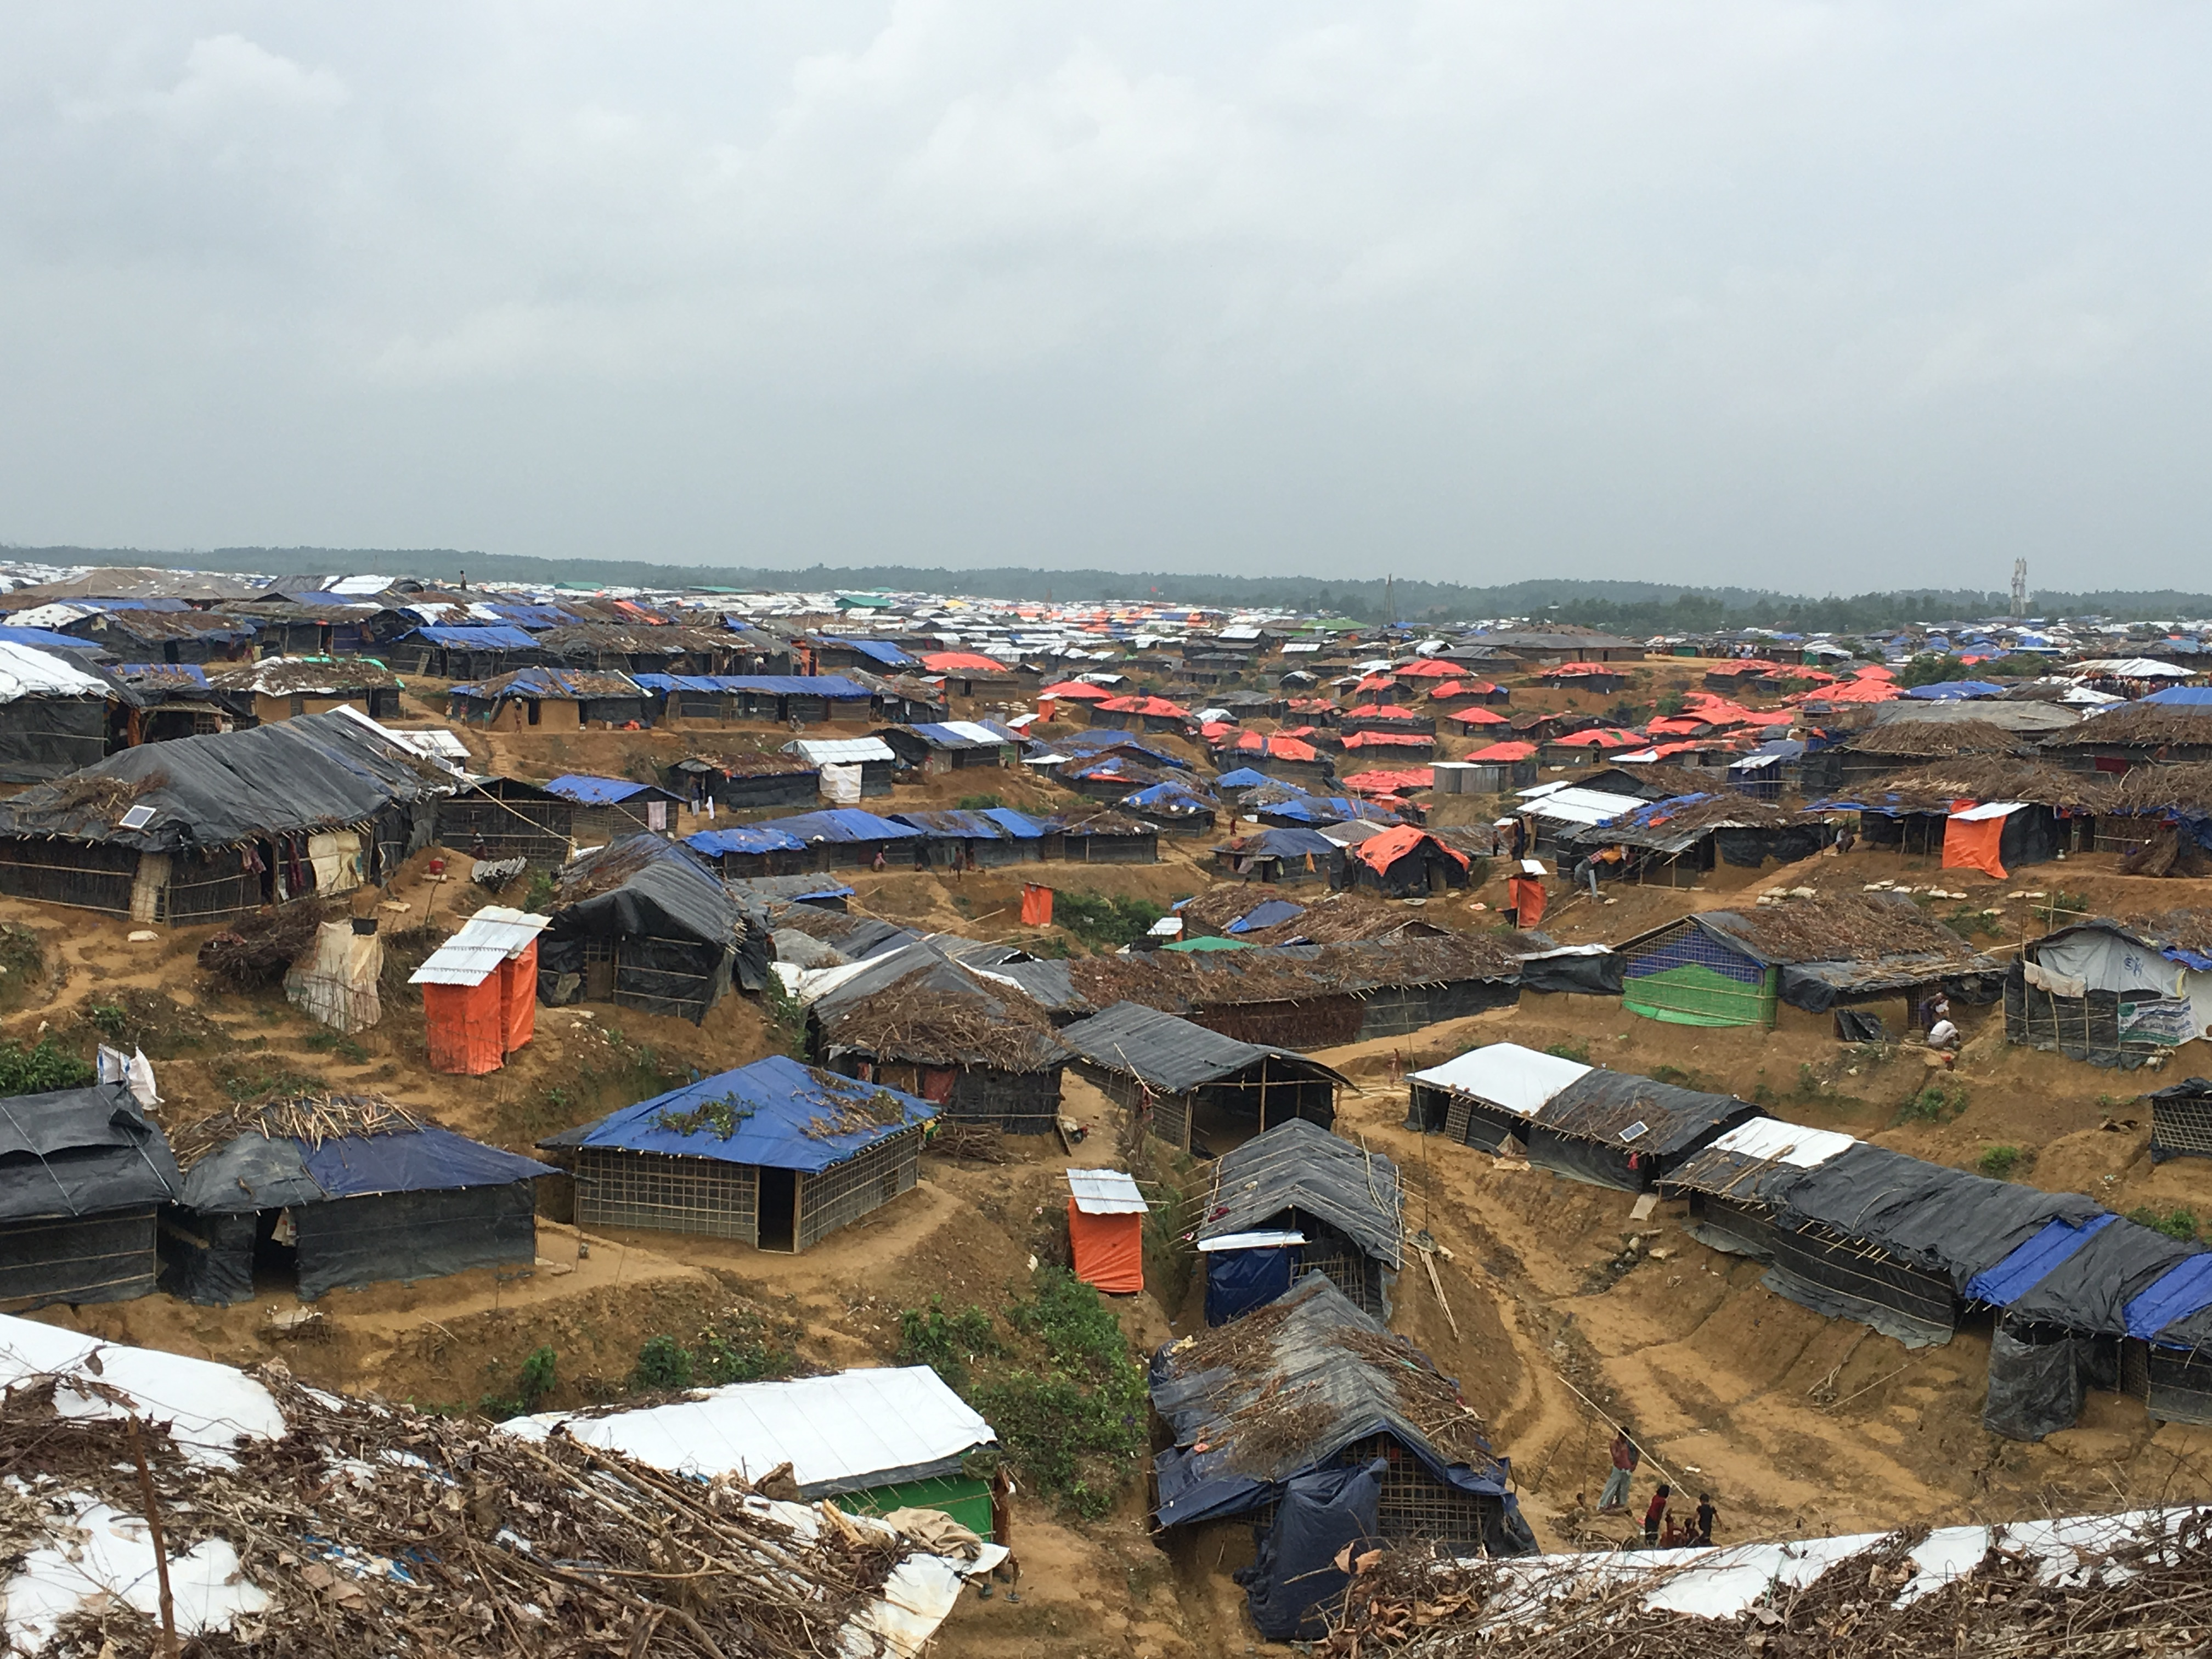
Rohingya crisis
August-December 2017, more than 600,000 Rohingya had fled a Myanmar military offensive into Bangladesh
Between 10 Nov 2017 and 9 Dec 2017 440 suspected diphtheria cases were reported in the refugee settlements, 168 of which were reported on 9 Dec 2017
MSF approached LSHTM to help forecast the expected scale of the diphtheria outbreak

Slide 3
Timeline
Nov 10 – 1st case
Dec 6 – LSHTM involved
Dec 12 – 1st forecast
Dec 20 – 2nd forecast
Dec 26 – 3rd forecast
Dec 30 – 4th forecast
Jan 8 – MSF treatment centre handed over
Dec 14 – Decision on bed capacity
Early Dec – rise in cases seen

Slide 4
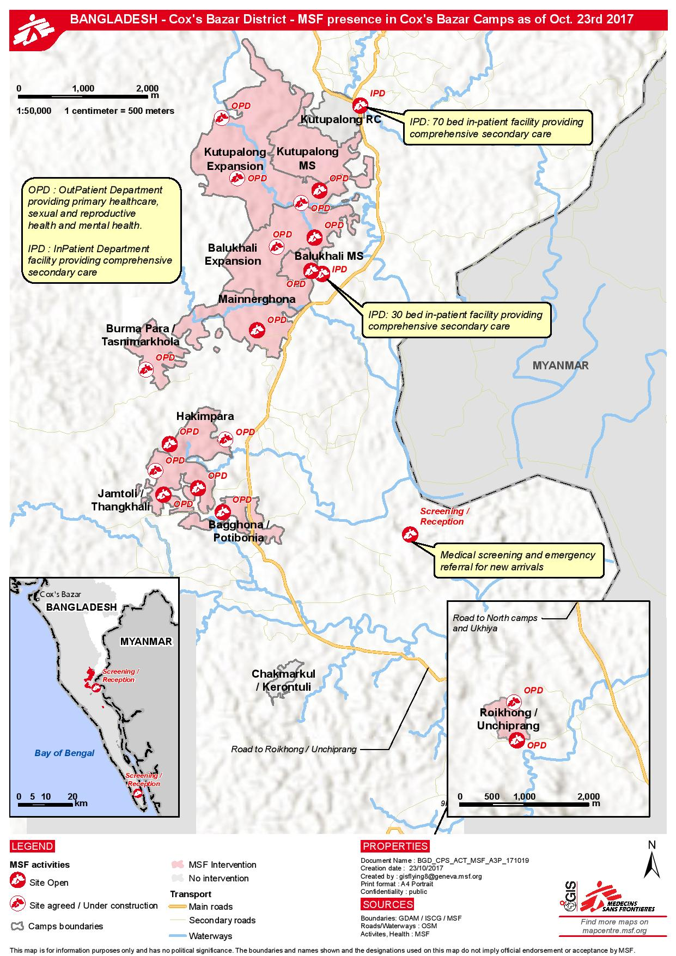
Model assumptions
Population at risk: 608’000
Incubation period: 2 days
Infectious period: 4 days
3 age groups: 0-4, 5-14, 15+
Initial susceptibility of 80% in the 5-14 year age group
Lower susceptibility in the 0-4 and 15+ year age groups
Two separate geographical areas (Kutupalong and Balukhali)
15% hospitalisation

Slide 5
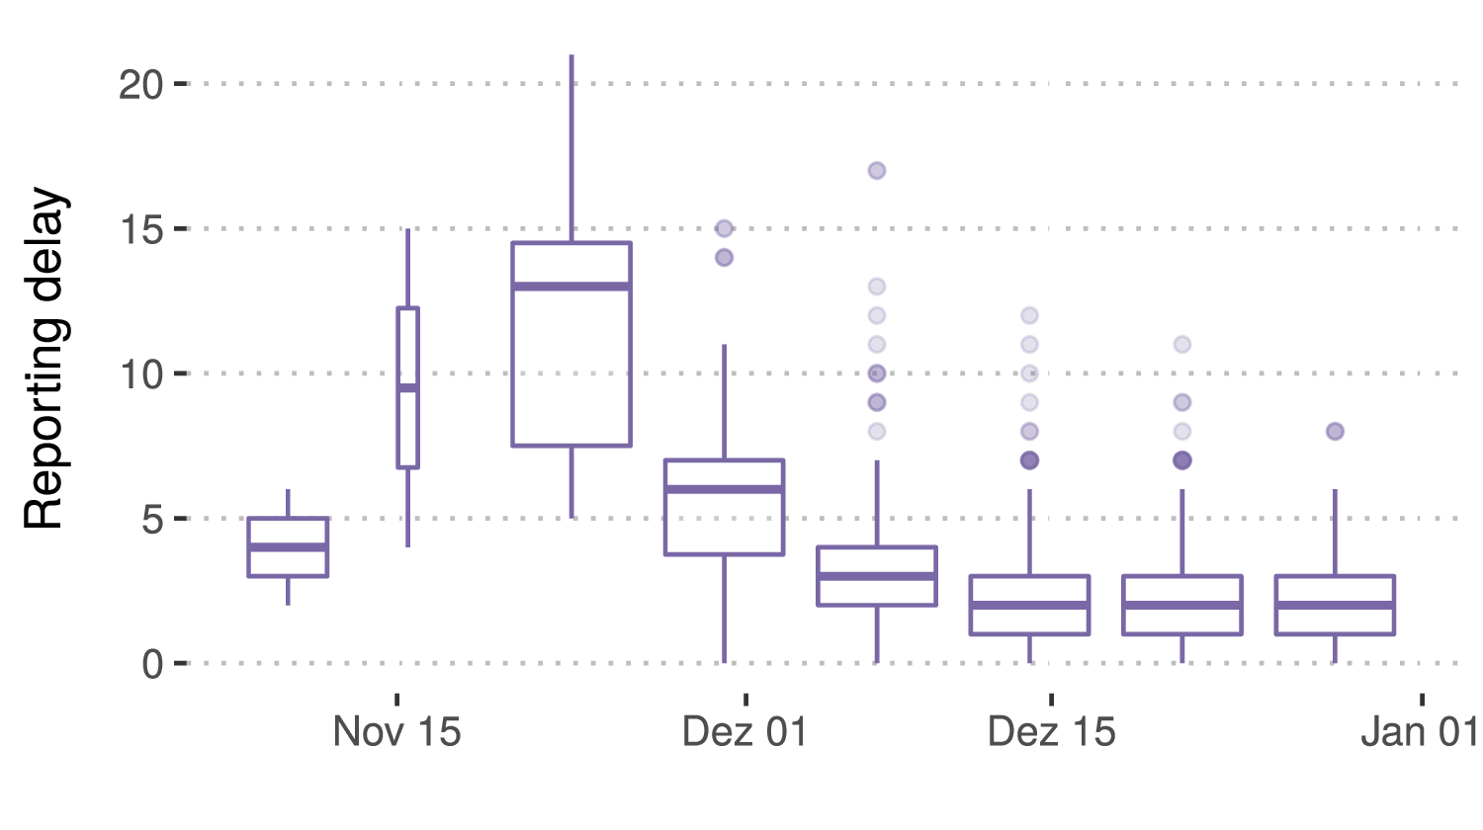
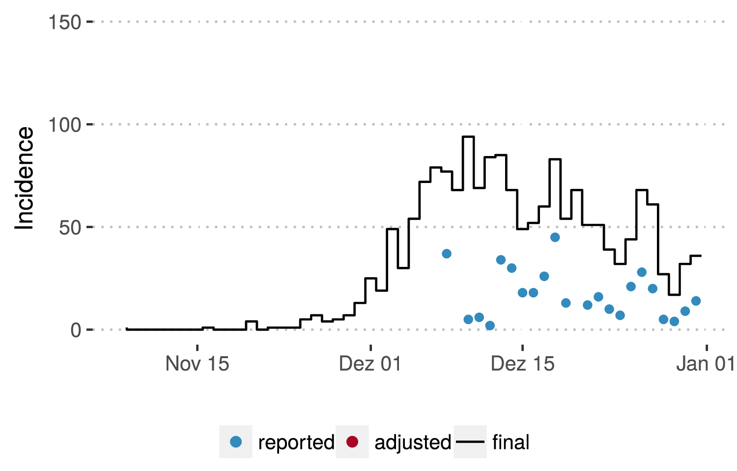
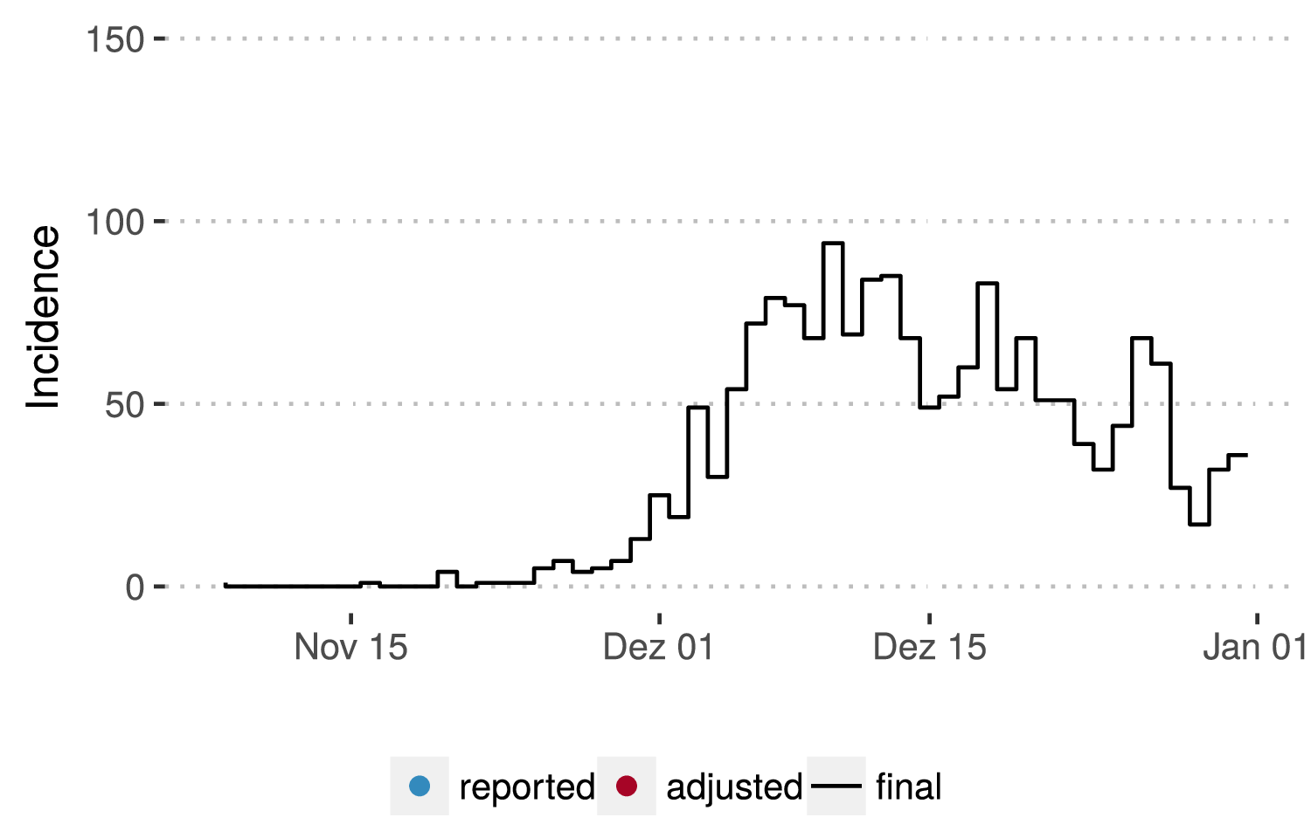
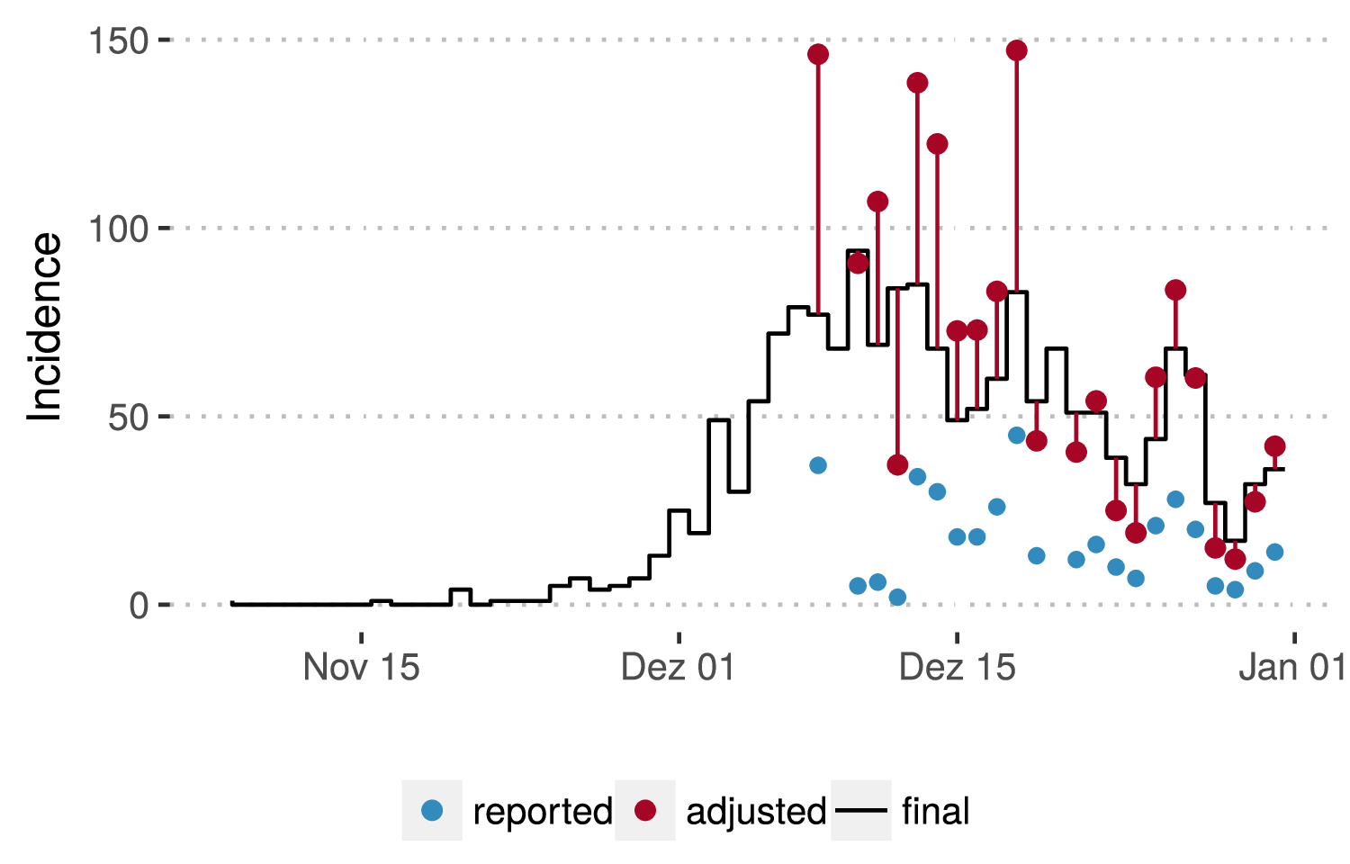
Adjusting for delayed reporting
Notes:
“final” is the number of cases that occurred as of the line list from Jan 12th 2018

Slide 6
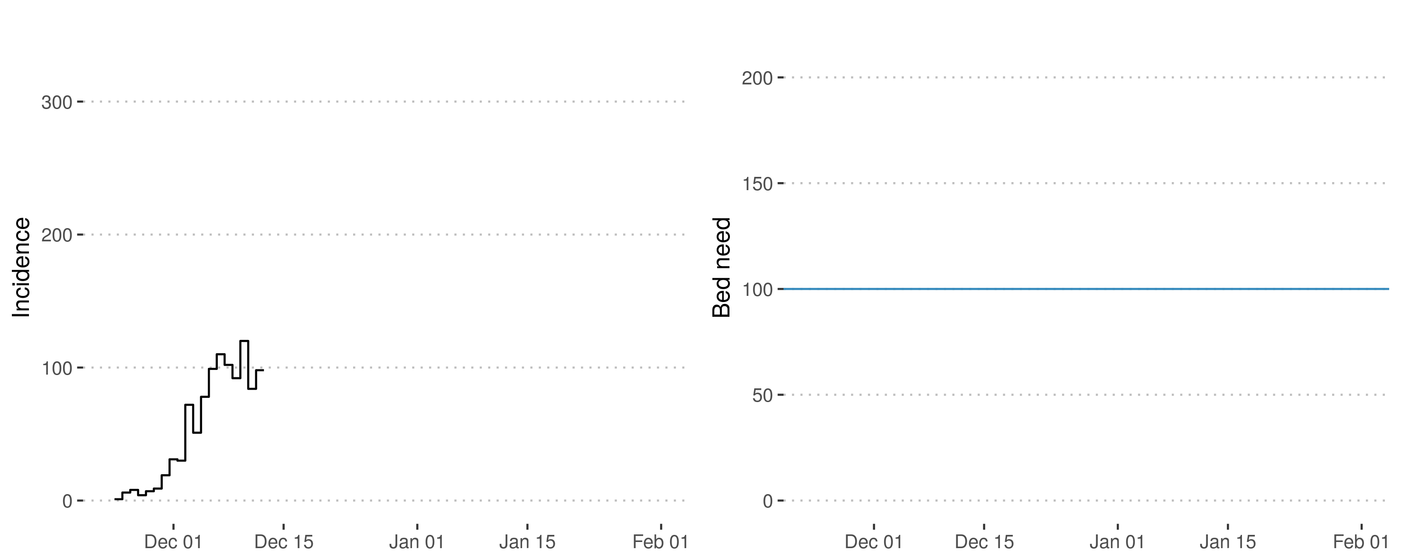
Forecasting
Decision for 100 hospital beds was made on Dec 14th
Final reported cases as of Jan 12th
Notes:
Beds = need for hospital beds

Slide 7
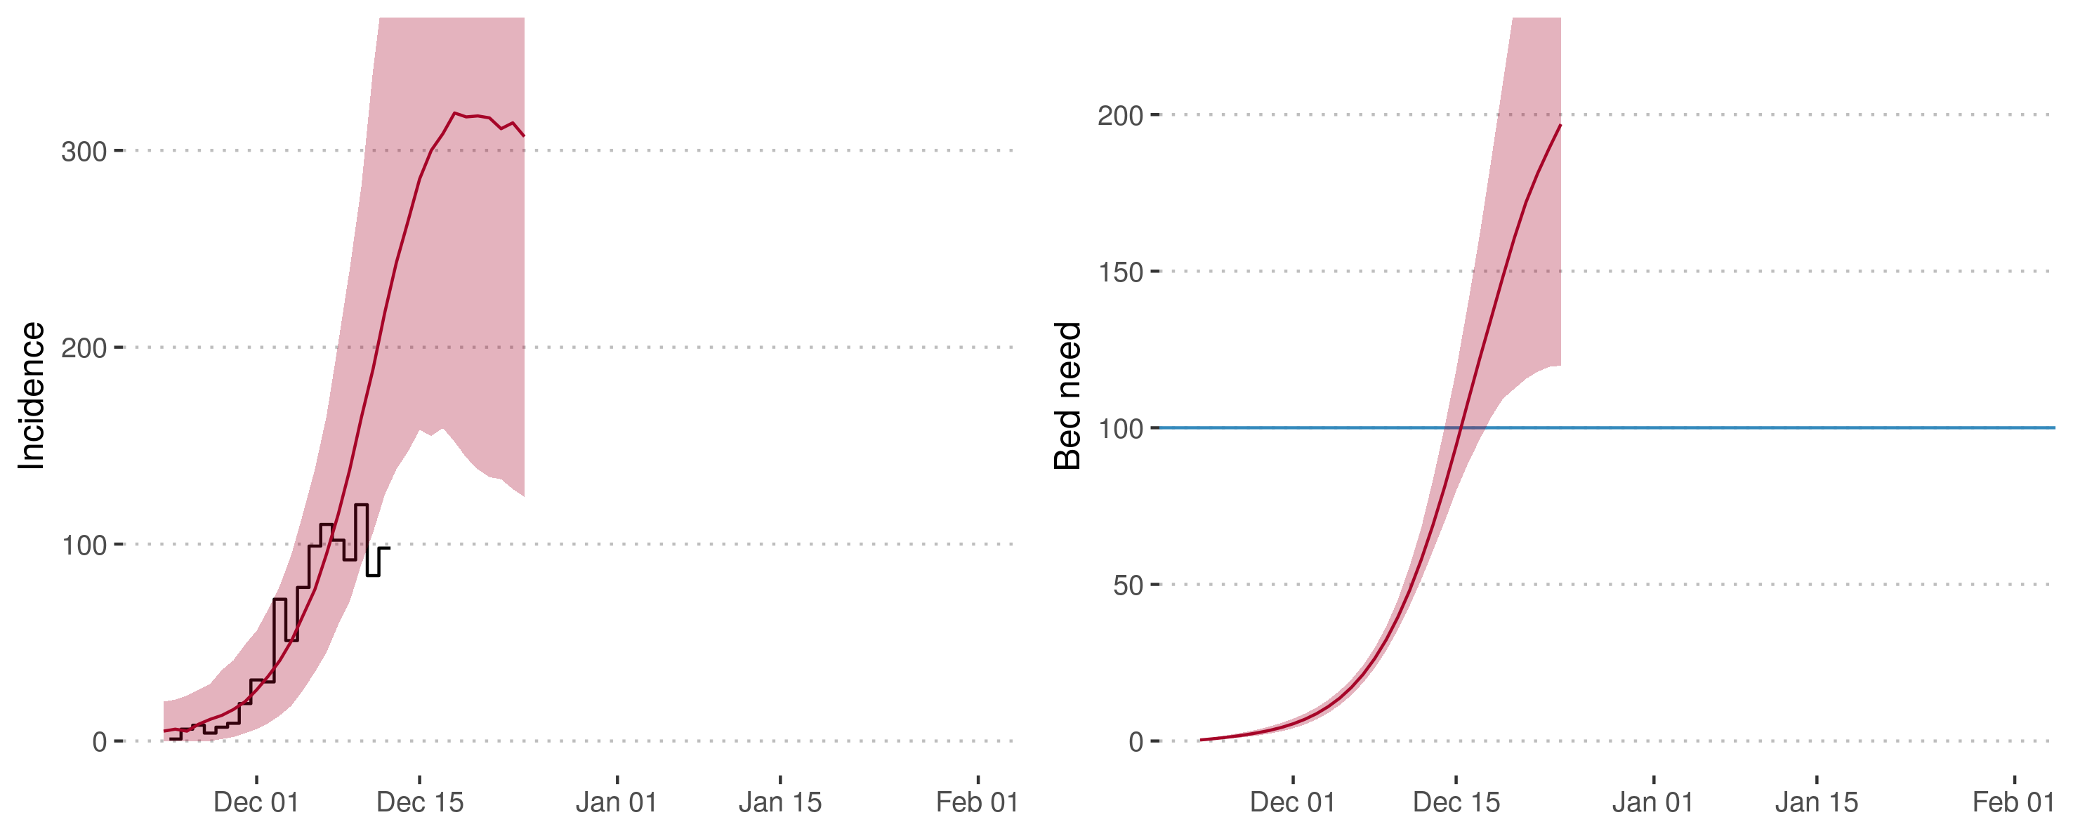
Forecasting
Forecast Dec 12th

Slide 8
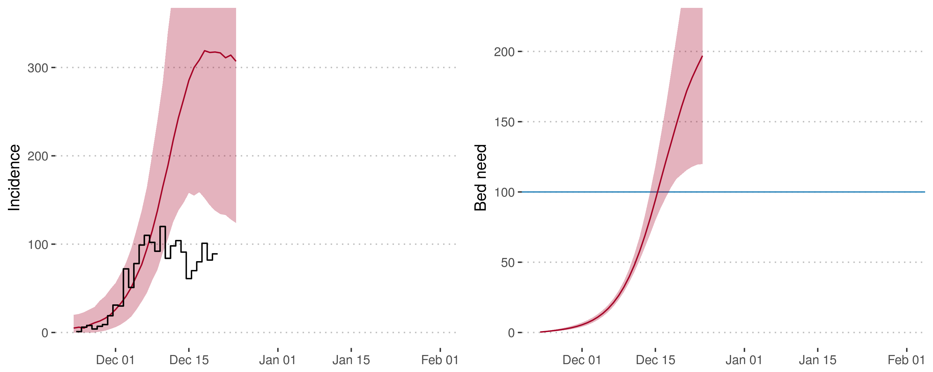
Forecasting

Slide 9
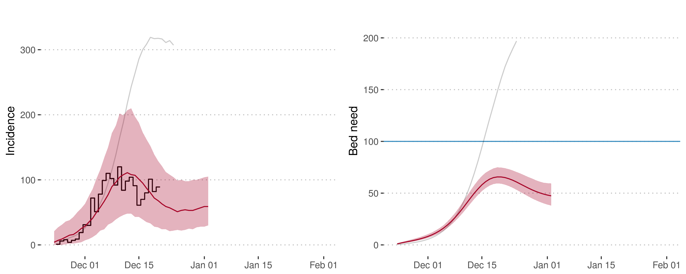
Forecasting
Forecast Dec 12th
Forecast Dec 20th

Slide 10
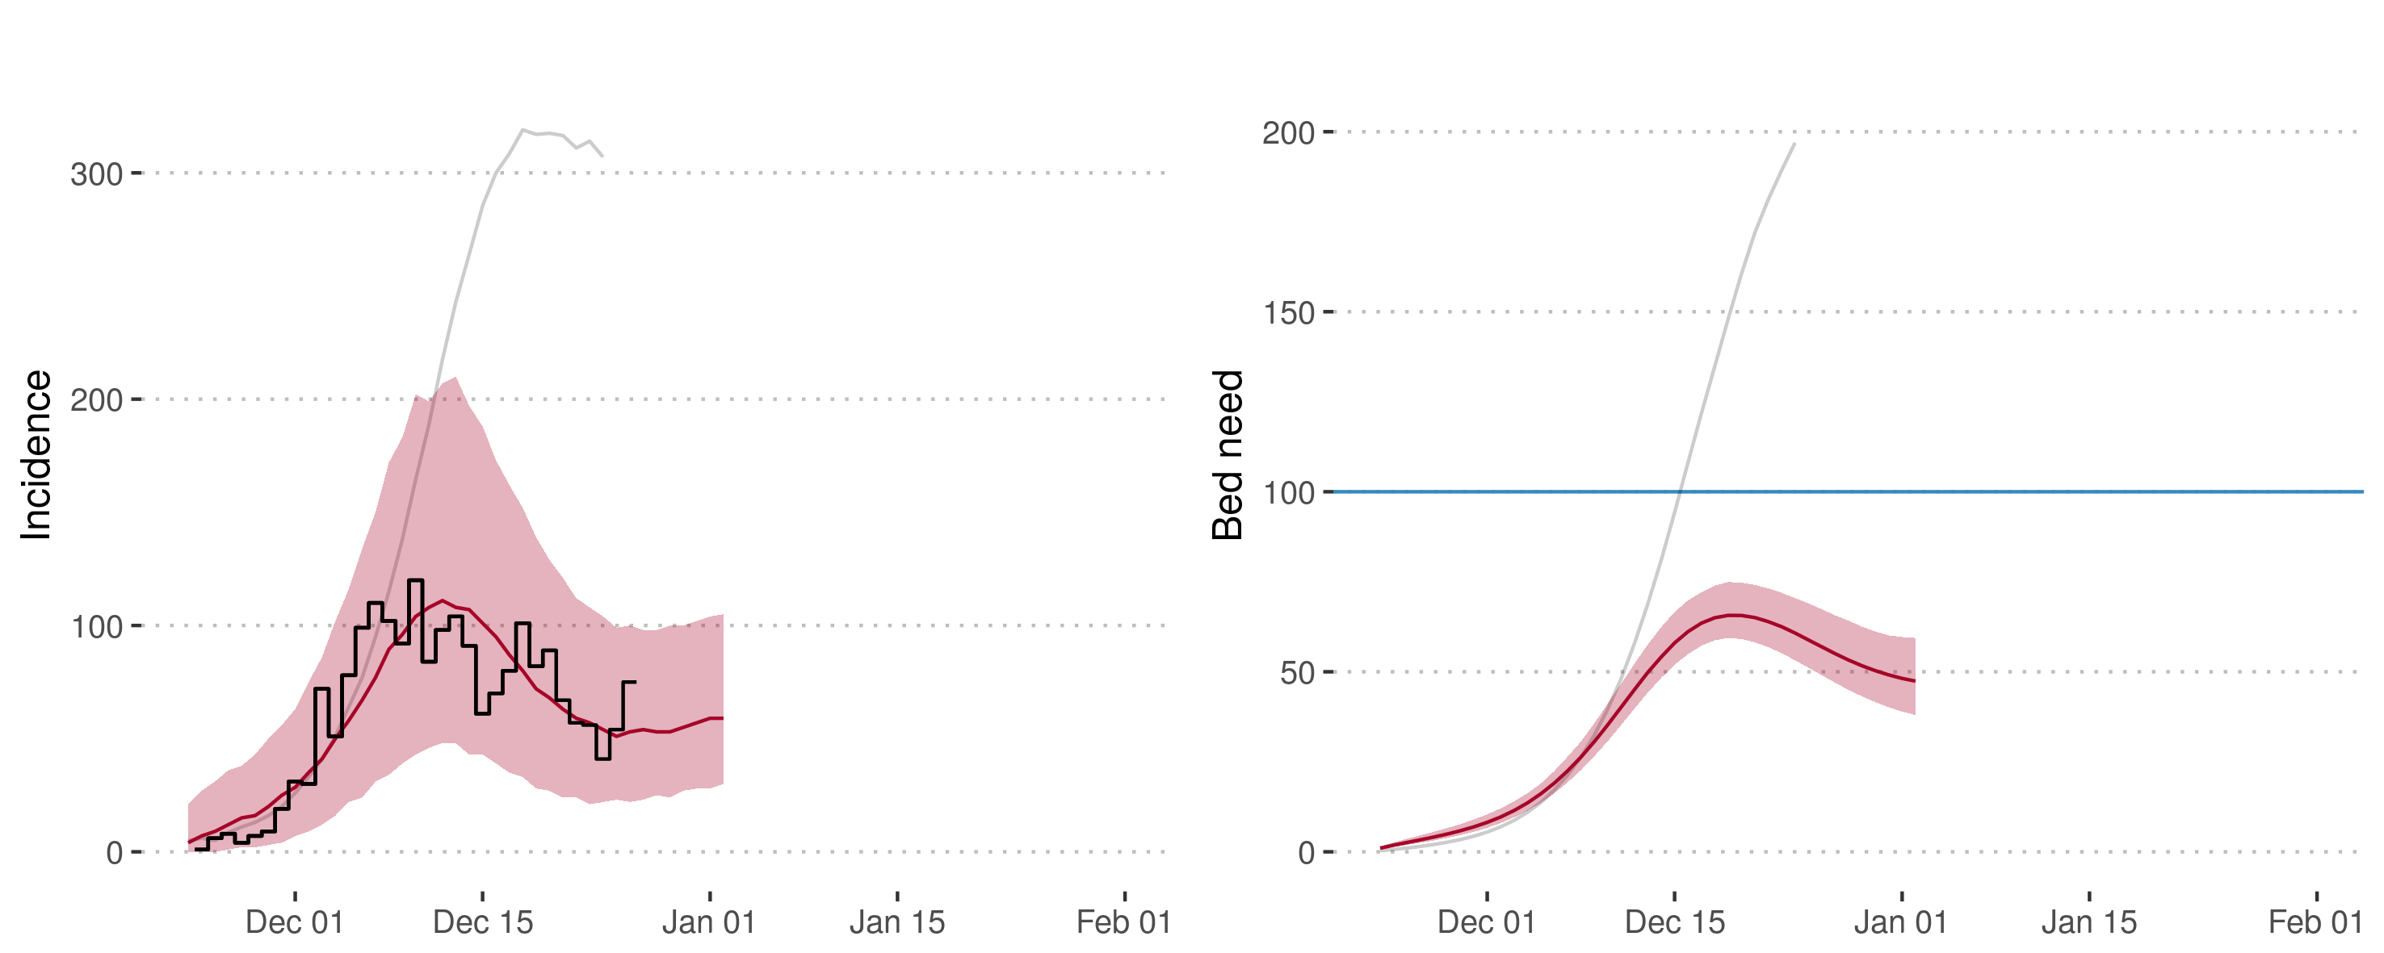
Forecasting

Slide 11
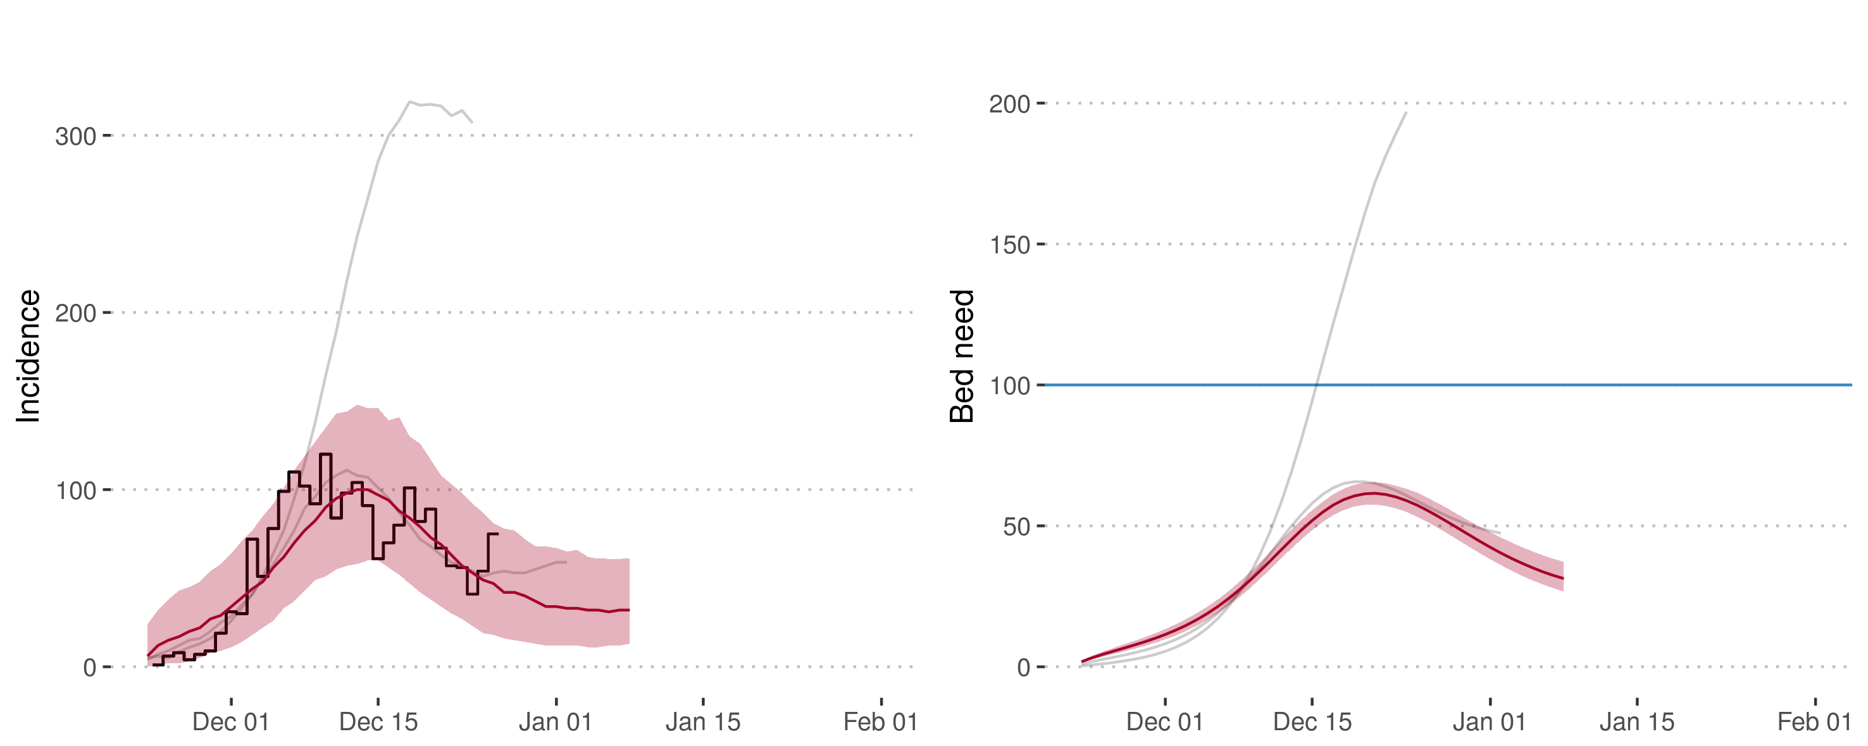
Forecasting
Previous forecasts
Forecast Dec 26th

Slide 12
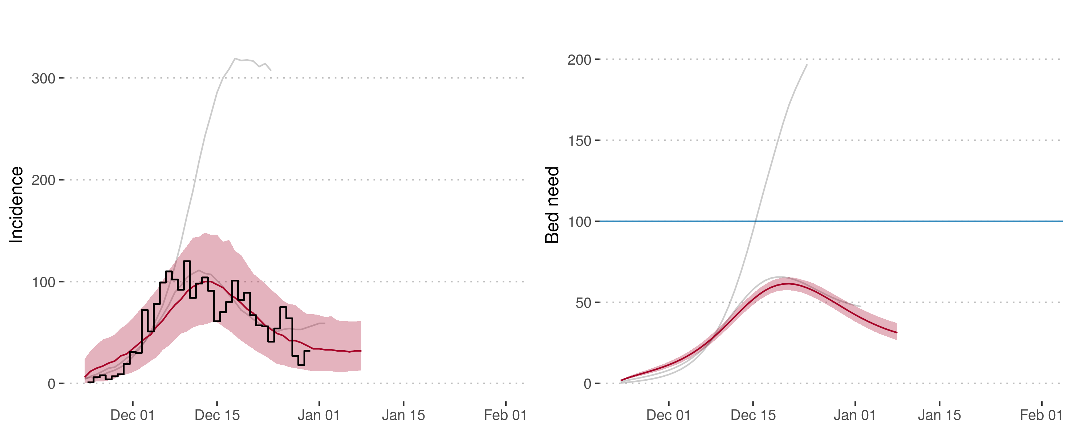
Forecasting

Slide 13
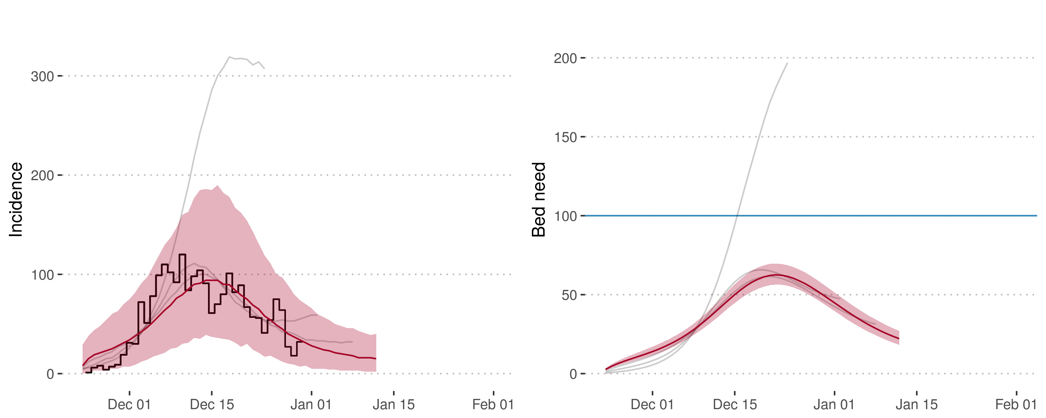
Forecasting
Previous forecasts
Forecast Dec 30th

Slide 14

Forecasting

Slide 15
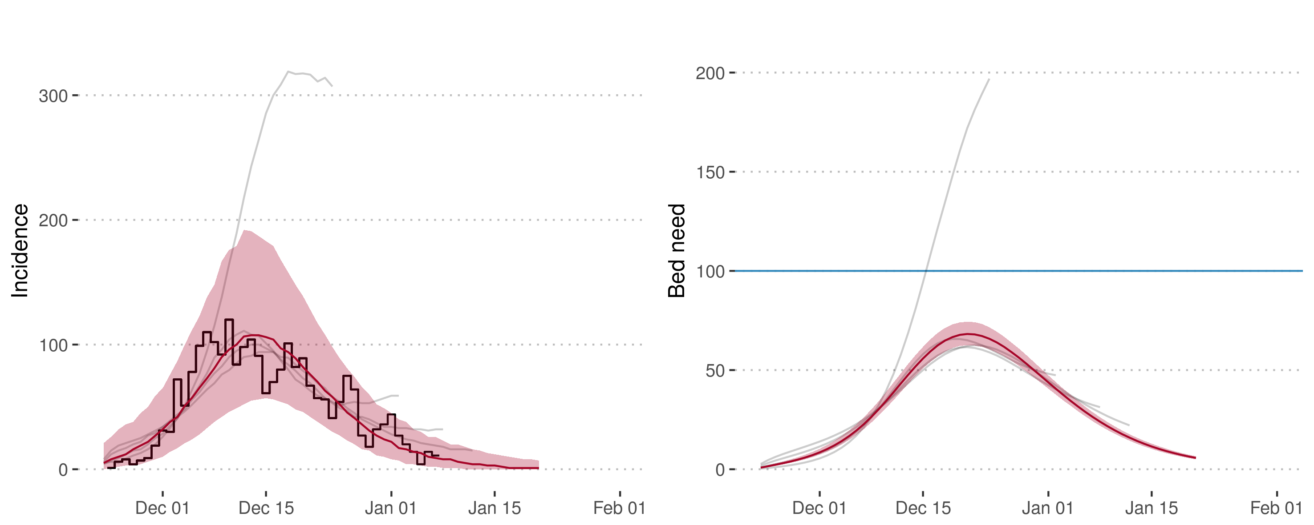
Forecasting
Previous forecasts
Final model run

Slide 16
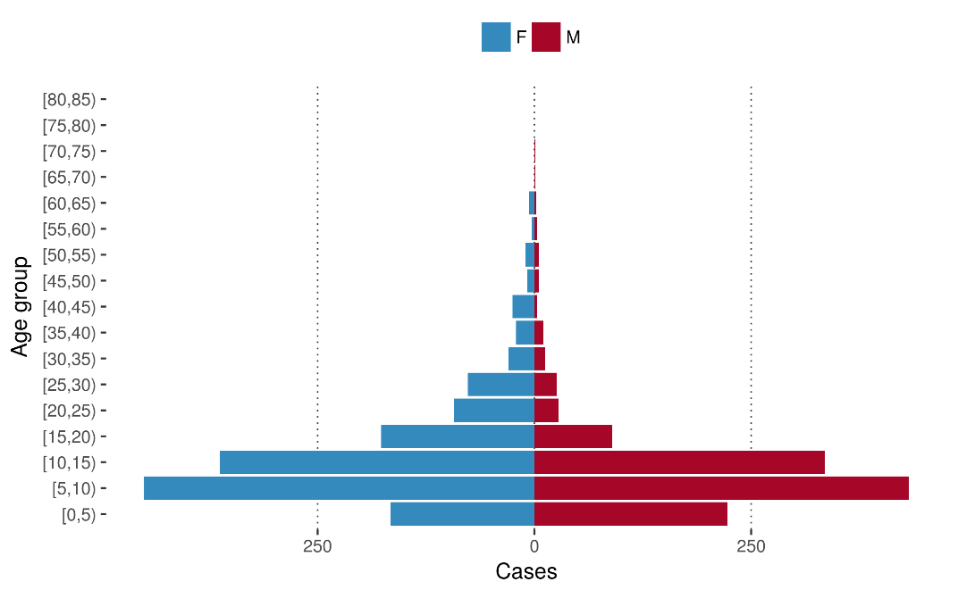
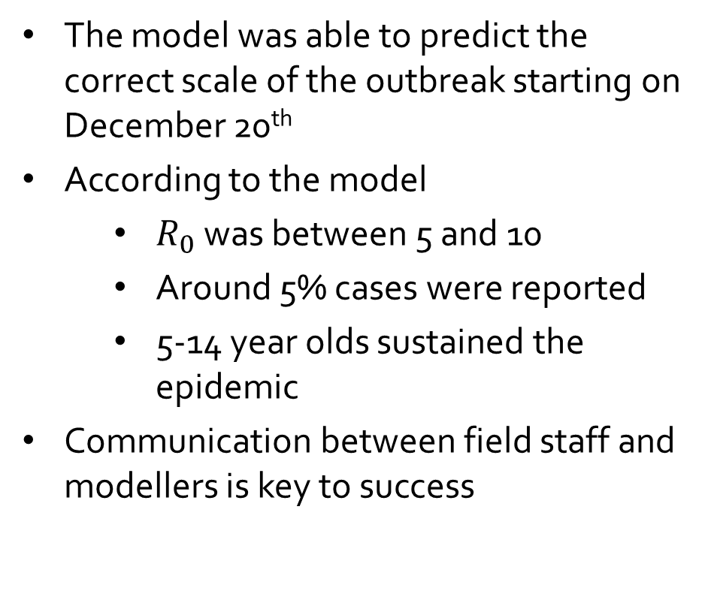
Model conclusions
The model was able to predict the correct scale of the outbreak starting on December 20th
According to the model
  $R_{0}$ was between 5 and 10
  Around 5% cases were reported
  5-14 year olds sustained the epidemic
Communication between field staff and modellers is key to success

Slide 17
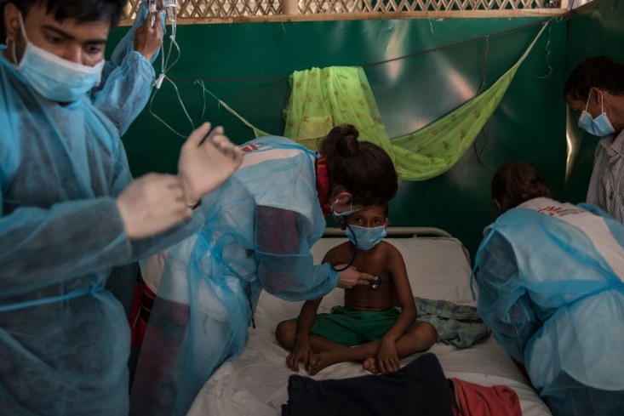
Impact on Operations
Bed Capacity
Division between critical and/or diphtheria anti-toxin (DAT) beds
Decision to treat mild cases in the community
Division of bed capacity and severity between different MSF clinics
Photo: Anna Surinyach

Slide 18
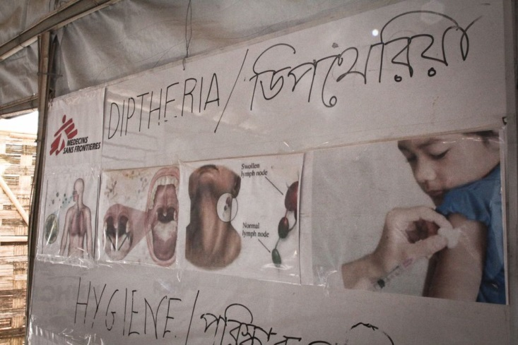
Impact on Operations
  Diphtheria Antitoxin (DAT)
Forecast amount needed
Decisions around prioritisation of use and treatment protocol
  Supply in General
Forecast for urgent International Medical Order
Photo: Sara Creta

Slide 19
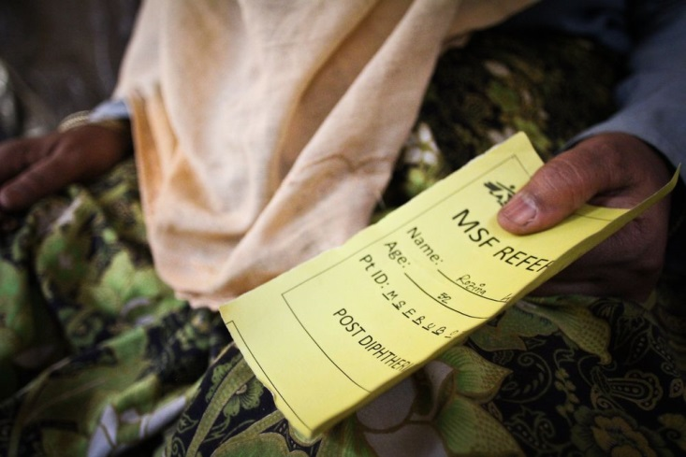
Impact on Operations
Staffing
Employed a strategy of surge staffing for International Staff
Expedited recruitment of National Staff doctors and nurses
Photo: Sara Creta

Slide 20
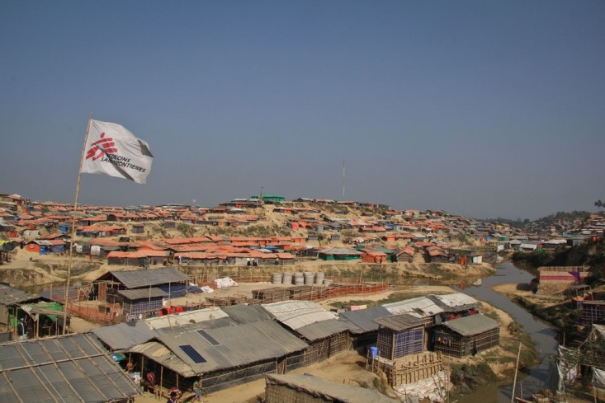
Impact on Advocacy
External Actors
Contributed to closer collaboration with WHO, GOARN and other actors
Vaccination Strategy
Initial advocacy centered on a much broader age group
Highlighted previous lack of vaccination in Myanmar
Photo: Sara Creta

Slide 21
Acknowledgements
LSHTM
Adam Kucharski
Sebastian Funk
John Edmunds
MSF
Crystal Van Leuwan
John Guzek
Ruby Siddiqui
Support
Swiss National Science Foundation
Wellcome Trust
Medical Research Council
RECAP project by the Global Challenges Research Fund
We confirm that we have obtained permission to use images from the patients included in this presentation.

