Slide 1
Photography as a research tool
Rhys Williams
Photography as a research tool
by Rhys Williams
Notes:
What is a photostory? What do we show?

Slide 2
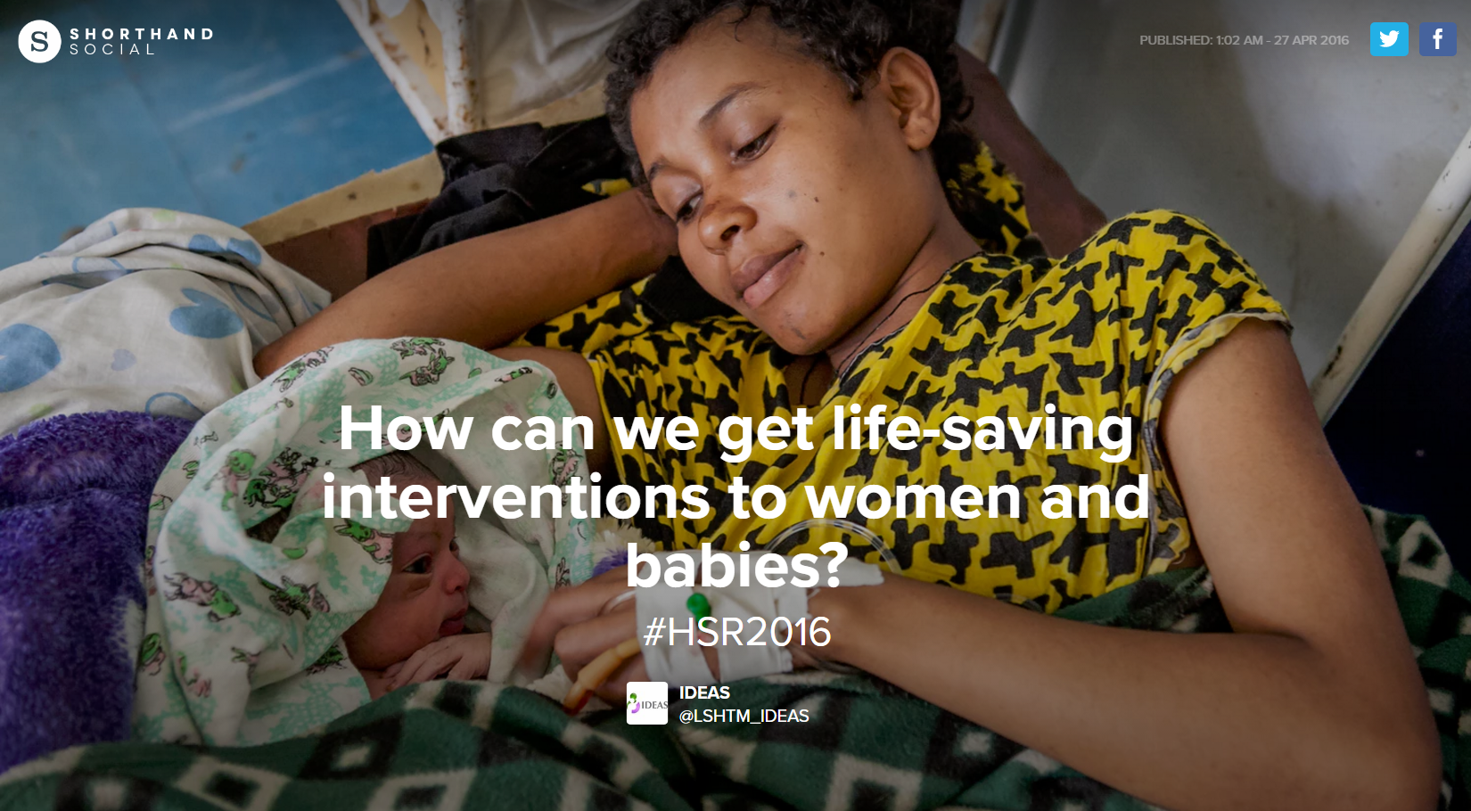

Slide 3
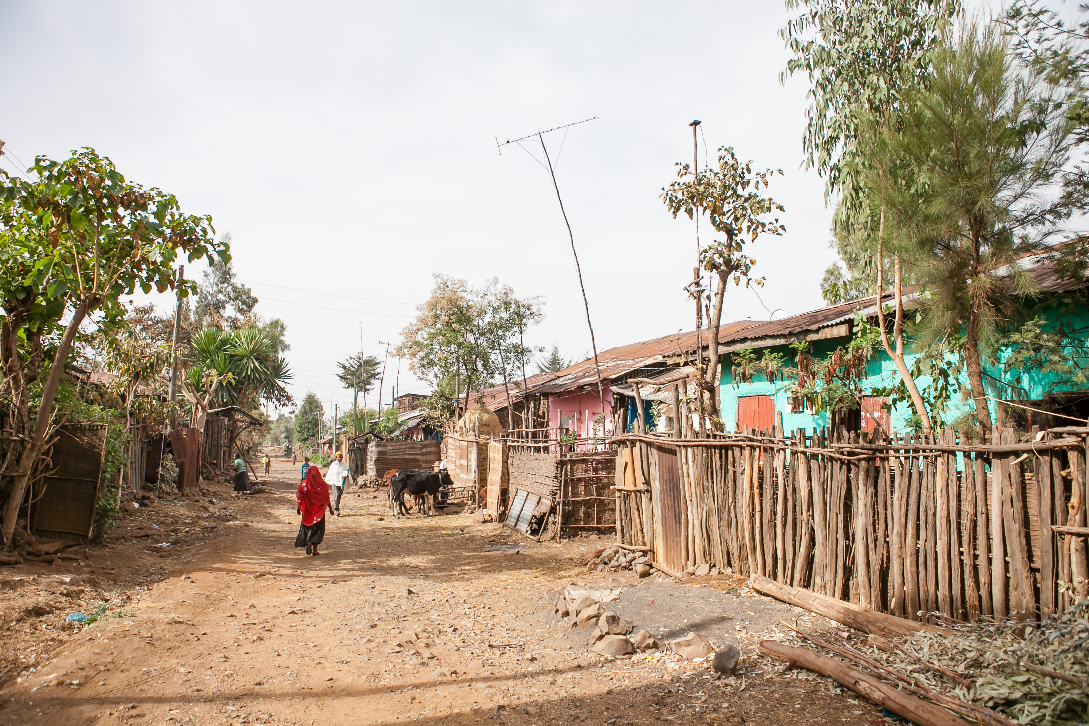

Slide 4
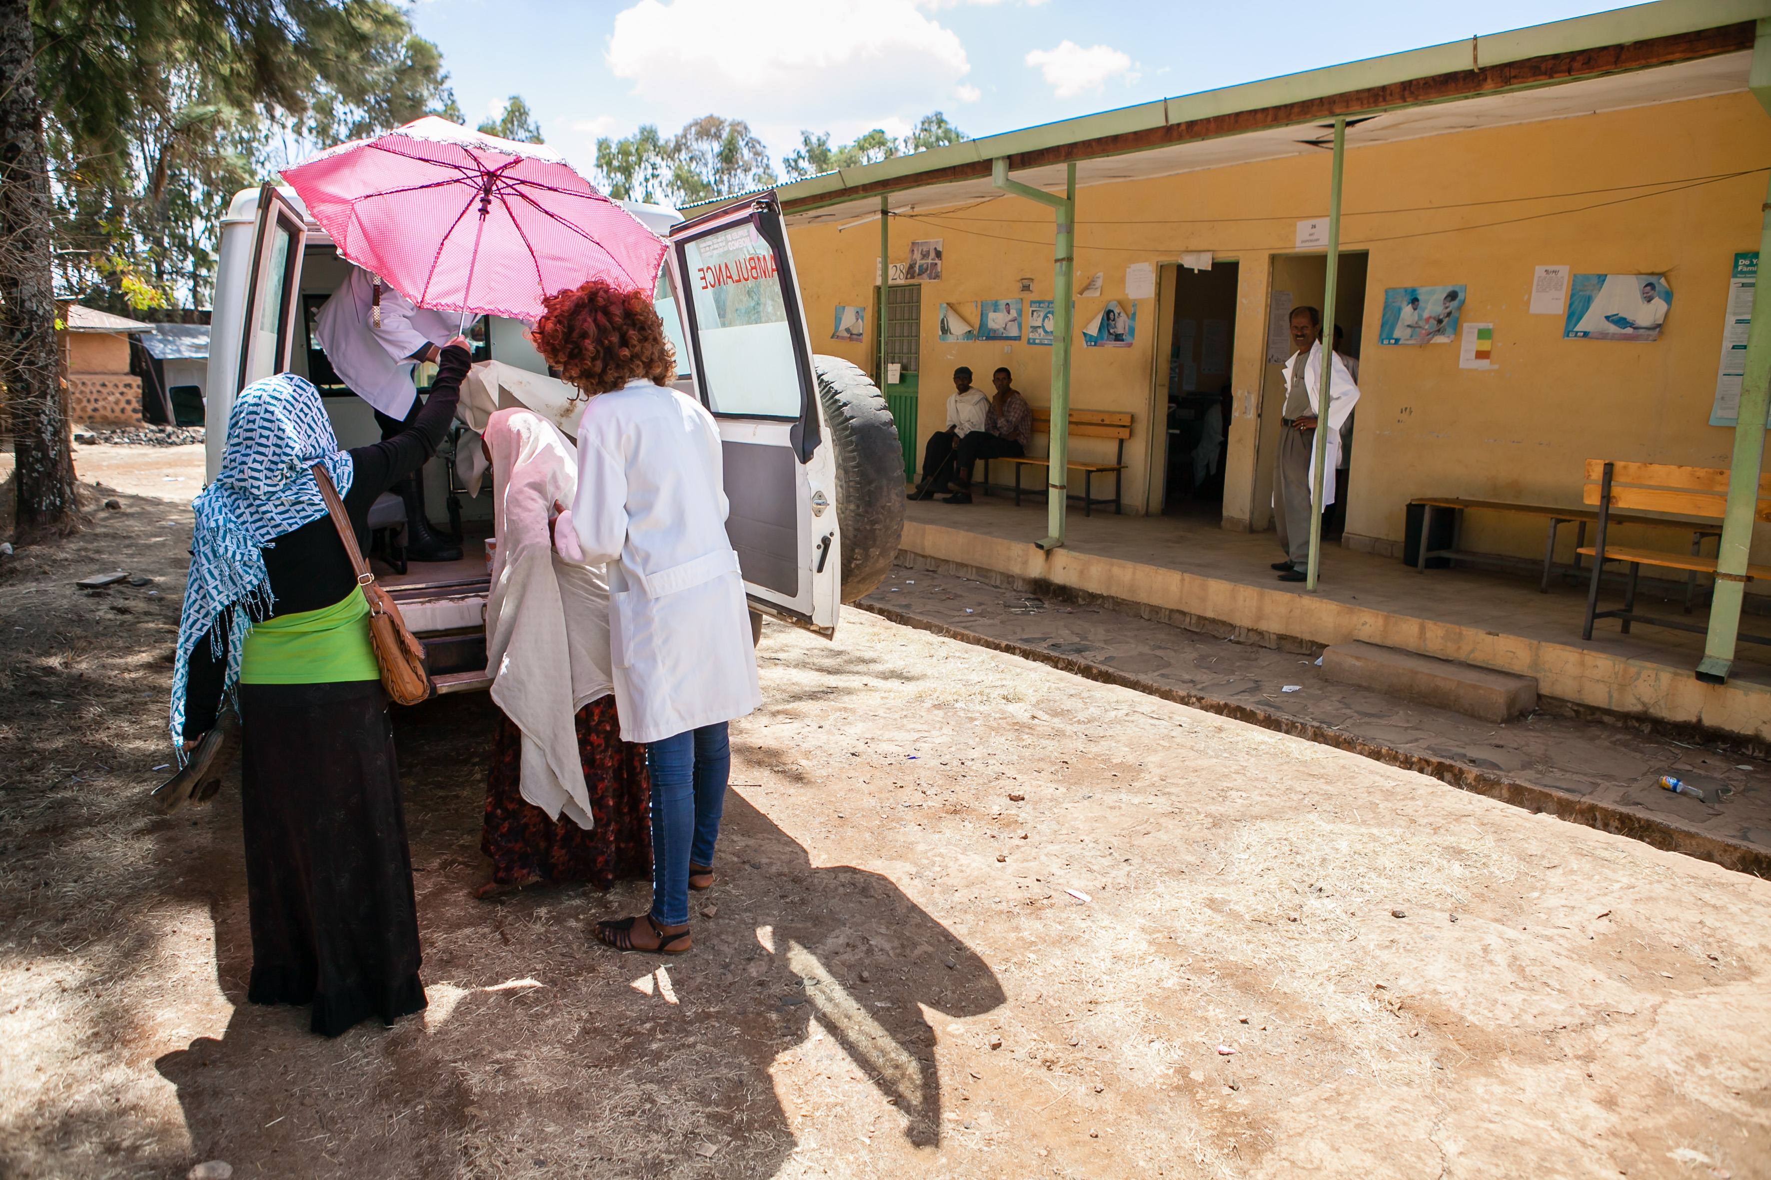

Slide 5
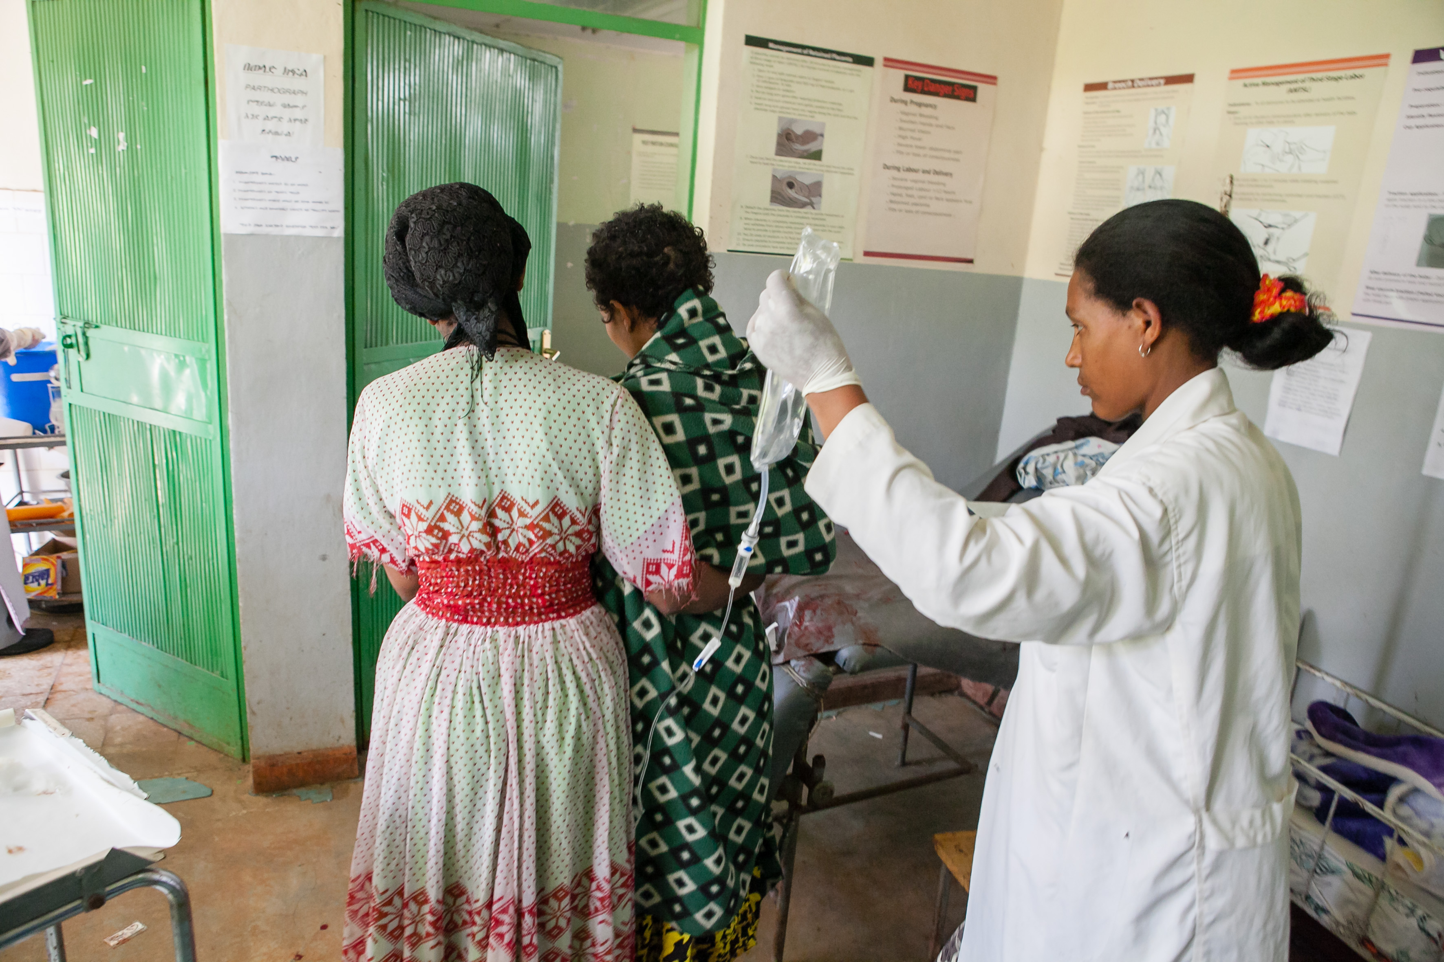

Slide 6
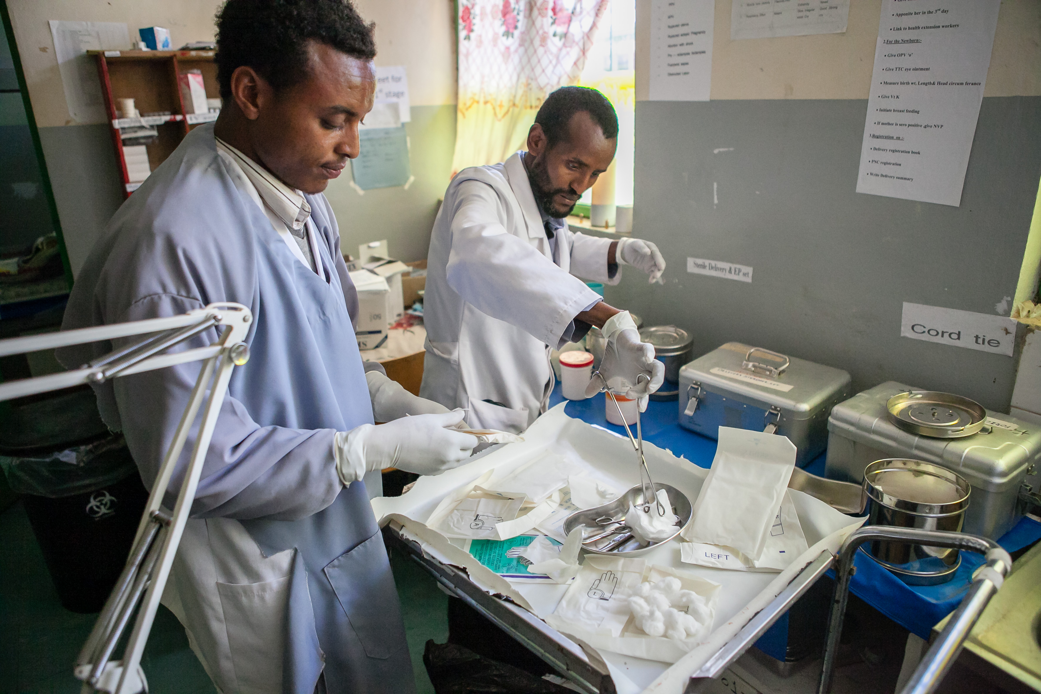

Slide 7
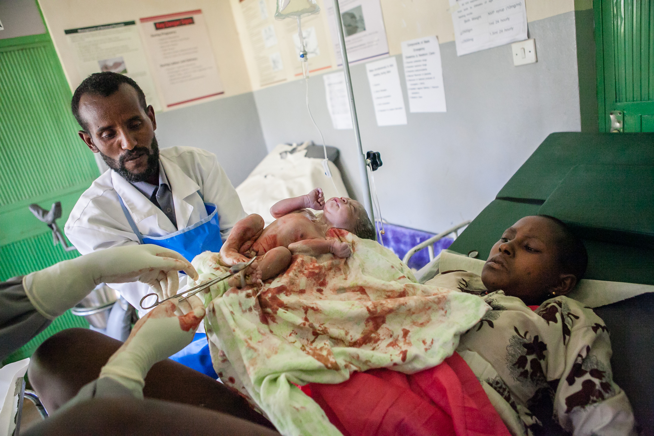

Slide 8
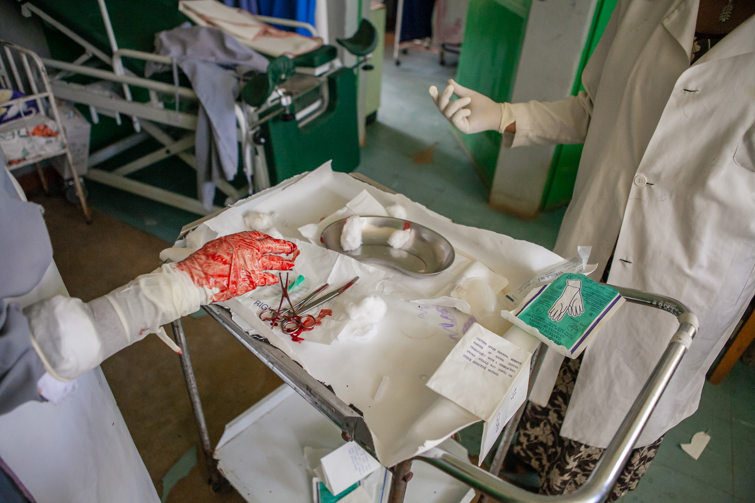

Slide 9
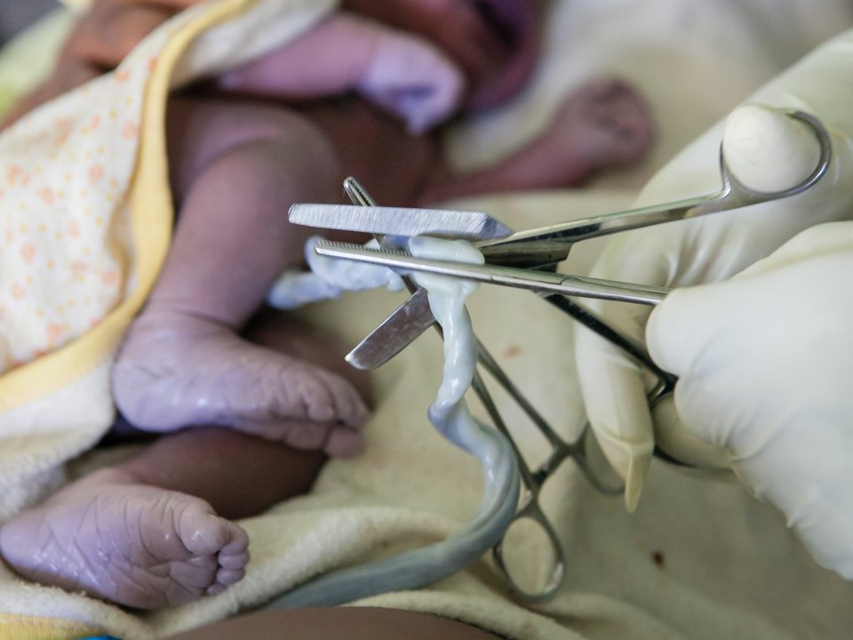

Slide 10
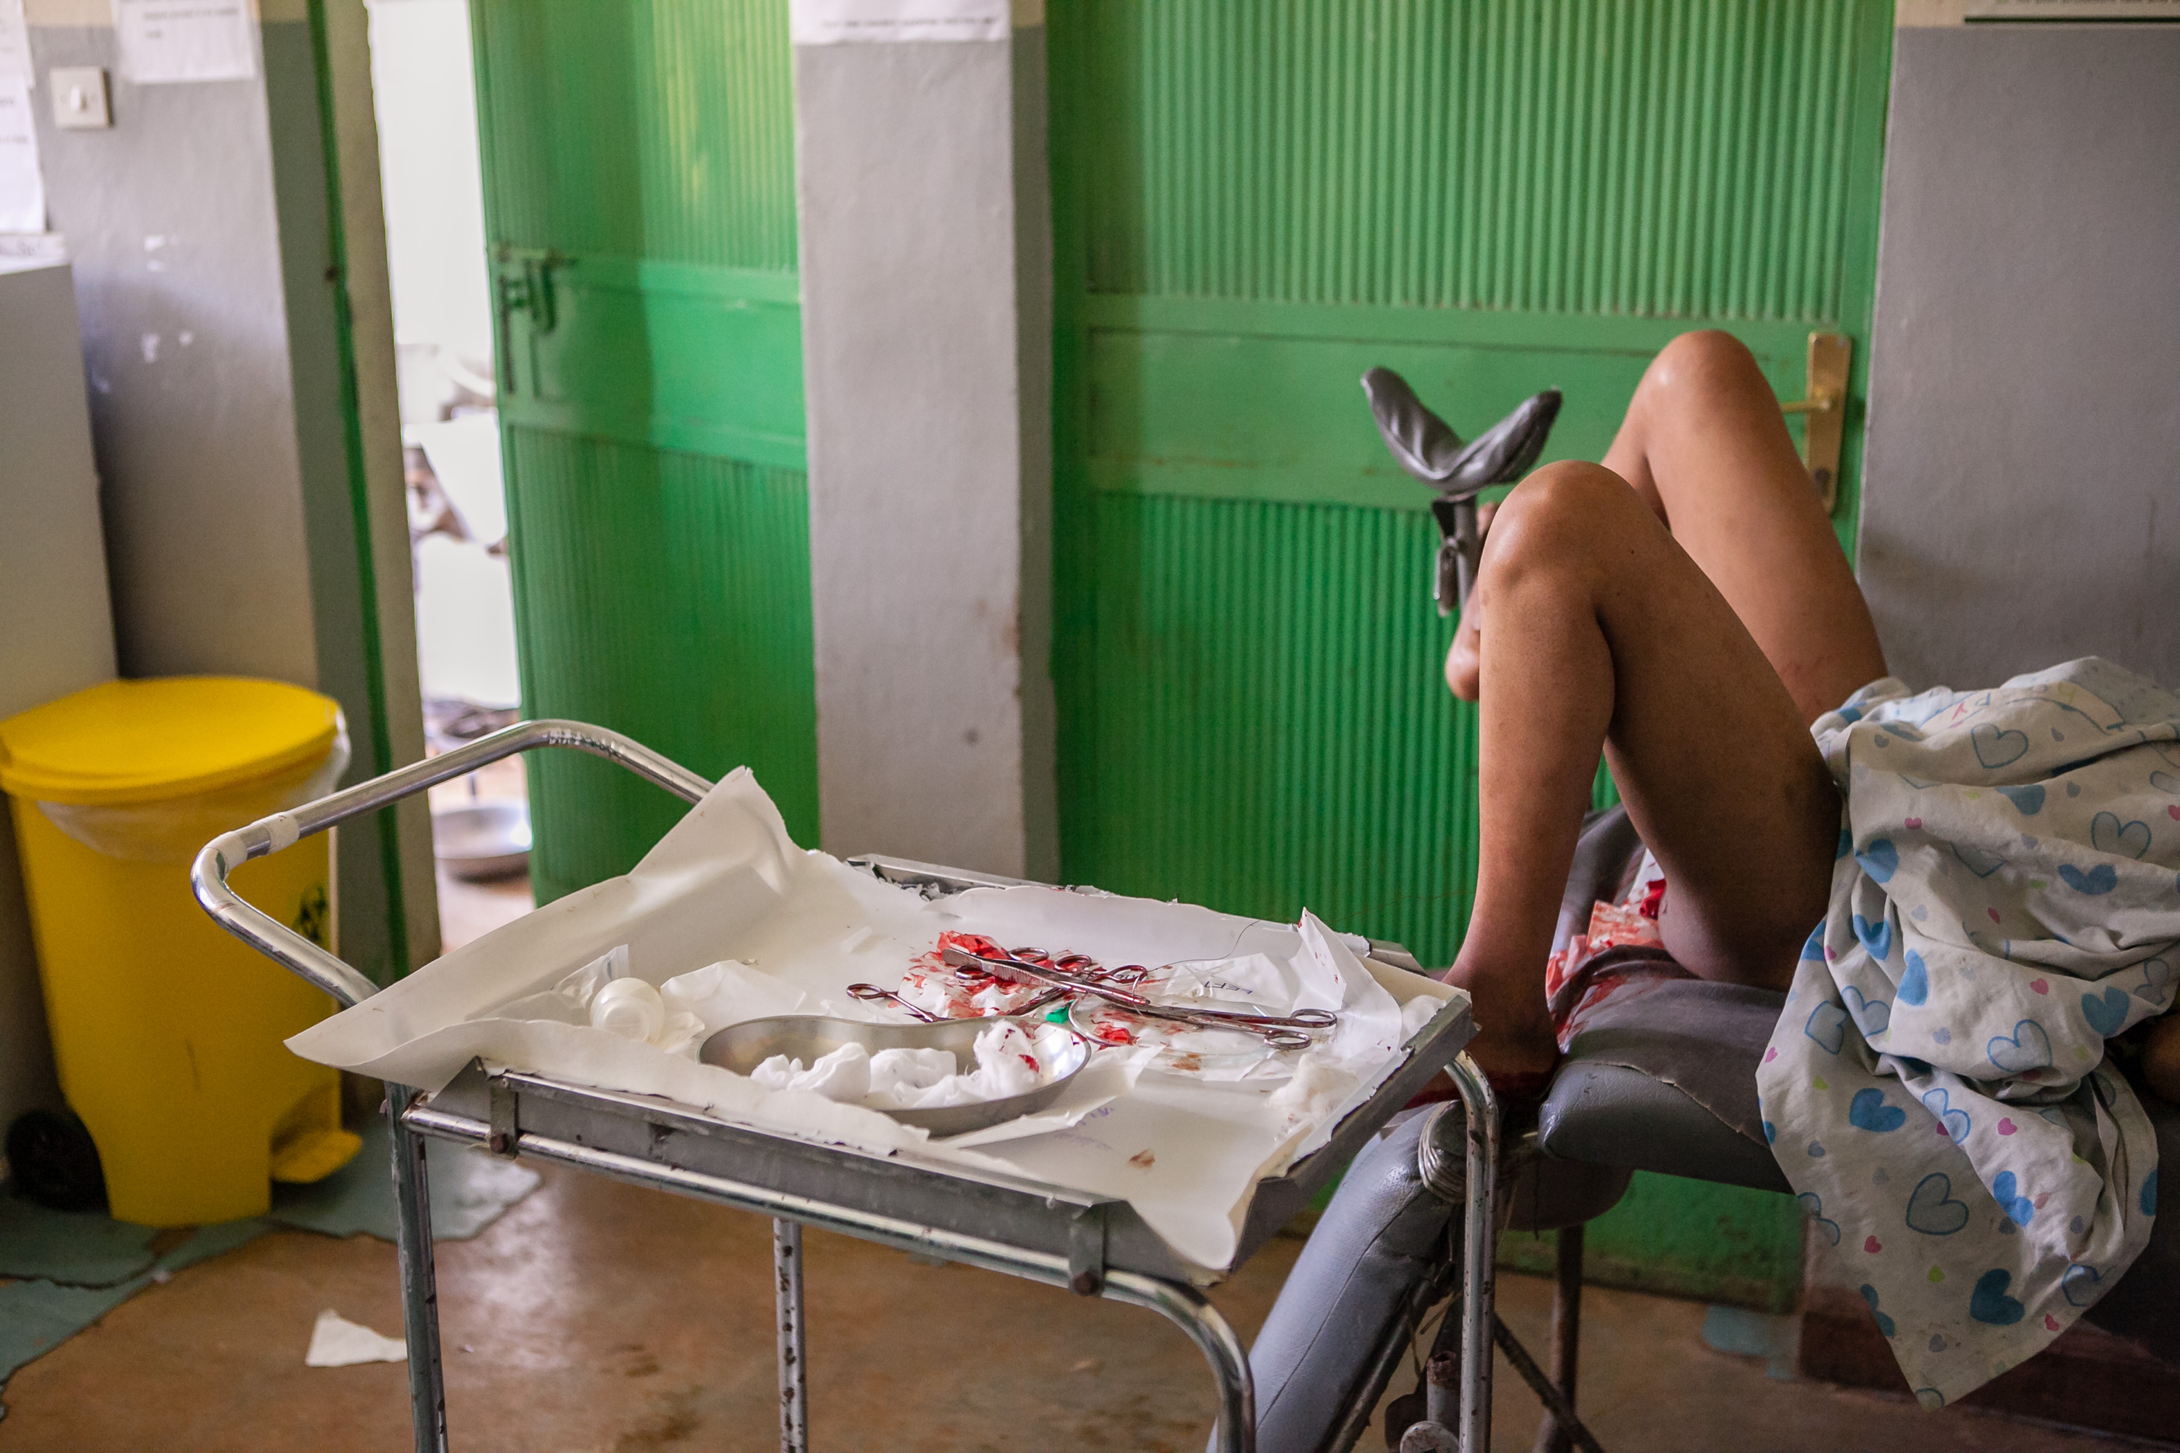

Slide 11
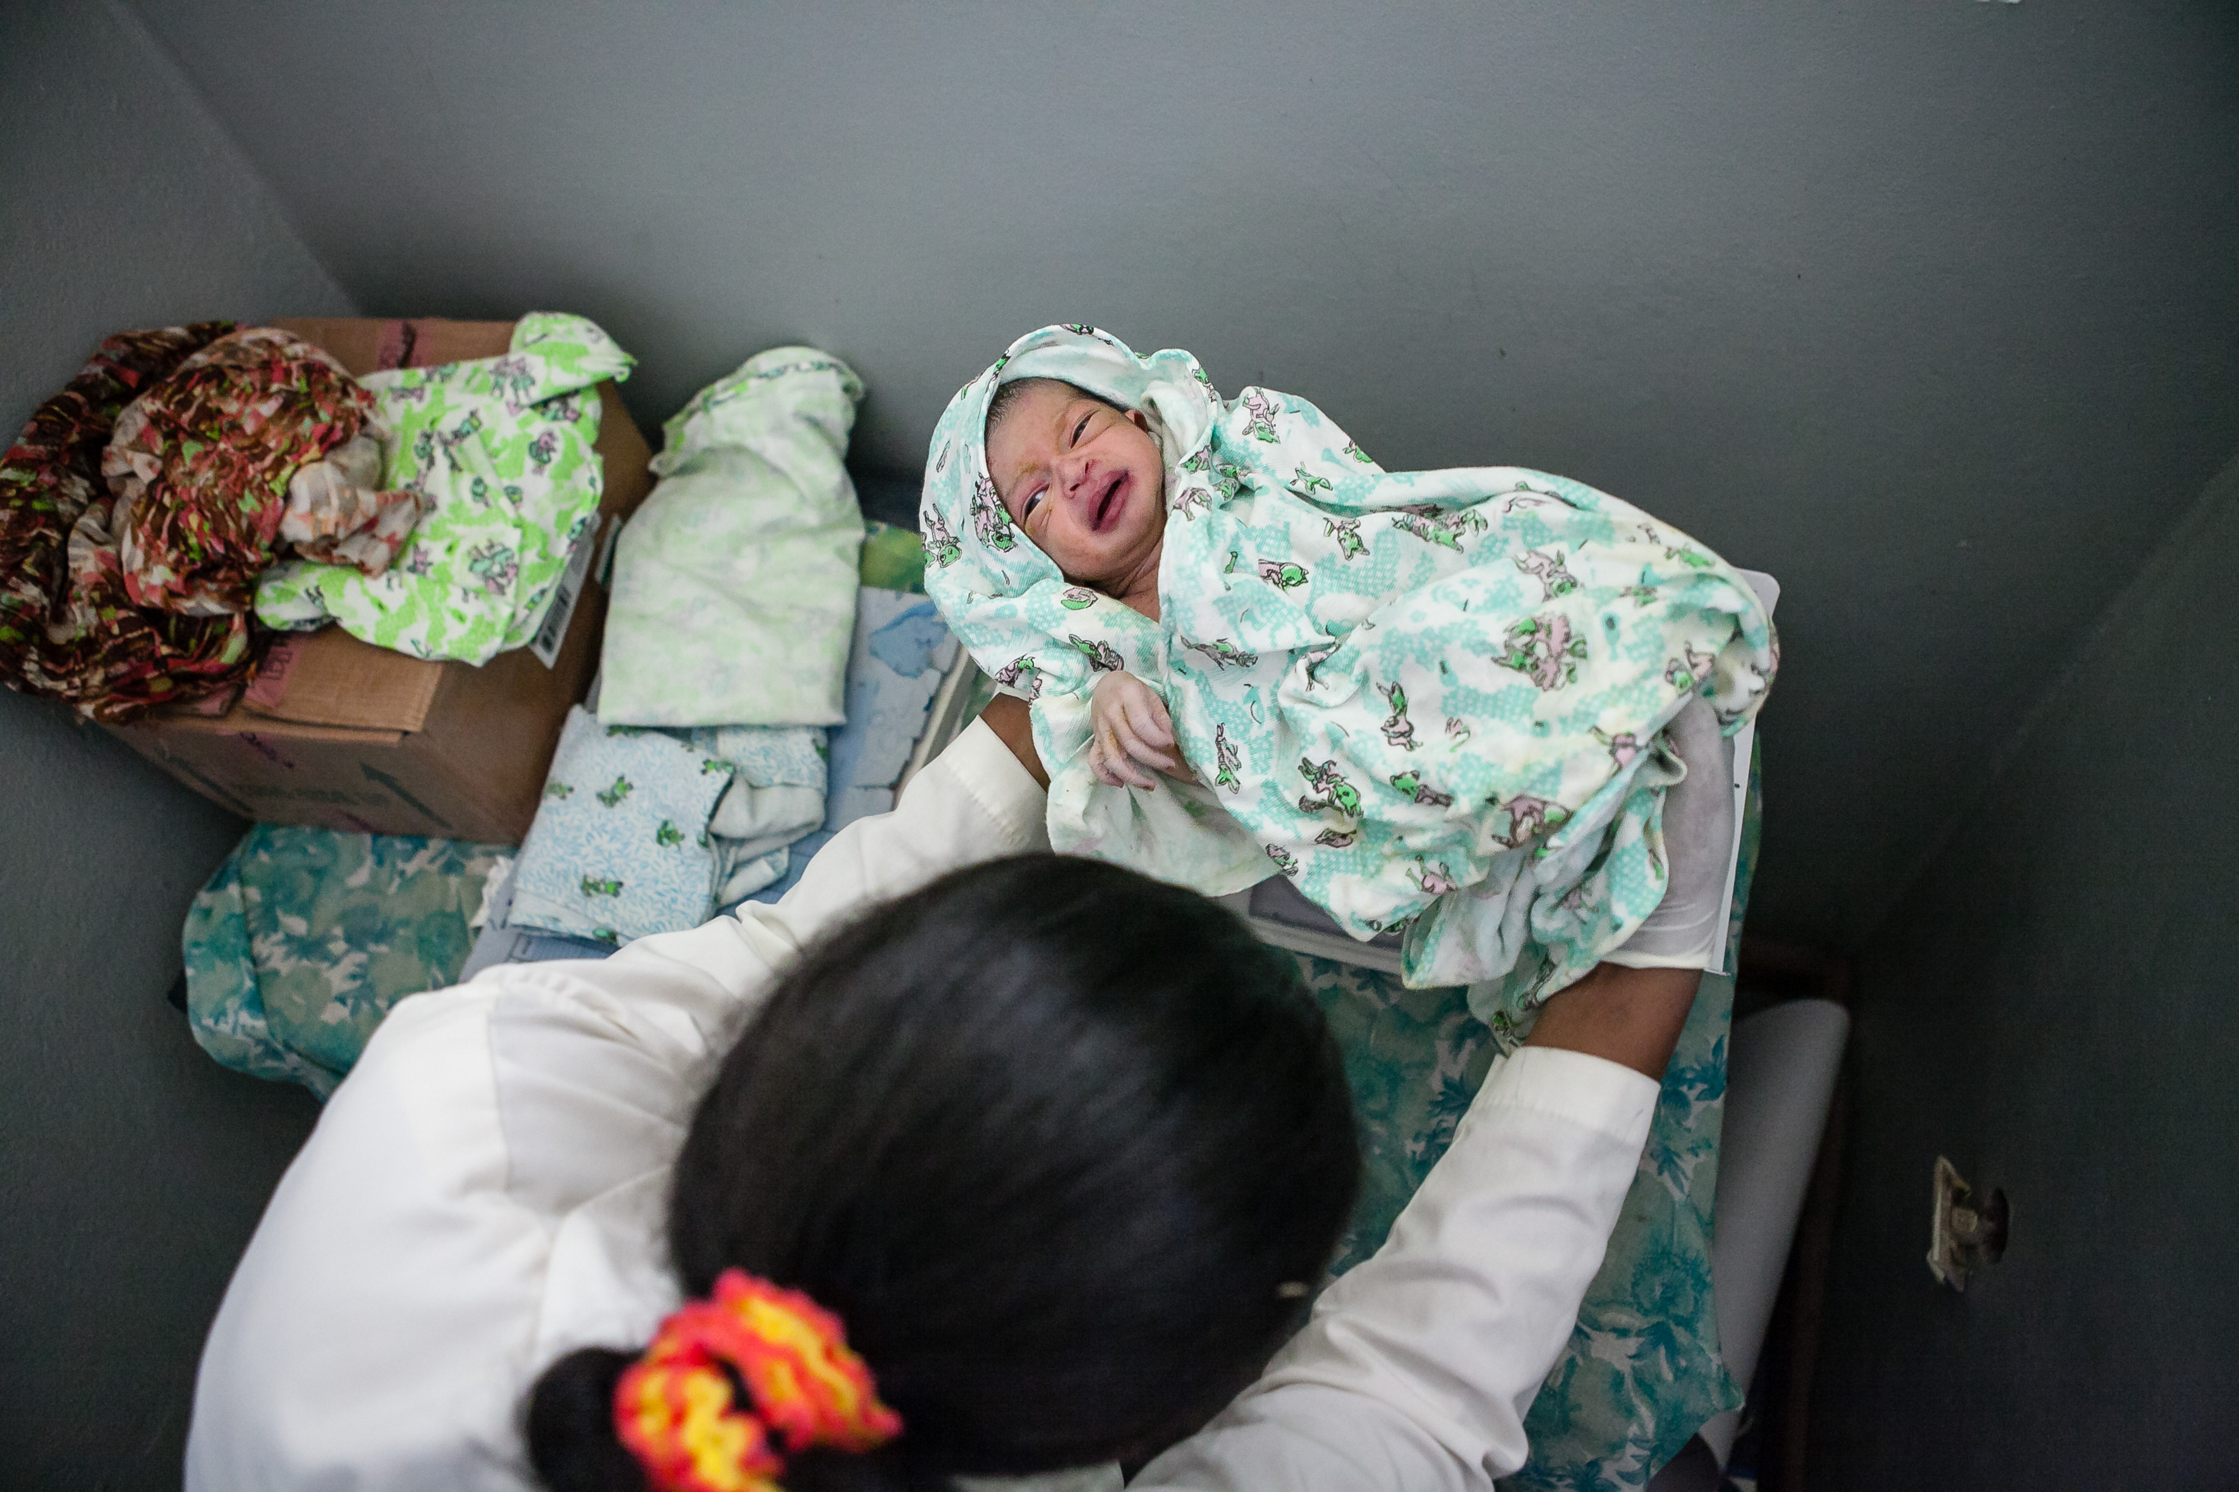

Slide 12
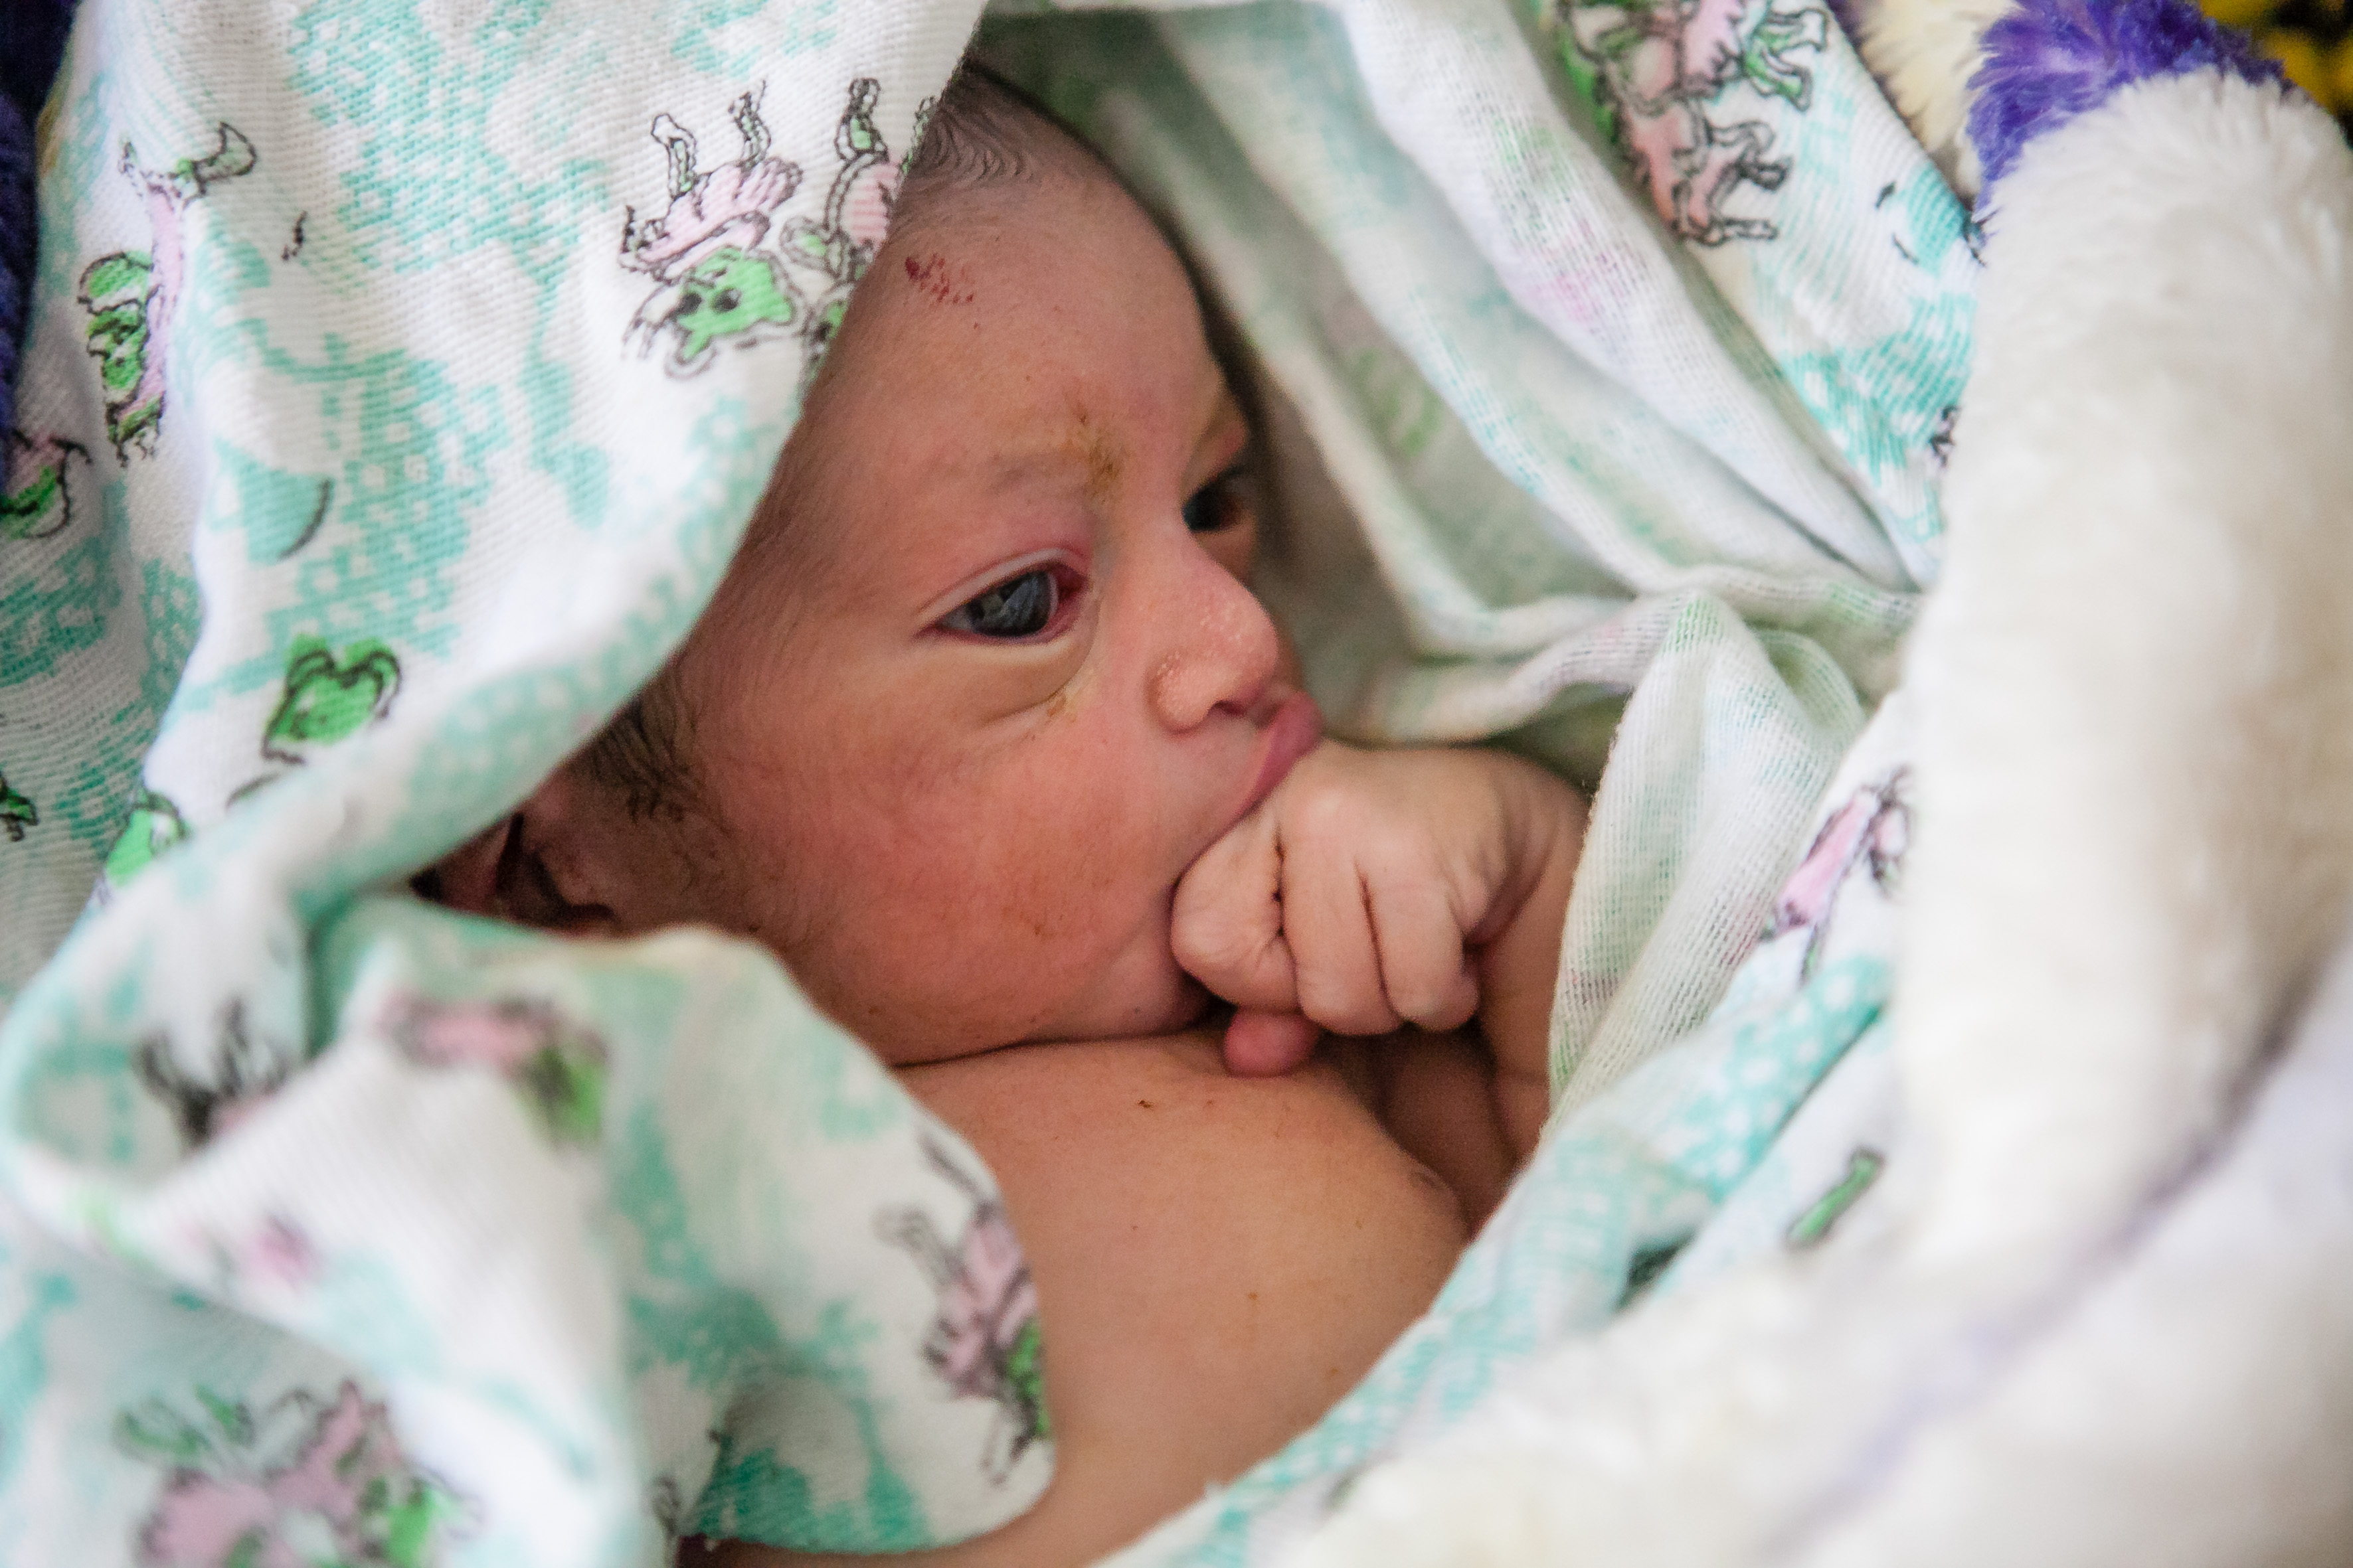

Slide 13
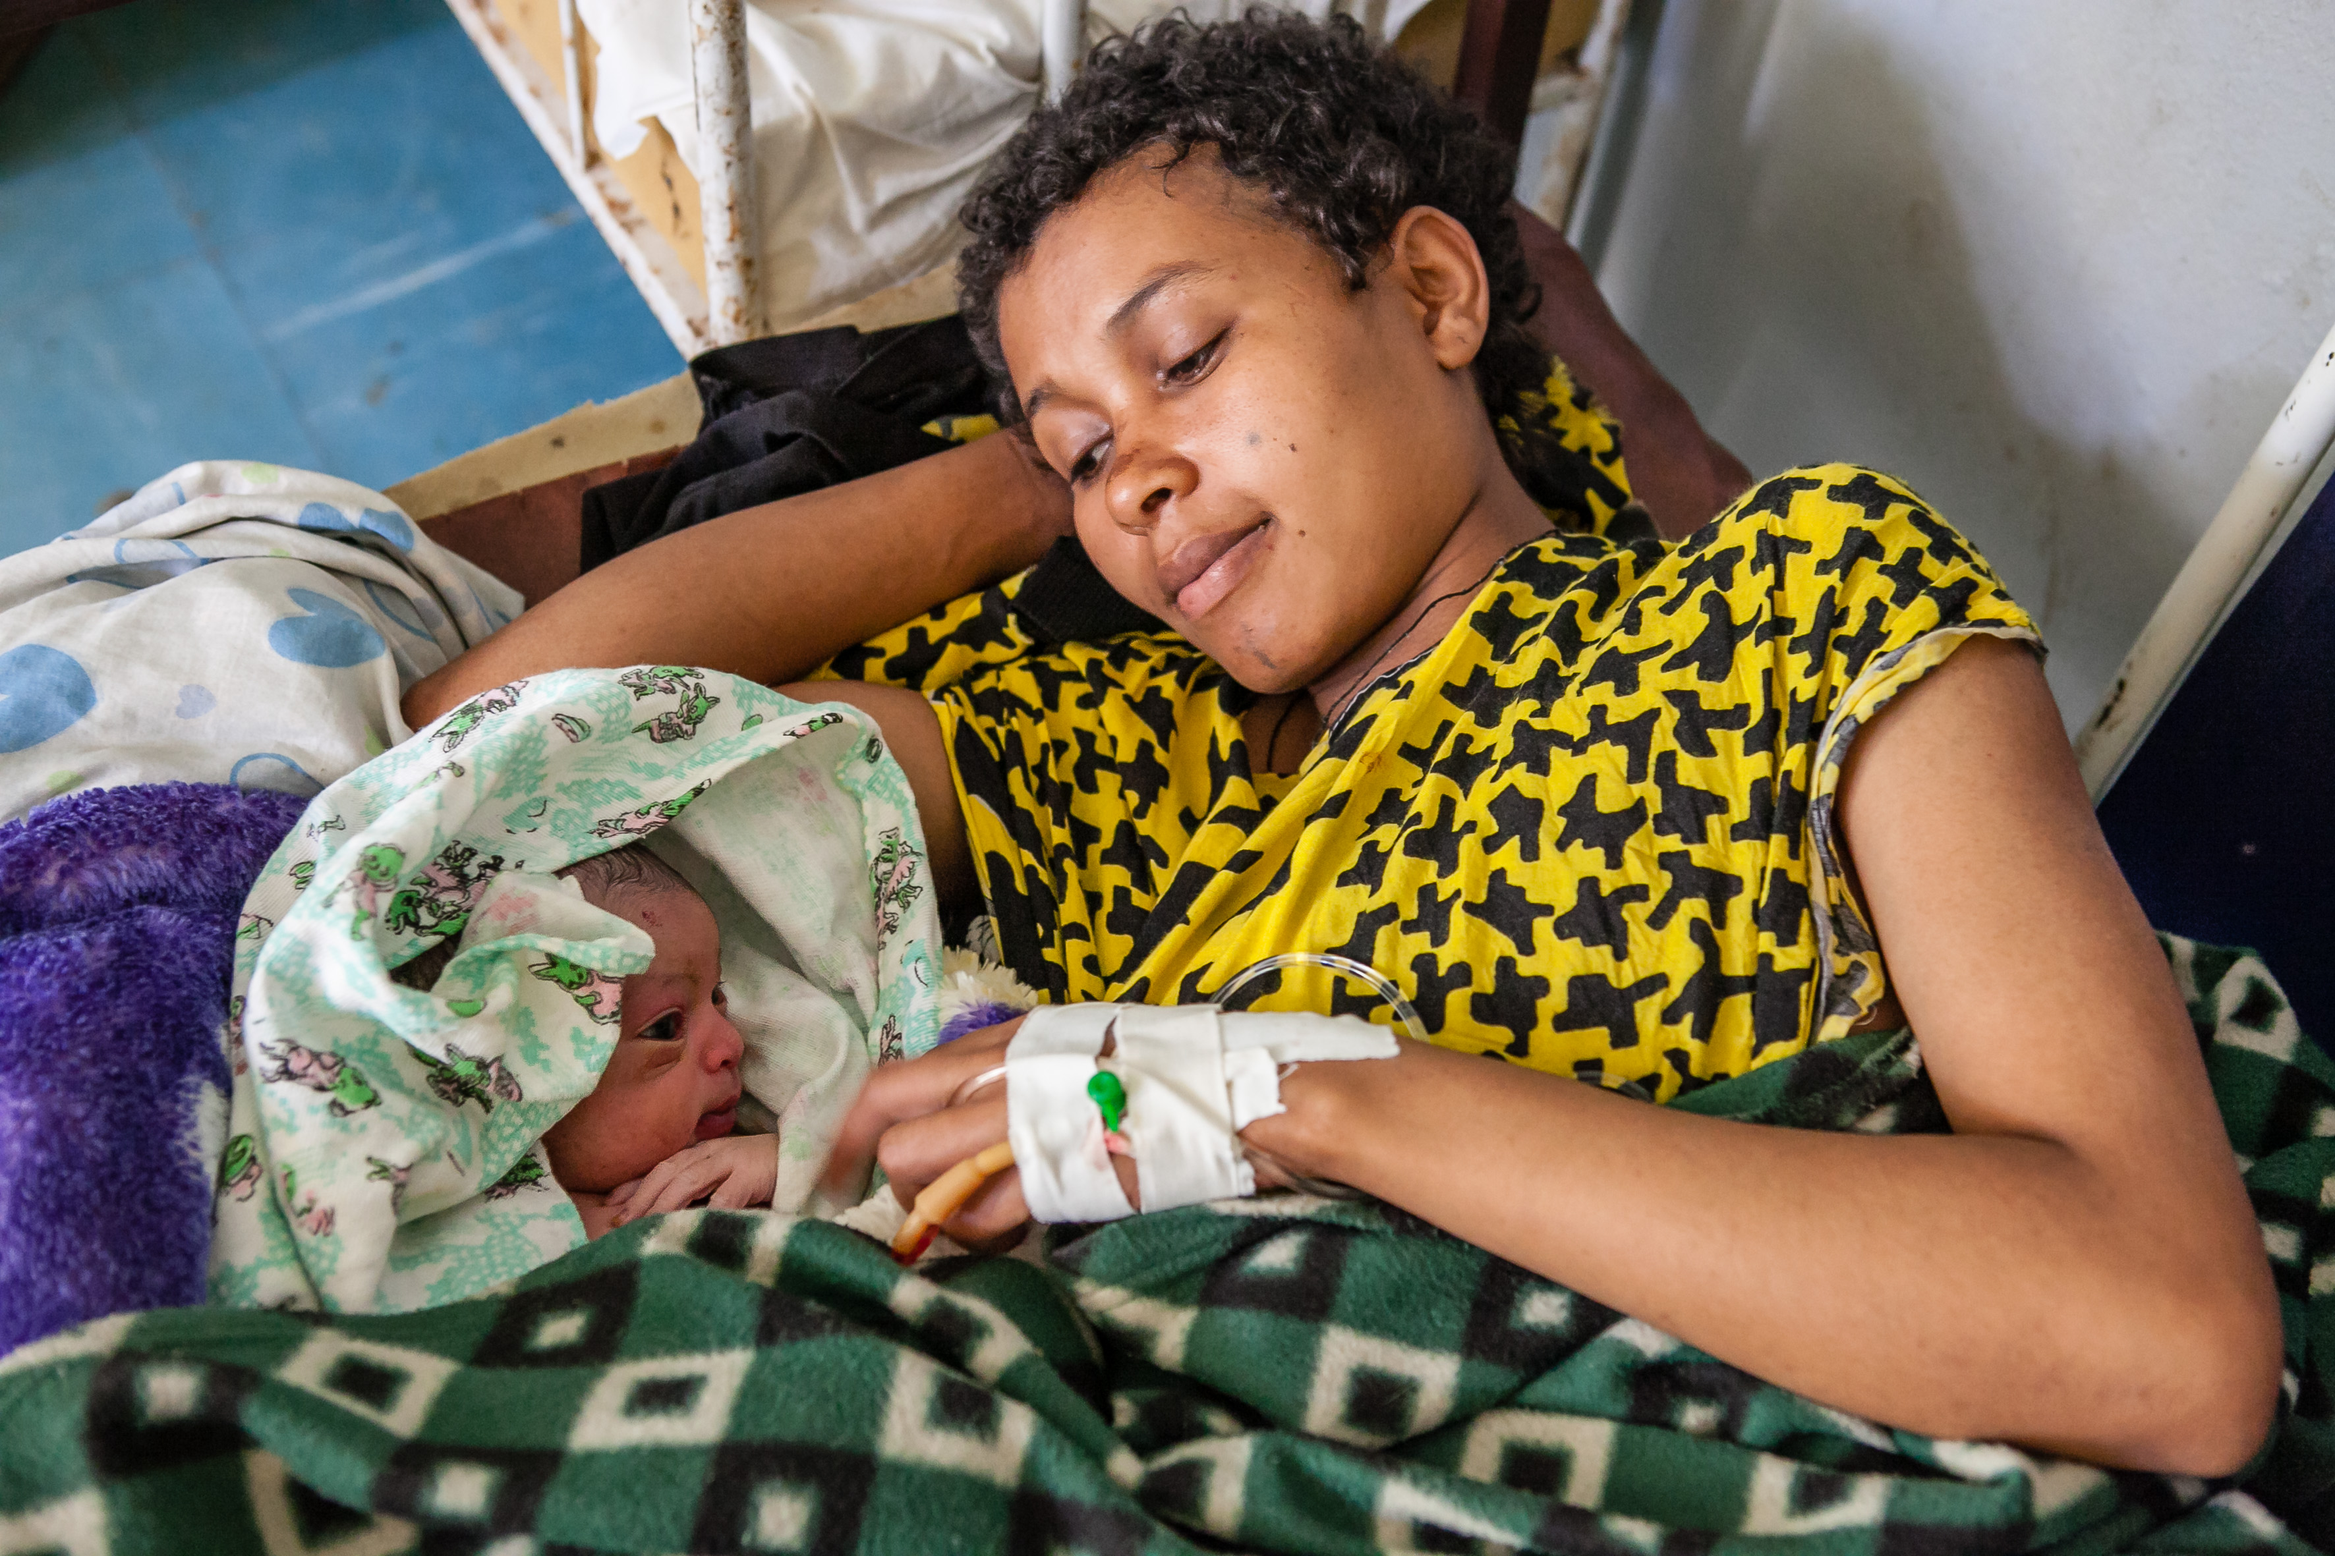

Slide 14
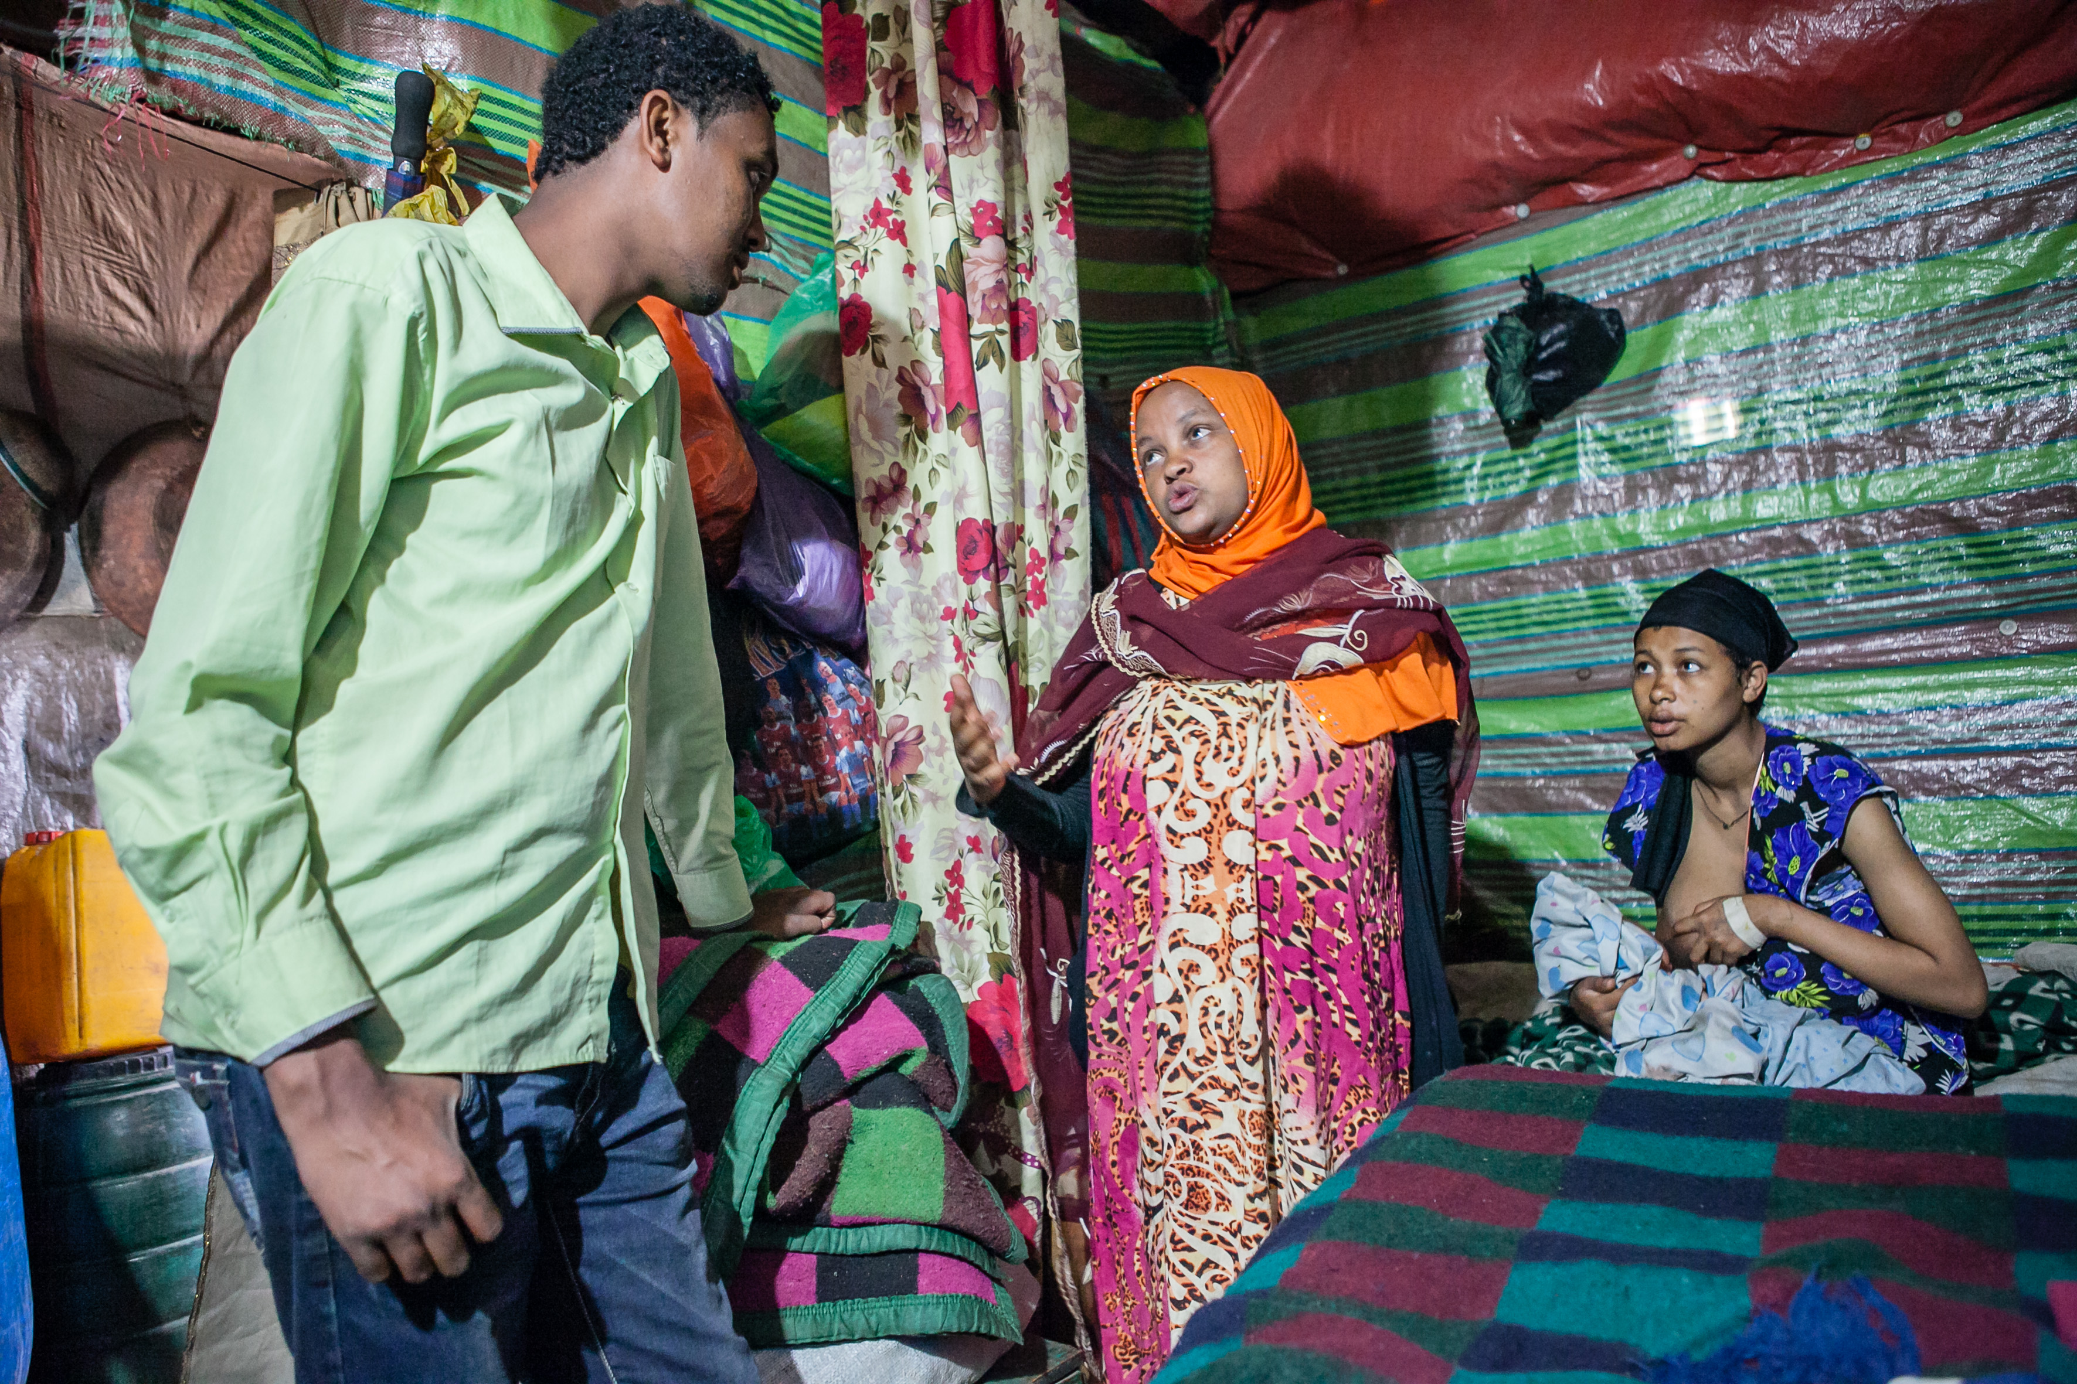

Slide 15
Presentation
What is IDEAS?
Charting progress in maternal and newborn health
How photography can help improve and innovate health systems by enhancing research
Wider debates
What next?

Slide 16


What is IDEAS?
IDEAS aims to improve the health and survival of mothers and babies through generating evidence to inform policy and practice
Working in Ethiopia, northeastern Nigeria and India
IDEAS uses measurement, learning and evaluation to find out what works, why and how in maternal and newborn health programmes
Funded by the Bill & Melinda Gates Foundation
Based at the London School of Hygiene & Tropical Medicine
Find out more ideas.lshtm.ac.uk

Slide 17
Progress*
Births at health centres increased from 14% to 43%
More women had the recommended four or more antenatal care visits
Births attended by skilled birth attendants like doctors, nurses or midwives increased from 15% to 46%
BUT not all health workers and families adopt the behaviours that could be the most effective in saving lives
*Data from IDEAS survey areas and not nationally representative

Slide 18
How did this photographic approach come about?
Four learning questions – mechanisms of change
Field research in Ethiopia
Explore the barriers and enablers to improving behaviours during the first hours and days of the newborn's life
What role do community health workers play in this?
Wanted to understand why change happens

Slide 19
Promoting heathy behaviours
Active management of the third stage of labour
Thermal care
Clean cord care
Weighing the newborn
Immediate breastfeeding

Slide 20
Qualitative Methods
Background: Community health workers trained to make early postnatal care visits. Community health volunteers help identify deliveries
Study sites: Two 'typical' Kebeles, with reasonably functioning Community Health Workers
Respondents: Recent mothers, grandmothers, fathers, community health workers and volunteers
Data collection methods: Narratives, in-depth interviews, friendship pair interviews and focus group discussions
Content: Perceptions and experiences with postnatal care visits
Analysis: Deductive and inductive coding and interpretation in Nvivo

Slide 21
Photostory as an innovation
“The picture round”
Participants shown a picture of the - correct or "incorrect" - execution of one of the life saving behaviour
In first instance the team used more generic pictures not specifically from the area where they were undertaking their research

Slide 22
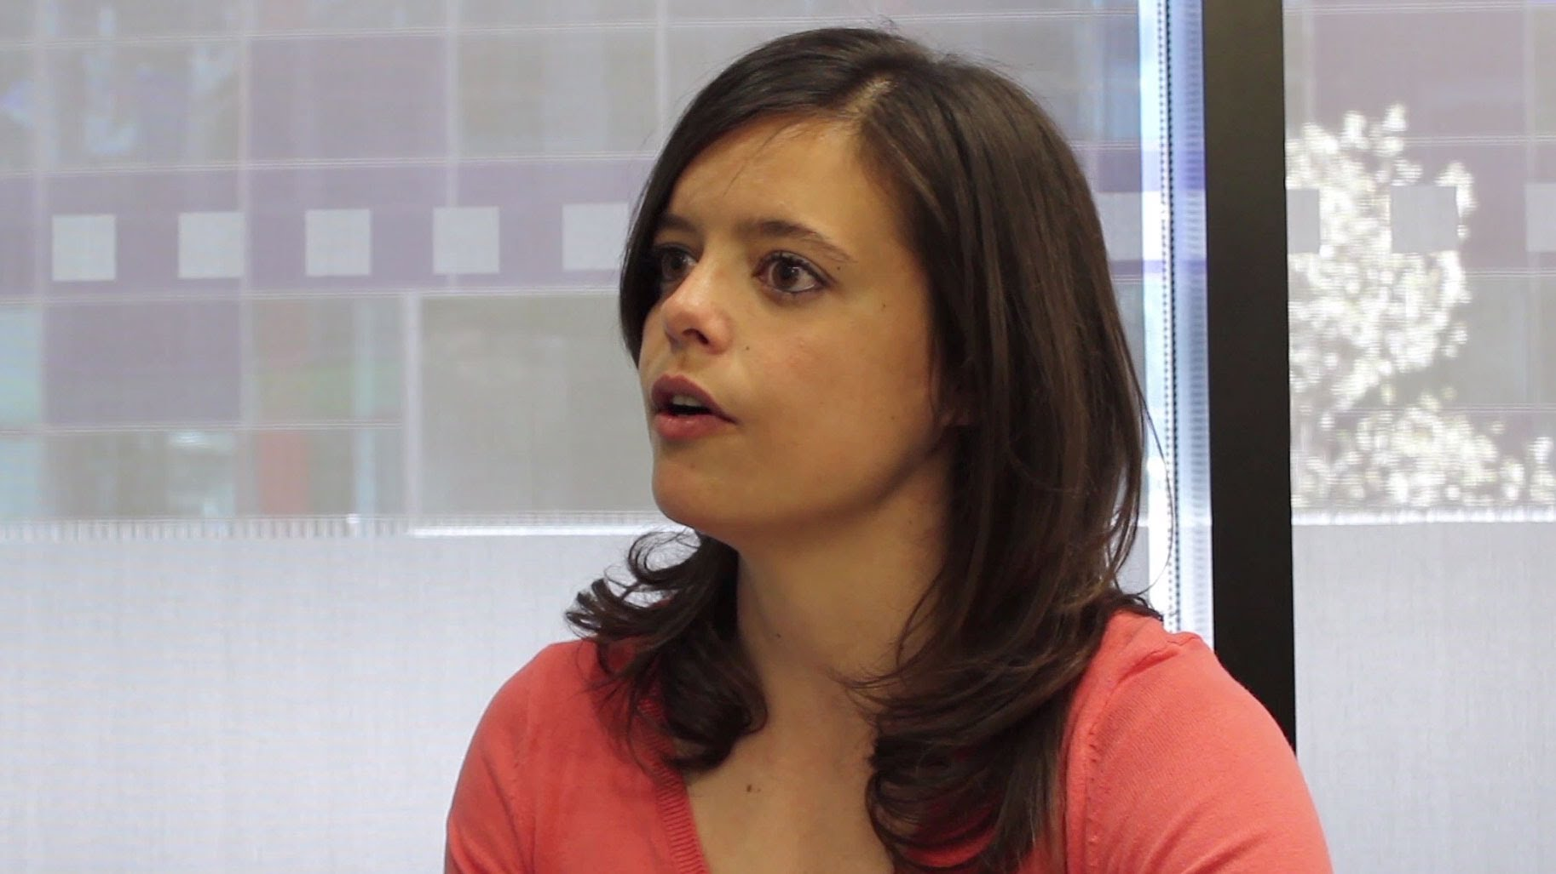
“We had tried out some of the picture rounds with pictures from several big multilateral organisations and most of the comments we received from the participants were "this baby is not from here, this mother has a strange necklace" etc. which was not very helpful in the research.”
Dr Pauline Scheelbeek
London School of Hygiene &
Tropical Medicine
Image © Grantham Imperial

Slide 23
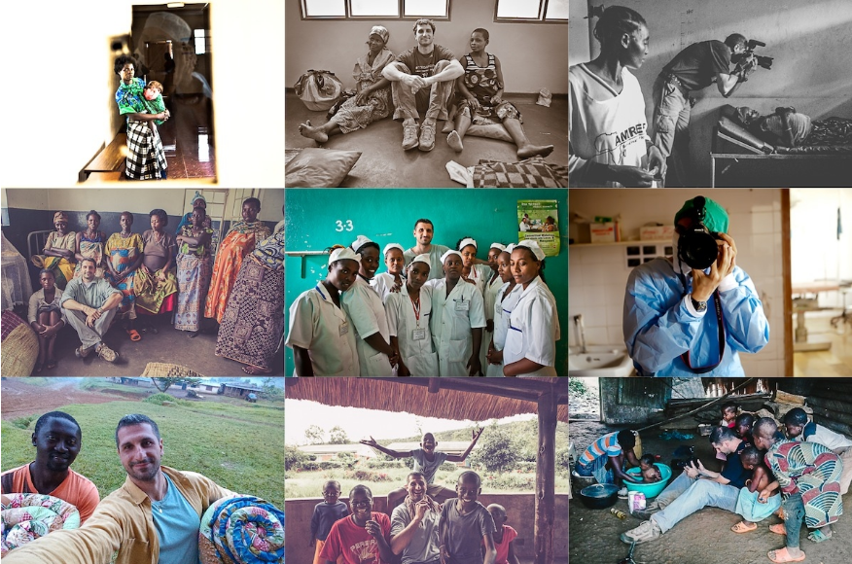

Slide 24
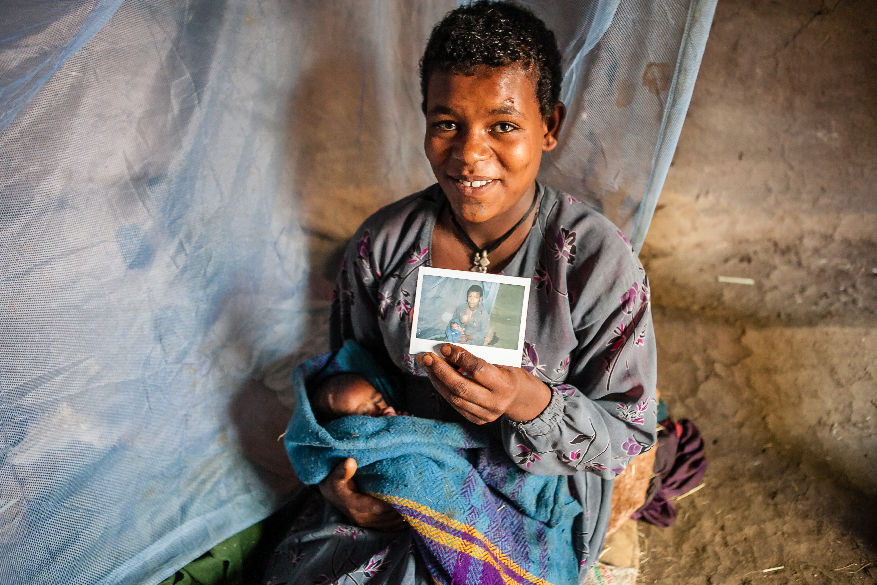
Notes:
So, the team asked Paolo if he could capture some specific behaviours in the local area, documenting local women’s experiences of giving birth. It was these pictures the team used to ask the questions in their research surveys.
With Paolo's new local pictures, the discussion became - in most of the cases - much more focused on the behaviour itself, and proved a major help in understanding the drivers of local maternal and newborn behaviours.
Also, all digital images have a timestamp. So for each of the stories, this allowed the team to trace the time it took for all the interventions to take place. So the images capture both quantitative and qualitative data.
One of the reasons we picked Paolo was for his energy and enthusiasm. He worked hard to gain the trust of the women in the photos and the health workers to get right in the middle of events.
Paolo also gave small, but valuable gift to the mothers – a polaroid picture of them and their newborn child. A small token of appreciation that probably meant a lot to many of the women who lived in rural parts of Ethiopia.
It is Paolo's striking images that make up this IDEAS story….

Slide 25
What happened to the research?
Produced culturally sensitive photographs for research
Discussion became more focused on the behaviour
Generated locally relevant evidence that directly that informed health programming
Evidence shared with government and implementers for course correction

Slide 26
Lessons learned
Powerful research tool
Essential to seek appropriate permission
Strong partnerships
Plan in detail all logistics
Can be very expensive
There is a strong case for using a local photographer

Slide 27
How multimedia can help to improve and innovate health services and systems?
Photography can…
Begin a conversation about a topic
May prompt or catalyse action
Be a different way to present data and context
Build on an evidence base
A powerful advocacy tool

Slide 28
Is photography reliable?
Social desirability bias
Behaviour
Ethics

Slide 29


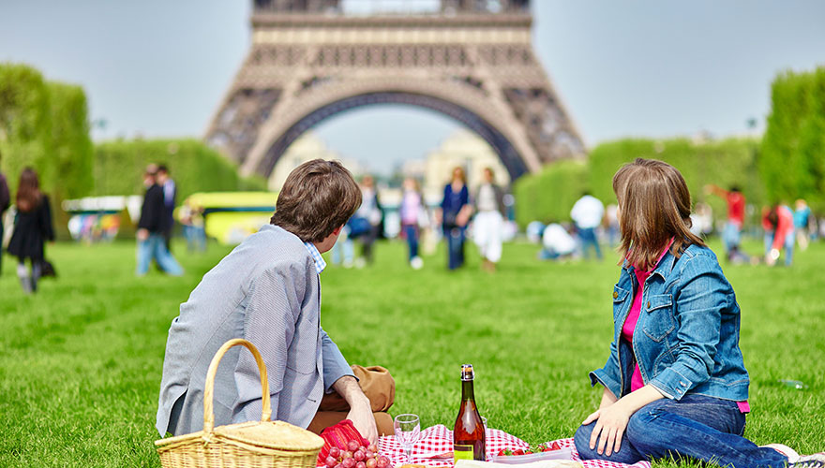

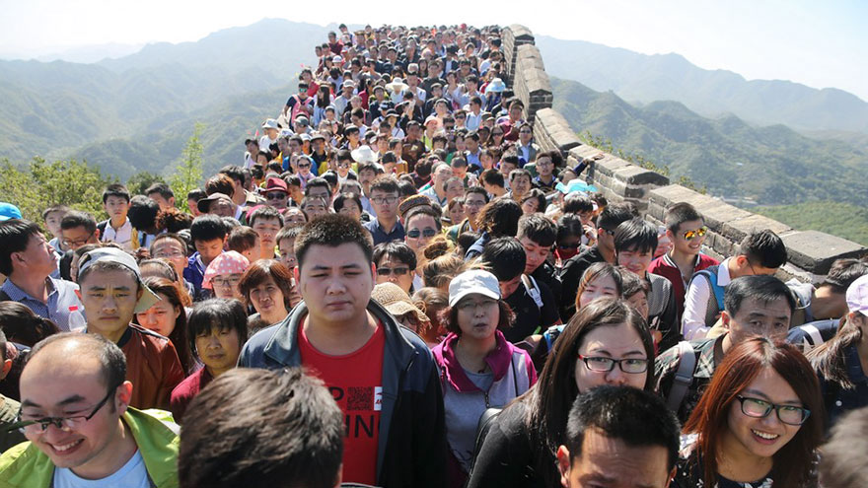
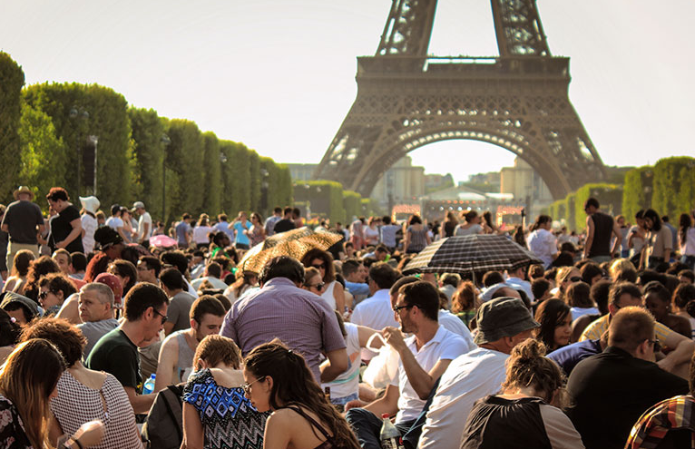
Appearance vs Reality
(Courtesy of Bored Panda)

Slide 30
Wider issues
Global imbalance in knowledge production and utilisation
Explicit focus of the SDGs on production and use of local knowledge and data

Slide 31




Behind the curve?
Networks vs
Institutions

Slide 32
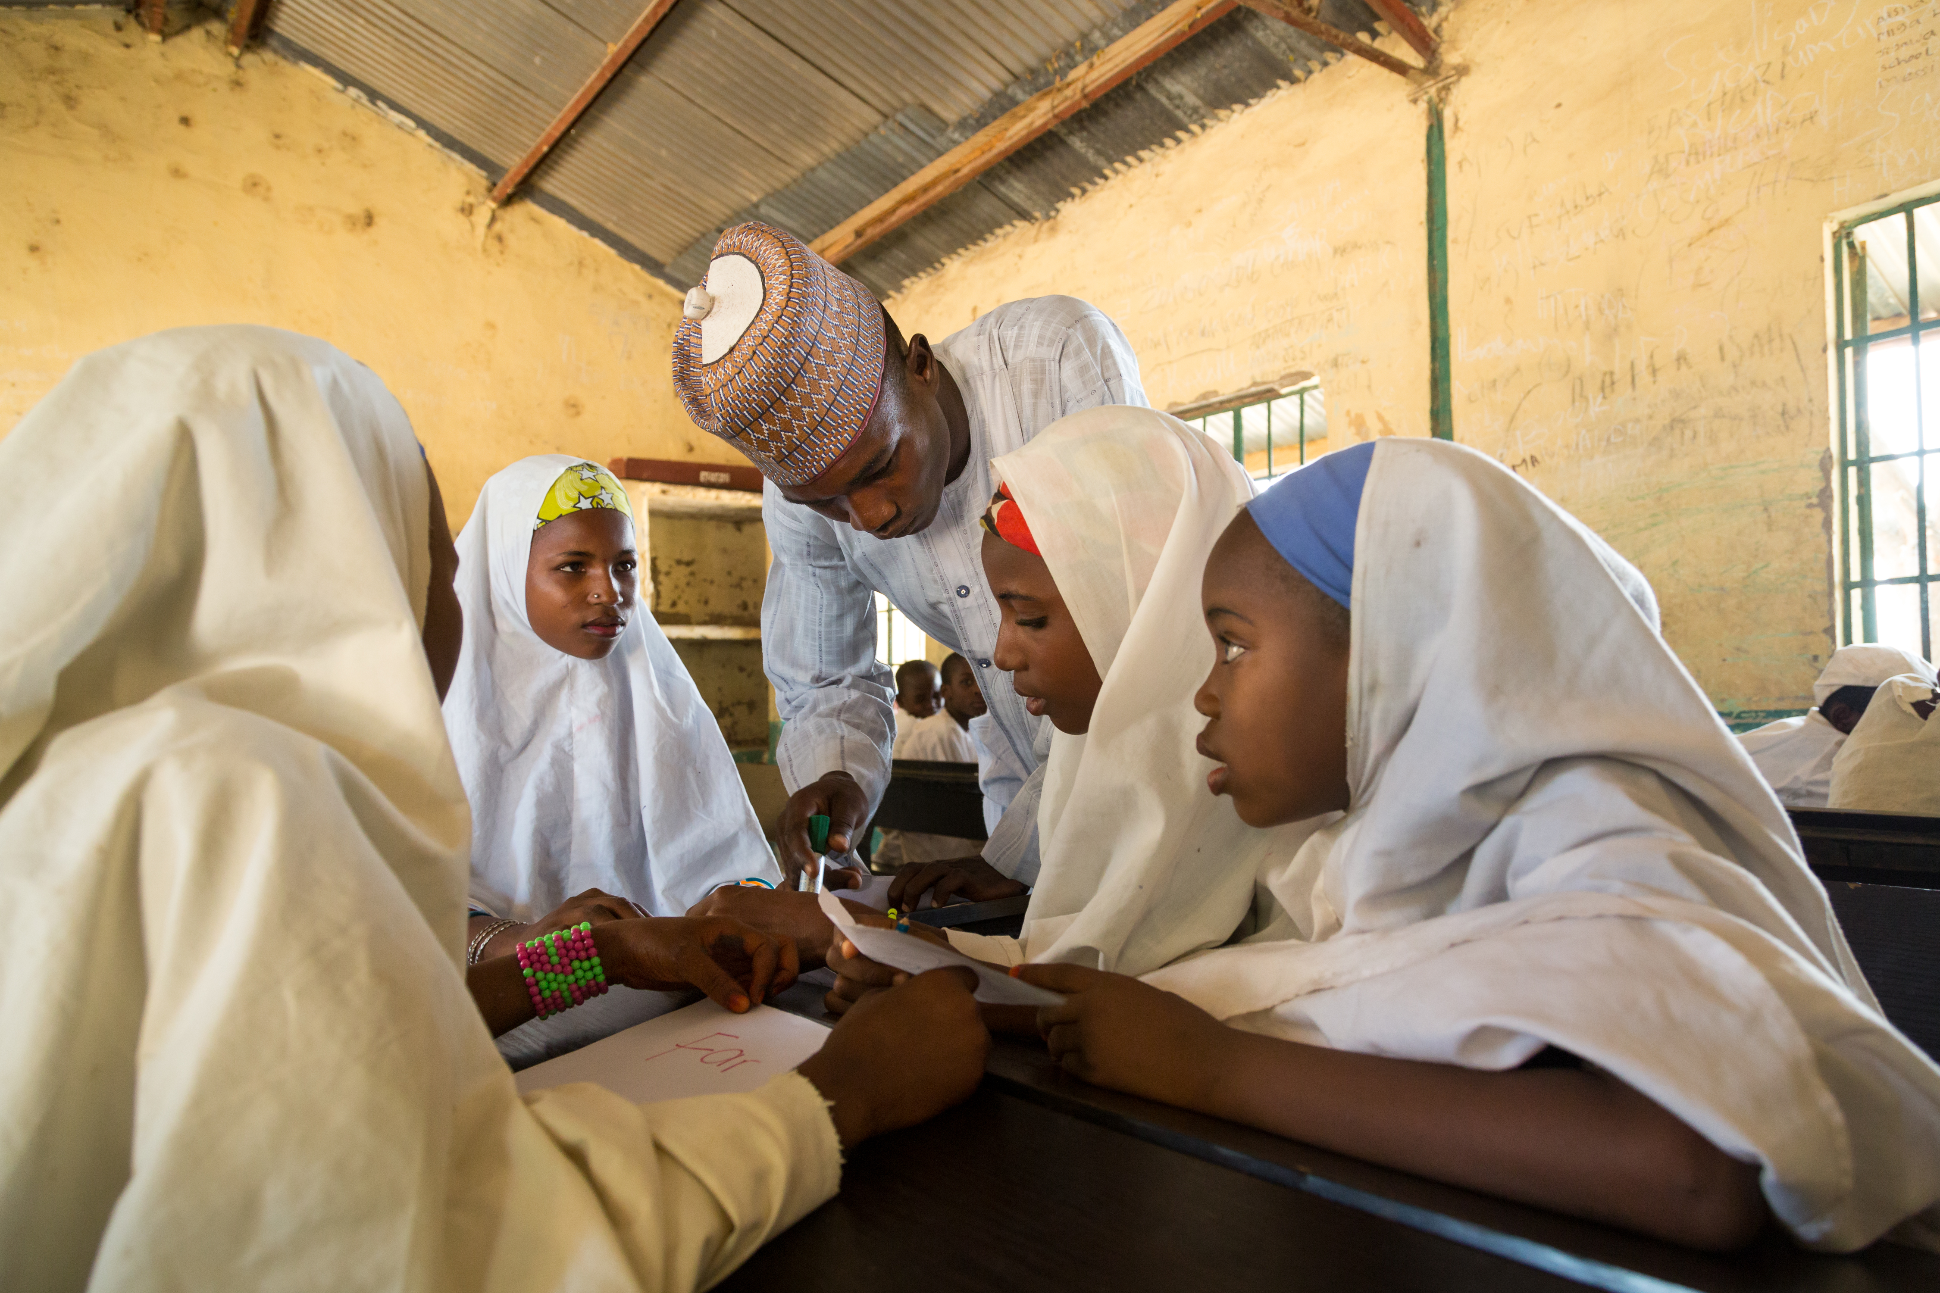
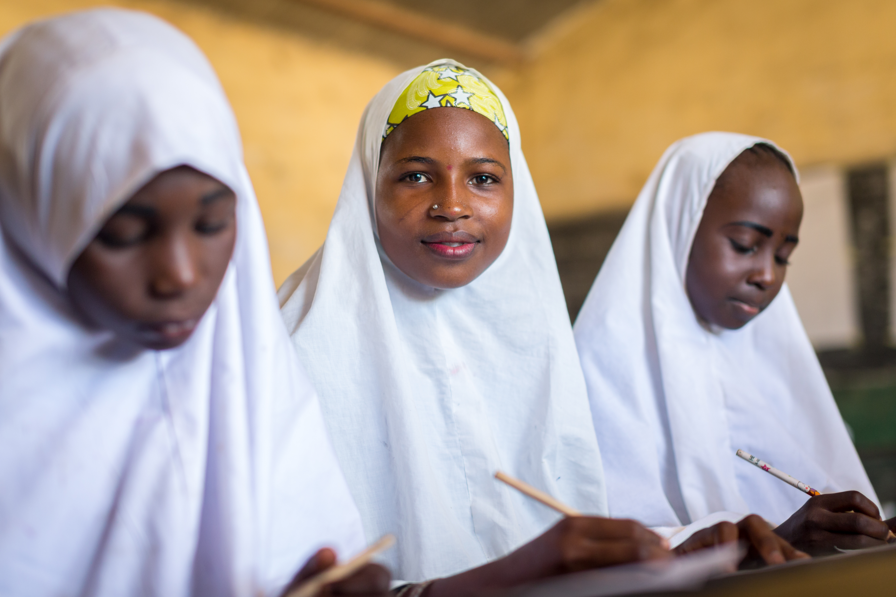
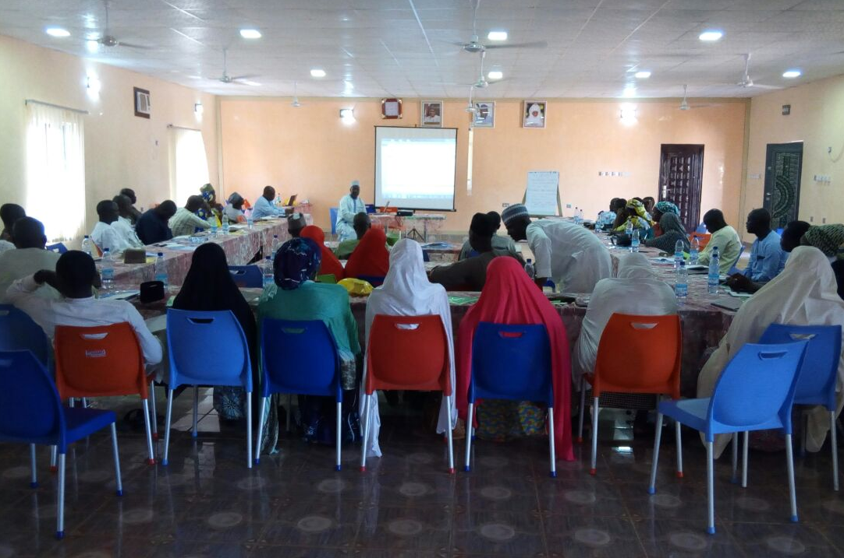
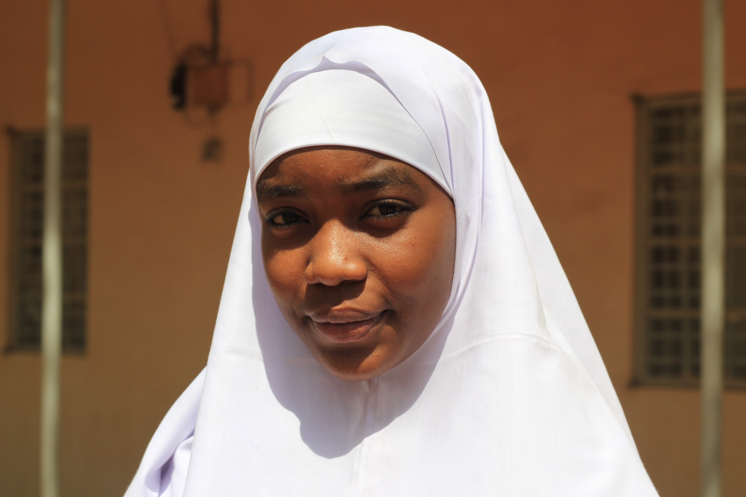
© GPfE
© GPfE
The Gombe Girls for Maternal and Newborn Health
© DFID

Slide 33
Key Message
Photography can be a good tool to generate locally relevant evidence
This evidence can also be a powerful tool for advocacy
Shortcomings – photography is susceptible to bias
New approaches need to be harnessed to increase impact
Alone is not enough for change

Slide 34
Thank you
Rhys Williams
Communications Officer - IDEAS ideas.lshtm.ac.uk rhys.Williams@lshtm.ac.uk
@LSHTM_IDEAS

Slide 35
Photographs by
Paolo Patruno www.paolopatrunophoto.org

