Slide 1

Measurement, learning and evaluation for maternal and newborn health
IDEAS Satellite Session
Fourth Global Symposium on Health Systems Research
Vancouver, Canada
15 November 2016
ideas.lshtm.ac.uk

Slide 2
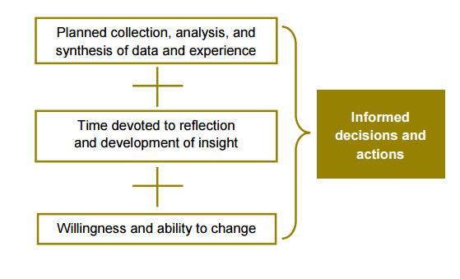
Introduction
Global dialogue on measurement improvement (John Grove)
Introduction to IDEAS (Joanna Schellenberg)
The plan for today’s session
Introduce the panellists and the presenters
Actionable measurement
ideas.lshtm.ac.uk

Slide 3
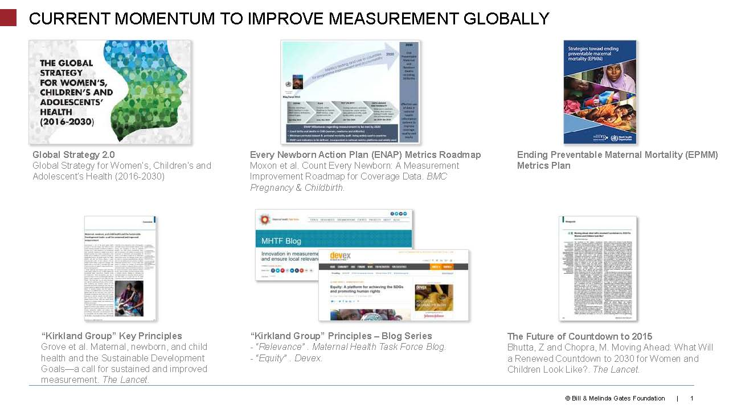

Slide 4
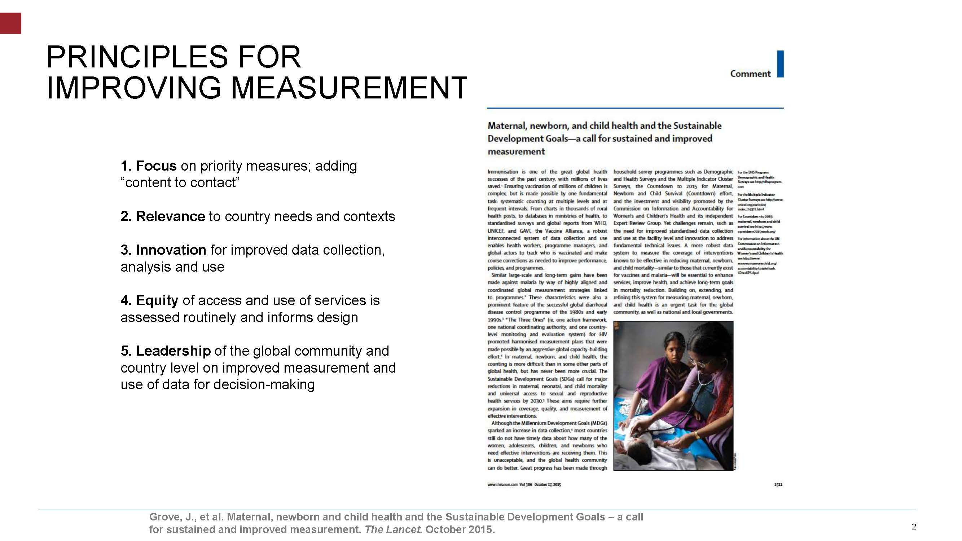

Slide 5
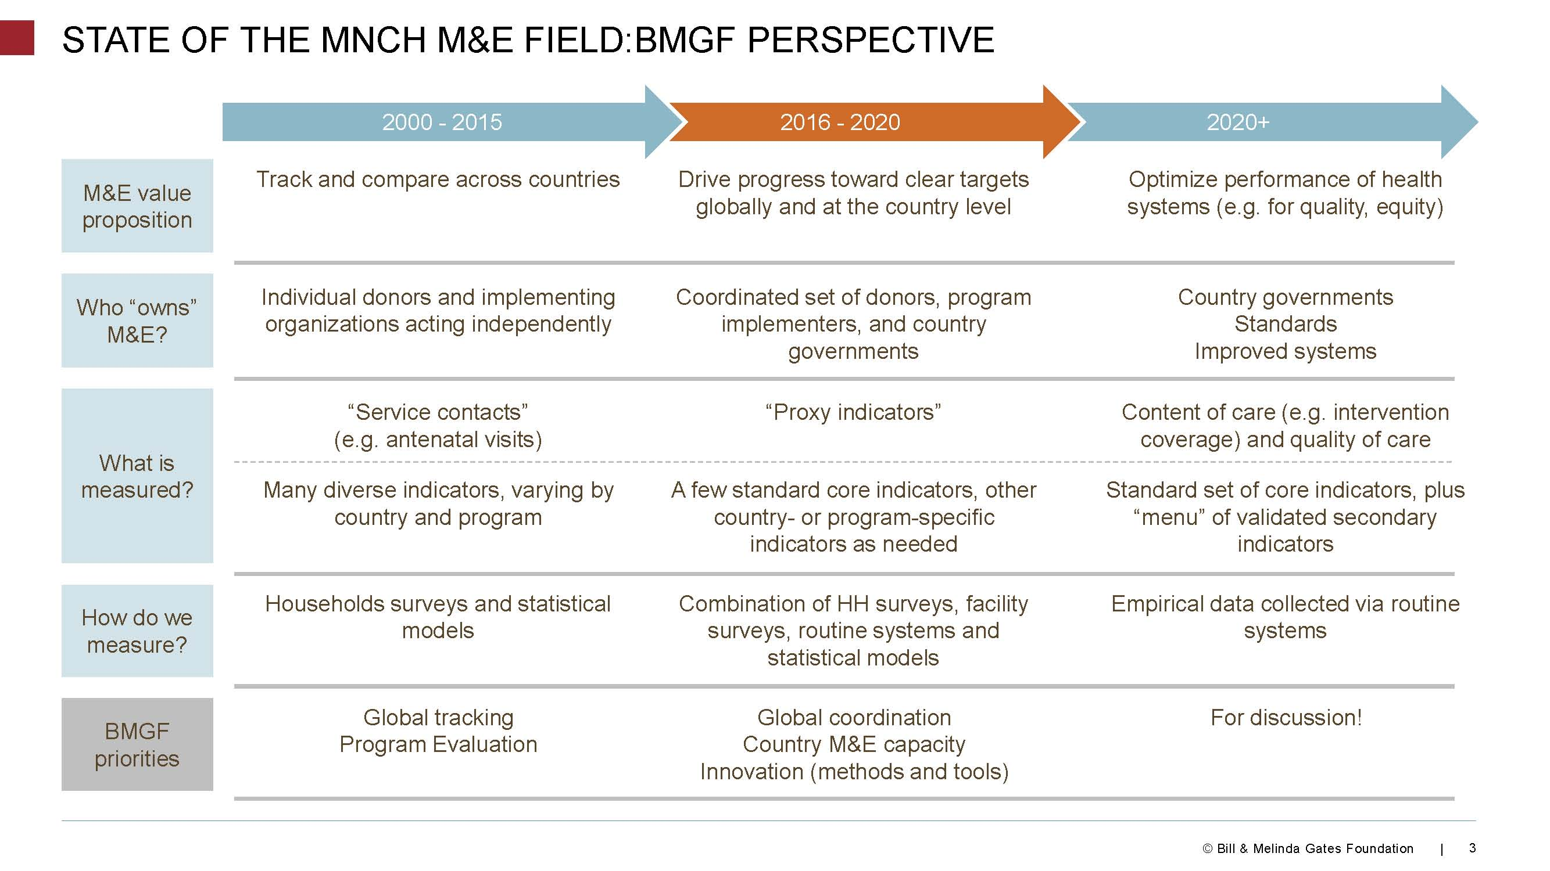

Slide 6
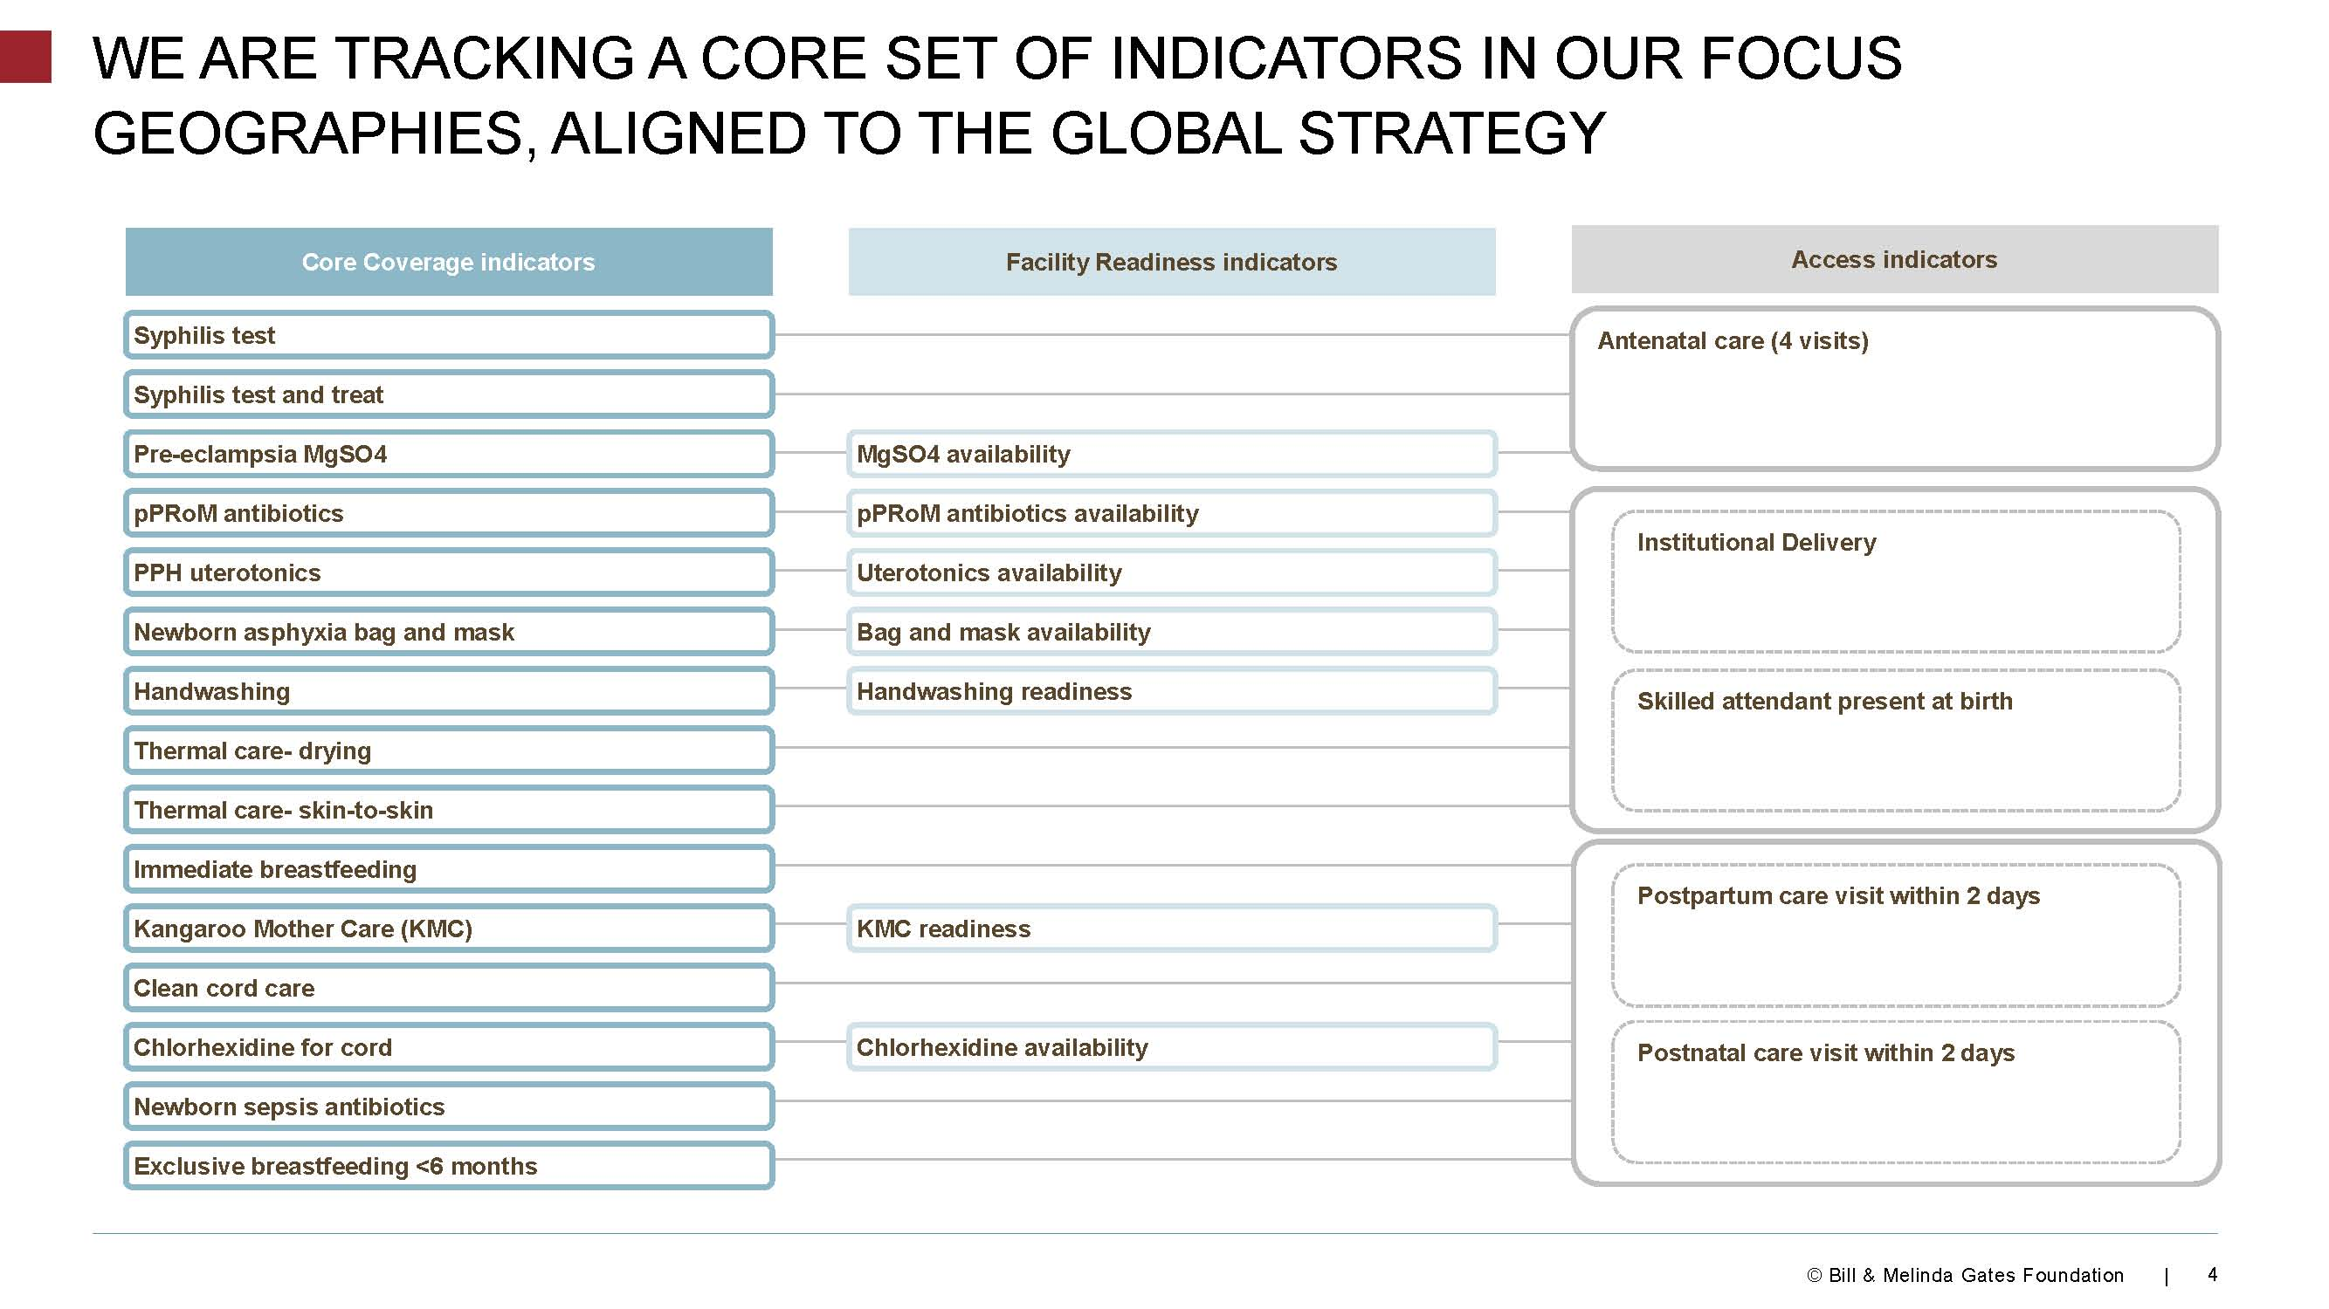

Slide 7
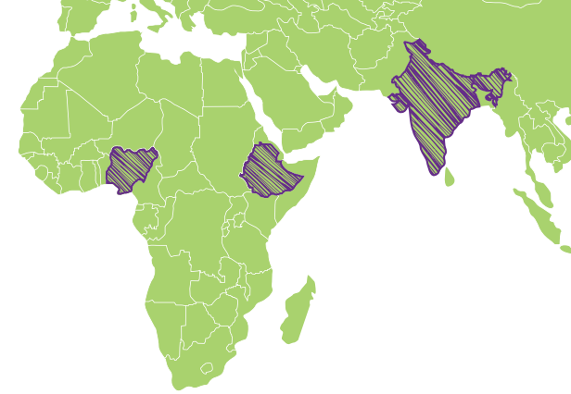
Actionable measurement for change
IDEAS: where, why, and what?
Uttar Pradesh State, India
Gombe State, Nigeria
West Bengal State, India
Oromia, Amhara, Tigray and SNNP Regions, Ethiopia
ideas.lshtm.ac.uk
Notes:
This session is about measurement, learning and evaluation. Since 2012 the IDEAS team with local partners in Nigeria, Ethiopia, and India have been engaged in field work in each of the three countries, looking at a series of questions about the BMGF maternal and newborn health strategy overall. We aim to take an independent evaluation perspective, collaborating closely with implementing partners but remaining largely separate. Our focus is on actionable measurement for change

Slide 8
IDEAS: where, why, and what?
..49 babies die in first month;
3 maternal deaths
..44 babies die in first month;
15 maternal deaths
for every thousand live births….
..37 babies die in first month;
7 maternal deaths
ideas.lshtm.ac.uk
Notes:
Around 18 million people live in the 6 states of north-east Nigeria, 200 million people live in the Indian state of Uttar Pradesh, and almost 100 million people live in Ethiopia, around 80% of whom live in these four states. Back in 2009-10, the Bill & Melinda Gates foundation maternal and child health team decided to focus on these areas because of the poor outcomes for mothers and newborns in combination with the high population numbers. They later added other areas such as Bihar State in India.

Slide 9
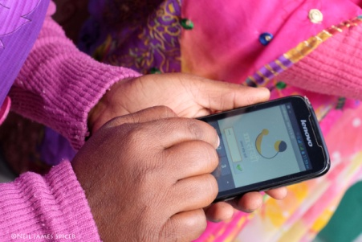
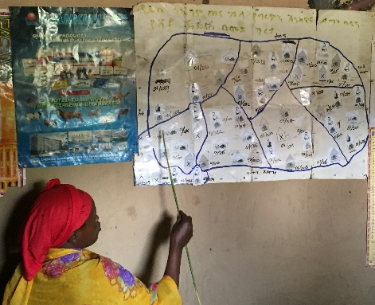
IDEAS: where, why, and what?
Will insert picture of innovation
Will insert picture of innovation
9 partners
57 innovations
Will insert picture of innovation
ideas.lshtm.ac.uk
Notes:
These partners in combination have been implementing the BMGF MNCH strategy. Individually, each are major investments by the foundation and each has it’s own measurement, learning and evaluation work. Our role in IDEAS has been to take an overview of evaluation and learning about the strategy overall. We have collected a wide range of quantitative and qualitative data in each country setting to answer specific questions. In this session we want to share some of our learning with you, and to hear your reflections on measurement, learning and evaluation in different settings too

Slide 10
Today’s session
Promoting learning in measurement, learning and evaluation of a maternal and child health strategy
What’s being evaluated?
Whether & how innovations improve coverage of critical, life-saving interventions?
First panel discussion
Break and scale-up game
How do we get “lasting impact at scale”
Emerging learning on scale-up and district data for decision-making
Second panel discussion
Wrap-up and close
ideas.lshtm.ac.uk
Notes:
We’ve split this session into sections. We have four presentations, each taking no more than 15 minutes, and two panel discussions. And at 10.30 just before we break for a few minutes we will introduce the ‘scale-up game’…. The first presentation will be given by Krystyna, and will look at how in IDEAS we identified specific innovations within the work of each implementing partner; the second will be given by Tanya and will look at our work on whether and how innovations improve coverage of critical, life-saving interventions. The first panel will follow, with the last 10 minutes or more being for questions from the audience. Krystyna and Tanya will lead this panel.
Neil will then briefly introduce the scale-up game and we will break for coffee
At 11 we’ll start again, concluding the game, handing out prizes, and Neil will present our work on how to get ‘lasting impact at scale’ , looking at how and why does scale-up happen? Then Bilal will present our work on emerging learning on district-level decision-making before the second panel discussion, followed by a wrap-up and close at 12 noon.

Slide 11
Our panellists and presenters
Presenters:
Krystyna Makowiecka
Characterising Change
Tanya Marchant
Data Driven Action
Neil Spicer
Scaling-Up Innovations
Bilal Avan
District Level Data for Decision Making
Panellists:
Wuleta Betemariam
John Snow Inc.
Ethiopia
Lynn Freedman
Mailman School of Public Health
Pinki Maji
Population Services International
India
Magdalene Okolo
Society for Family Health
Nigeria
ideas.lshtm.ac.uk

Slide 12
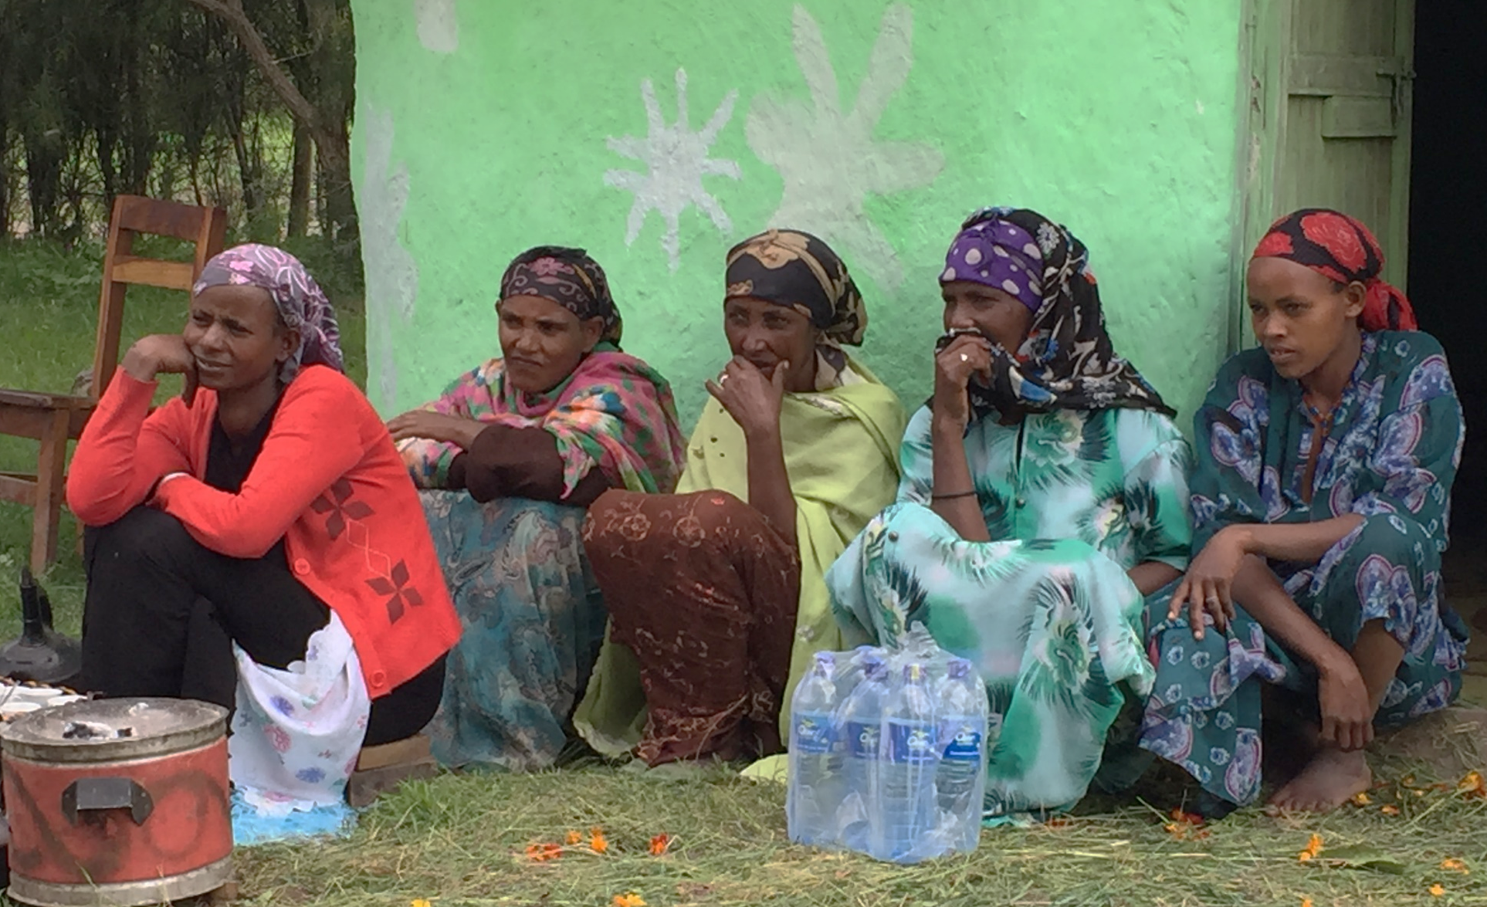
Characterising change
Krystyna Makowiecka

Slide 13
The first step in actionable measurement: describe the intervention
Key Message
A structured and rigorous description of implementation projects’ work may benefit a range of actors
ideas.lshtm.ac.uk

Slide 14
Characterisation
An approach to describing a complex intervention
Step 1. Agree a framework
Step 2. Describe the implementation project innovations
Step 3. Collate the data for the big picture
Step 4. Annual Update
ideas.lshtm.ac.uk

Slide 15
Step 1. Framework for characterisation of innovations: BMGF Theory of Change with IDEAS Characterisation questions
BMGF THEORY OF CHANGE
1. INNOVATON
to enhance MNH practice in the community and by frontline workers
2. ENHANCED INTERACTIONS between families and frontline workers
3. INCREASED COVERAGE of critical life-saving interventions
4. HEALTH OUTCOME
Improved maternal and newborn survival
IDEAS CHARACTER-ISATION QUESTIONS
1.What innovations are implemented by grantees
- What is the purpose?
- What is the geographical scope and timing?
2. What changes in contacts between frontline workers and service users were anticipated as a result of the innovation?
- What kind of enhancement - frequency, quality, or equity?
3. What changes in coverage of life-saving interventions were anticipated as a result of the innovation?
ideas.lshtm.ac.uk

Slide 16
Step 2. Describe the implementation project innovations
BMGF THEORY OF CHANGE
1. INNOVATON
to enhance MNH practice in the community and by frontline workers
2. ENHANCED INTERACTIONS between families and frontline workers
3. INCREASED COVERAGE of critical life-saving interventions
4. HEALTH OUTCOME
Improved maternal and newborn survival
IDEAS CHARACTER-ISATION QUESTIONS
1.What innovations are implemented by grantees
- What is the purpose?
- What is the geographical scope and timing?
2. What changes in contacts between frontline workers and service users were anticipated as a result of the innovation?
- What kind of enhancement - frequency, quality, or equity?
3. What changes in coverage of life-saving interventions were anticipated as a result of the innovation?
ideas.lshtm.ac.uk

Slide 17
  Q1. What innovations were implemented by grantees?
  2013: 57 varied innovations, implemented by nine projects in three countries
Typology of innovations funded under the BMGF MNCH strategy
Innovation types, by objective
Community-focused innovations | Enhance awareness and positive actions in MNH in the community
 | Enhance community structures
Frontline worker-focused innovations | Strengthen capacity of frontline workers
 | Motivate frontline workers
 | Provide job-aids to enhance provision
 | Set up new infrastructure
 | Enhance operation of the health system.
Case study. Innovations of the Society for Family Health Gombe State, Nigeria, 2013.
Society for Family Health innovations
Mass media event, Train and deploy community volunteers
Emergency Transport Scheme
Train and deploy community volunteers
Financial incentives for frontline workers.
Frontline workers’ toolkit
Call centre for MNH advice
Map service users and providers; Enhanced supply of clean delivery kits
ideas.lshtm.ac.uk

Slide 18
Step 2. Describe the implementation project innovations
BMGF THEORY OF CHANGE
1. INNOVATON
to enhance MNH practice in the community and by frontline workers
2. ENHANCED INTERACTIONS between families and frontline workers
3. INCREASED COVERAGE of critical life-saving interventions
4. HEALTH OUTCOME
Improved maternal and newborn survival
IDEAS CHARACTER-ISATION QUESTIONS
1.What innovations are implemented by grantees
- What is the purpose?
- What is the geographical scope and timing?
2. What changes in contacts between frontline workers and service users were anticipated as a result of the innovation?
- What kind of enhancement - frequency, quality, or equity?
3. What changes in coverage of life-saving interventions were anticipated as a result of the innovation?
ideas.lshtm.ac.uk

Slide 19
Q2. What changes in contacts between frontline workers and service users were anticipated as a result of the innovation?
Does the innovation aim to enhance skilled birth attendance?
Frequency of skilled birth attendance
Quality of skilled birth attendance | Timing
 | Content
Equity of access to skilled birth attendance
Facility Readiness (equipment and infrastructure)
Example, SFH Community volunteers
Indirect
Direct
-
Direct
-
ideas.lshtm.ac.uk

Slide 20
Step 2. Describe the implementation project innovations
BMGF THEORY OF CHANGE
1. INNOVATON
to enhance MNH practice in the community and by frontline workers
2. ENHANCED INTERACTIONS between families and frontline workers
3. INCREASED COVERAGE of critical life-saving interventions
4. HEALTH OUTCOME
Improved maternal and newborn survival
IDEAS CHARACTER-ISATION QUESTIONS
1.What innovations are implemented by grantees
- What is the purpose?
- What is the geographical scope and timing?
2. What changes in contacts between frontline workers and service users were anticipated as a result of the innovation?
- What kind of enhancement: frequency, quality, or equity?
3. What changes in coverage of life-saving interventions were anticipated as a result of the innovation?
ideas.lshtm.ac.uk

Slide 21
  Q3. What changes in coverage of life-saving interventions were anticipated as a result of the innovation?
Does the innovation aim to increase coverage of intrapartum life-saving interventions at community and primary care level?
Appropriate administration of antibiotics
Management of PPH using uterine massage & uterotonics
Active management of the 3rd stage of labour
Hand-washing w soap, use of gloves by delivery attendant
Management of early onset of labour using corticosteroids
Example, SFH Community volunteers
Indirect
Indirect
Indirect
Direct (community births) and indirect (facility births)
Indirect
ideas.lshtm.ac.uk
Notes:
Left – LS interventions
R SFH

Slide 22
  Step 3. Collate the data for the bigger picture
Map innovations by type and by geography
Map the anticipated combined effect of all project innovations
Map the anticipated combined effect of all projects working in the same geography
Theory of Change
1. INNOVATON
to enhance MNH practice in the community and by frontline workers
2. ENHANCED INTERACTIONS between families and frontline workers
3. INCREASED COVERAGE of critical life-saving interventions
4. HEALTH OUTCOME
Improved maternal and newborn survival
ideas.lshtm.ac.uk

Slide 23
Step 4 – annual update. 2013 - 2016: changes in innovations implemented by Society for Family Health in Gombe State, Nigeria
Innovation type |  | 2013 | 2016
Community-focused innovations | Awareness/ behaviour change | Mass media event; Train and deploy community volunteers | Mass media event; Village Health Worker training, equipping and deployment
 | Community structures | Emergency Transport Scheme | Emergency Transport to Facilities; Forum of Mothers-in-Law; Forum of male community members, and religious leaders; Ward Development Committee; LGA MNH steering committee
Frontline worker-focused innovations | FLW capacity-strengthening | Train and deploy community volunteers | Village Health Worker training and deployment
 | FLW motivation | Financial incentives for frontline workers. | Financial Incentives for continuum of care including appropriate referral by Village Health Workers
 | Job-aids | Frontline workers’ toolkit | -
 | New infrastructure | Call centre for MNH advice | -
 | Operational enhancement | Map service users and providers; Enhanced supply of clean delivery kits | Enhance supplies in Primary Care Facilities; Access to cheaper Clean Delivery Kits; VHW linkage with facilities

Slide 24
Who benefits from the characterisation?
A structured and rigorous description of implementation projects’ work may benefit a range of actors including:
  Researchers
  Implementation projects
  Funders
  Governments
ideas.lshtm.ac.uk

Slide 25
Acknowledgements
Implementation project officers who contributed time and expertise
- Nigeria: Society for Family Health and PACT
- Ethiopia: L10K, MaNHEP, SNL Combine
- Uttar Pradesh, India: Sure Start, Manthan, Better Birth, Community Mobilisation Project
IDEAS country coordinators
ideas.lshtm.ac.uk

Slide 26
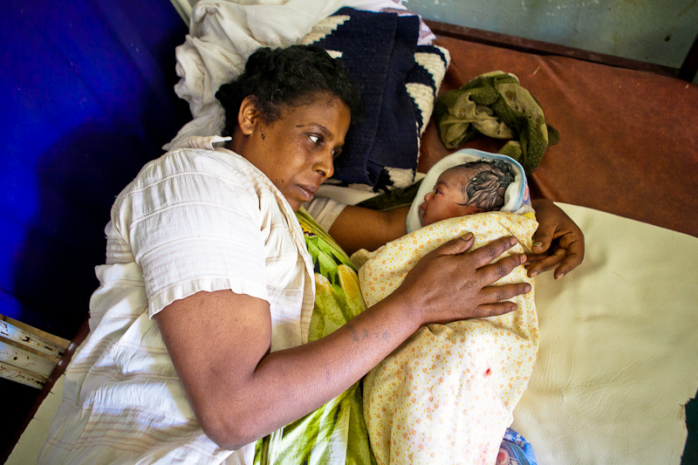
Understanding the mechanisms behind change
Tanya Marchant and Zelee Hill

Slide 27
Key Message
When measuring change in targeted outcomes it is also important for implementation planning to understand why changes do – or do not - occur
ideas.lshtm.ac.uk

Slide 28
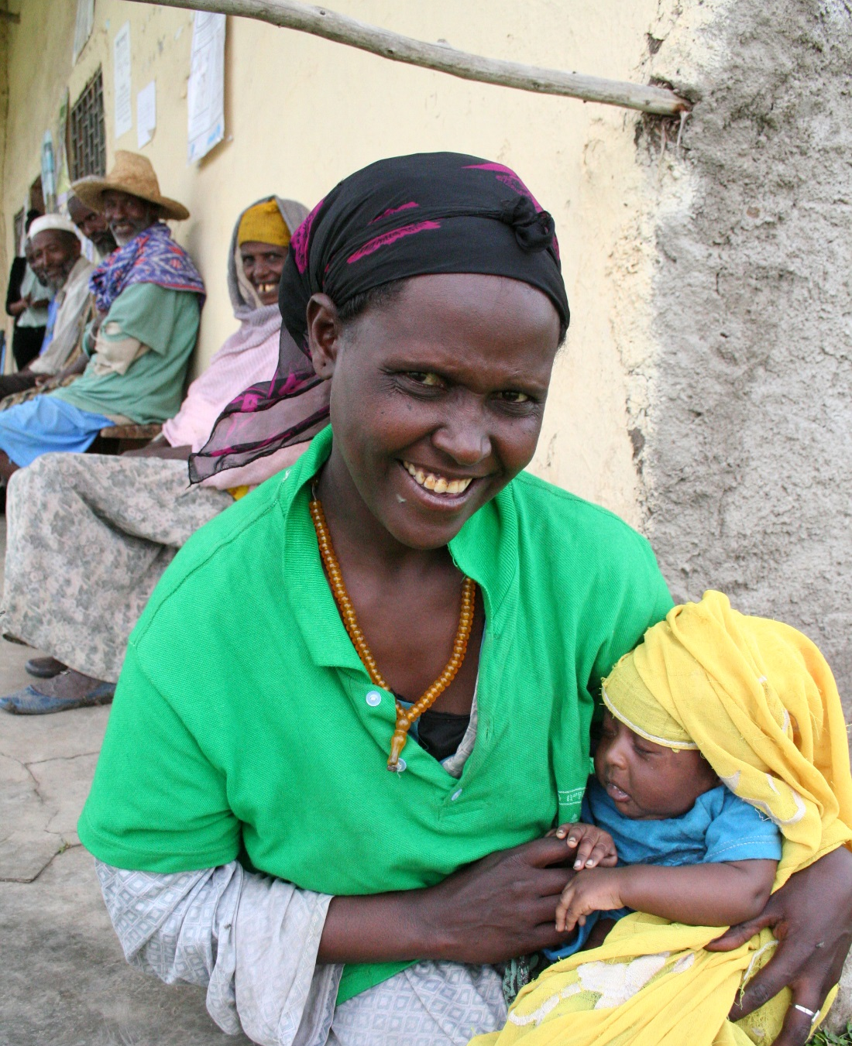
Outline
Using example of postnatal care within two days of birth in Ethiopia, here we present:
  Change in coverage of postnatal care between 2012-2015 in the context of other contact points, and
  Evidence on the mechanisms behind change
ideas.lshtm.ac.uk

Slide 29
Context
The Ethiopian government has prioritised the importance of making home visits to newborns to provide health checks and identify the need for extra care
Community health workers “Health Extension Workers” are trained to make early PNC visits
Community health volunteers “Woman’s Development Army” are trained to help community workers identify deliveries
Projects are working with the government to test innovations that achieve high coverage of postnatal care
ideas.lshtm.ac.uk

Slide 30
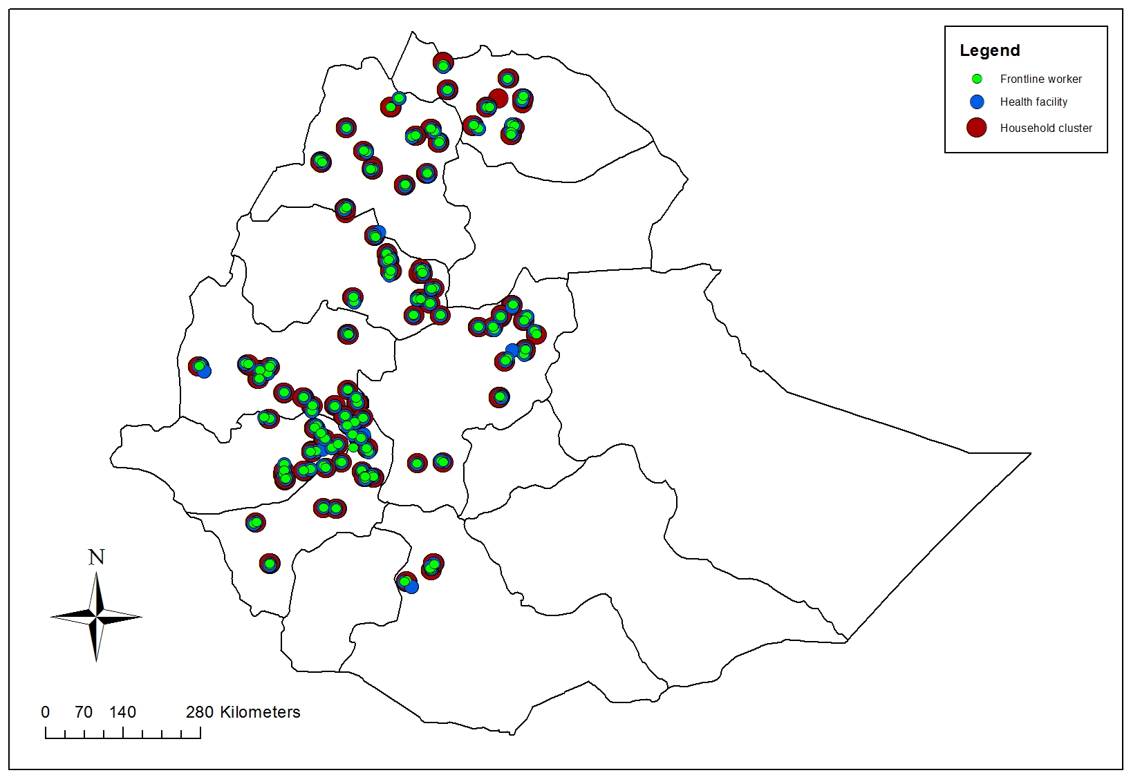
Quantitative methods
Category
Timing | 2012 and 2015
Location | 59 districts, 4 Regions
Survey | Household survey, DHS-type tools
Reference | Births <12 months
2012 sample | 2118 households, 277 women
2015 sample | 3000 households, 404 women
Notes:
Add a household survey picture here or next slide

Slide 31
Results: change in coverage of contacts
Up 17 percentage points for ANC4 (almost doubled)
  Equitable changes
Up 28 percentage points for facility delivery (tripled)
  Equitable changes
No change in PNC despite considerable effort
  No changes for any group
43%
39%
4%
ideas.lshtm.ac.uk
Notes:
Still to add 95% CI to this chart

Slide 32
What was different about postnatal care?
ideas.lshtm.ac.uk

Slide 33
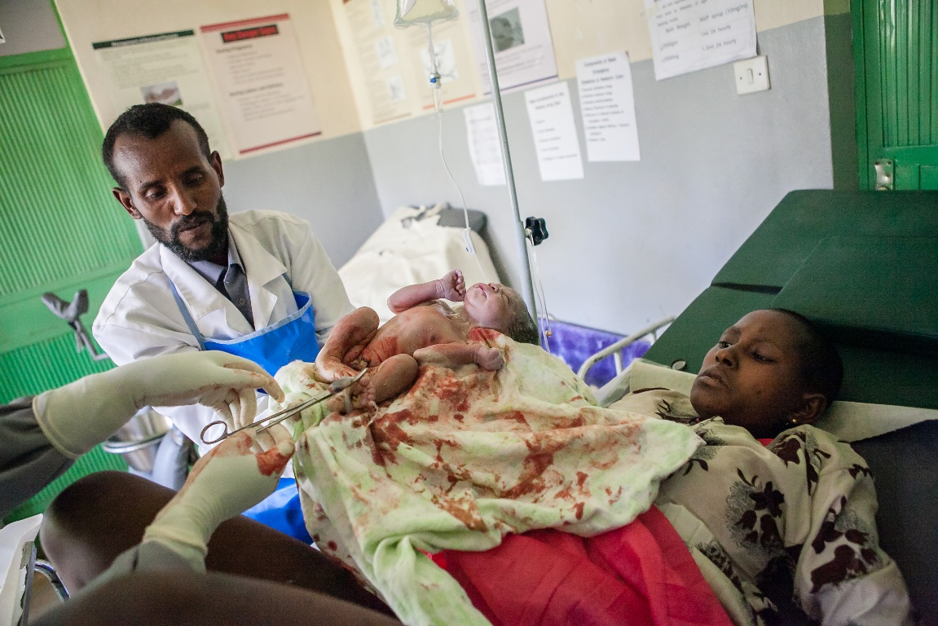
Outline
Using example of postnatal care within two days of birth in Ethiopia, here we present:
  change in coverage of postnatal care between 2012-2015 in the context of other contact points,
  and
  evidence on the mechanisms behind change
ideas.lshtm.ac.uk

Slide 34
Qualitative methods
Category
Location | Two 'typical' Kebeles, Amhara and SNNP regions
Respondents | Recent mothers, grandmothers, fathers, community health workers and volunteers
Methods | Narratives (12), in-depth interviews (13), friendship pair interviews (5) and FGDs (16)
Content | Experiences of PNC visits, including why they did or did not occur and how women were identified
Analysis | Deductive and inductive coding and interpretation
ideas.lshtm.ac.uk

Slide 35
Results
What influences whether PNC visits occur?
Accessibility
CHW knowledge of delivery
Work issues

Slide 36
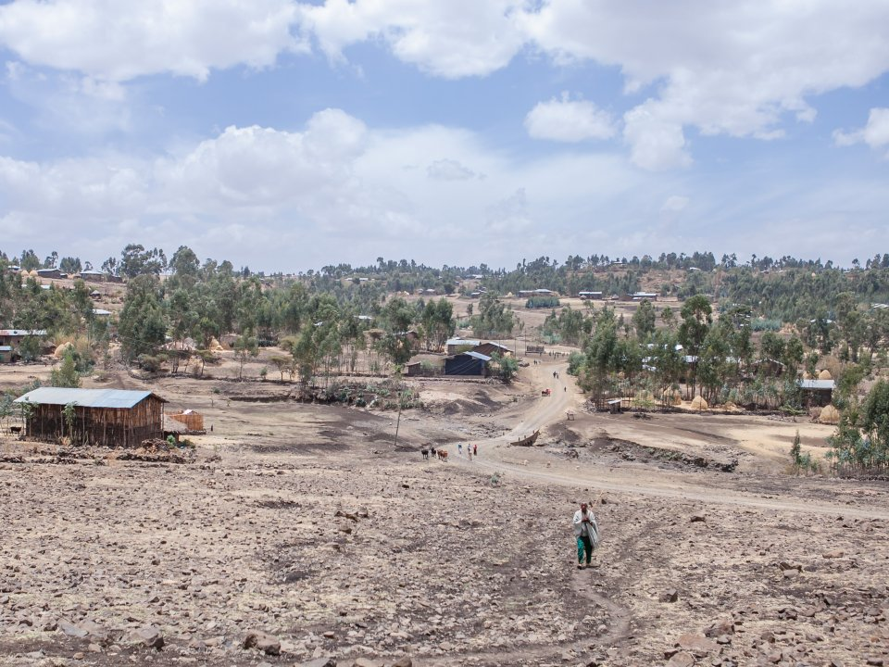
Accessibility
Extreme distances and difficult terrain made visits impossible in some areas
  Flat terrain and having a bicycle offset distance issues
Information and work issues a greater barrier than moderate physical difficulties
‘Some of the places are quite mountainous, and other places can only be accessed using a ladder to descend a ravine….There are places that we can’t access in the wet season…. Those that are nearer are not problematic’ [Amhara, CHW]

Slide 37
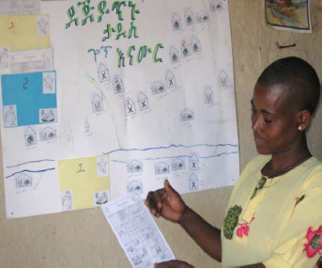
Community worker knowledge of deliveries
  More visits in places where CHW had engaged with families close to the time of the delivery
  More likely in areas where community
  volunteer/CHW information system functioned
      Poor function in less accessible areas, where CHWs relied most on this system, or on proactive mothers
      Poor function if volunteer thought the CHW would not come anyway
‘The problem is that we do not get the feedback through the [volunteers] on time. They have to go a lot of distance …….because of that we visit them after 7 days. So that is our major problem’ [Amhara, CHW]

Slide 38
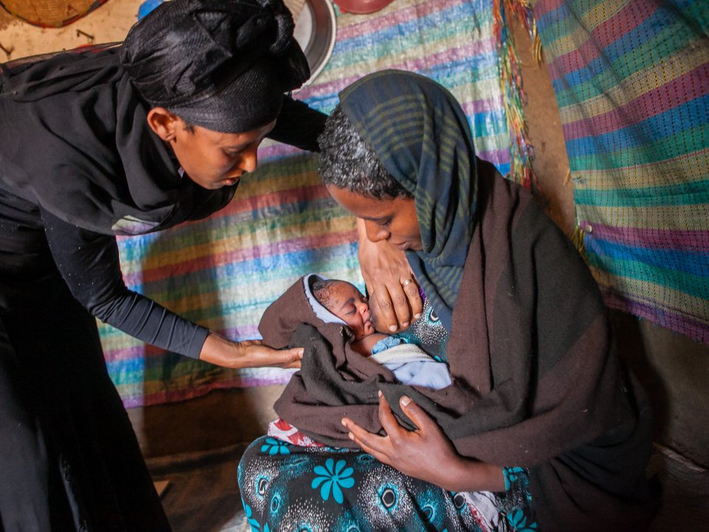
Work issues
  Well organized CHWs had clear strategies for visiting each community
  Many CHWs were unavailable due to competing activities +/- motivation
    Temporary staff and those less connected to
    the community were less active
    Some CHWs relied on volunteers to do community work
    Some CHWs focused mainly on increasing
    facility deliveries
‘There are only two [CHWs]. They have lots of activities, which they are expected to perform. Therefore, they cannot cover all mothers in the three days after delivery’ [SNNPR, Mother]

Slide 39
Interpretation
The understanding gained from this study can enhance plans to improve PNC coverage. It shows:
  importance of realistic workloads and catchment areas
  need to improve the community volunteer/CHW notification system
  need to consider alternative notification systems
  differences between workers suggests that selection and motivation of workers could play a key role in PNC coverage.

Slide 40
Acknowledgements
Ethiopian Government for support
JaRco Consulting for survey implementation and oversight
Y Amare, P Scheelbeek, D Berhanu for qualitative data collection
Bill & Melinda Gates Foundation grantees for support and input
All families and community members interviewed

Slide 41
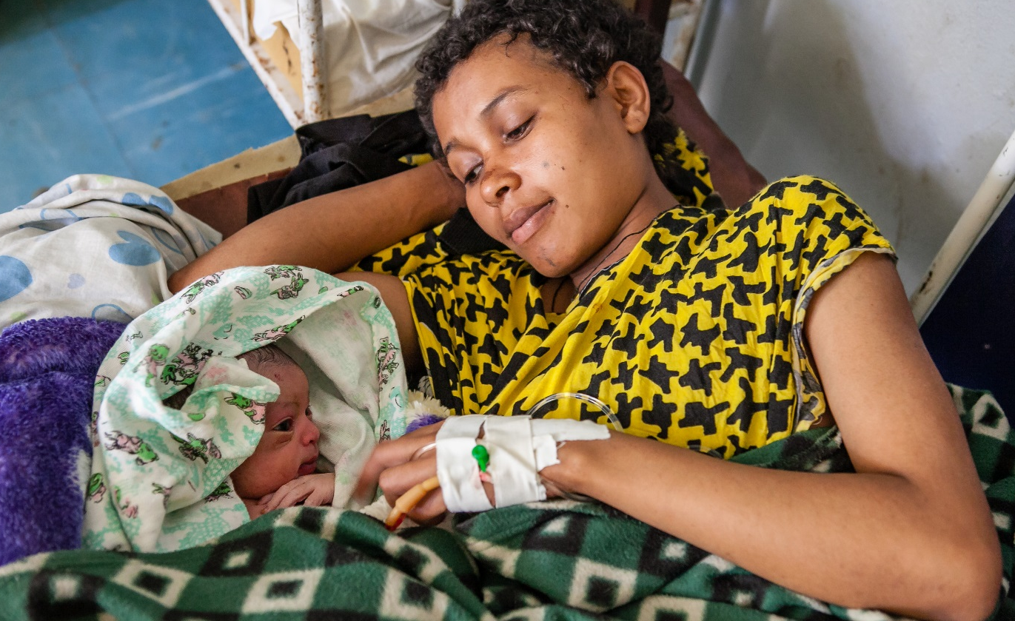
Panel discussion

Slide 42
Scale-up game
In the break: what words or phrases do you think of when considering ‘scale-up’...? Please write them down!
Fantastic prizes!
ideas.lshtm.ac.uk

Slide 43
Innovation effectiveness
Systems readiness
Scalability
Alignment
Evidence
Coverage
Diffusion
Powerful individuals
Passion
Vision
Government ownership
Flexibility
Donor harmonisation
Trust
ideas.lshtm.ac.uk

Slide 44

Scaling up innovations: how and why does scale-up happen?
Neil Spicer

Slide 45









Key message
Scale-up is an art not a science: multiple factors influence scale-up beyond developing a strong innovation and having evidence of its impacts
ideas.lshtm.ac.uk

Slide 46
Outline
Study design and definitions
Key messages from the study (1) - implementer actions to catalyse scale-up
Key messages from the study (2) – donor actions to catalyse scale-up
ideas.lshtm.ac.uk

Slide 47
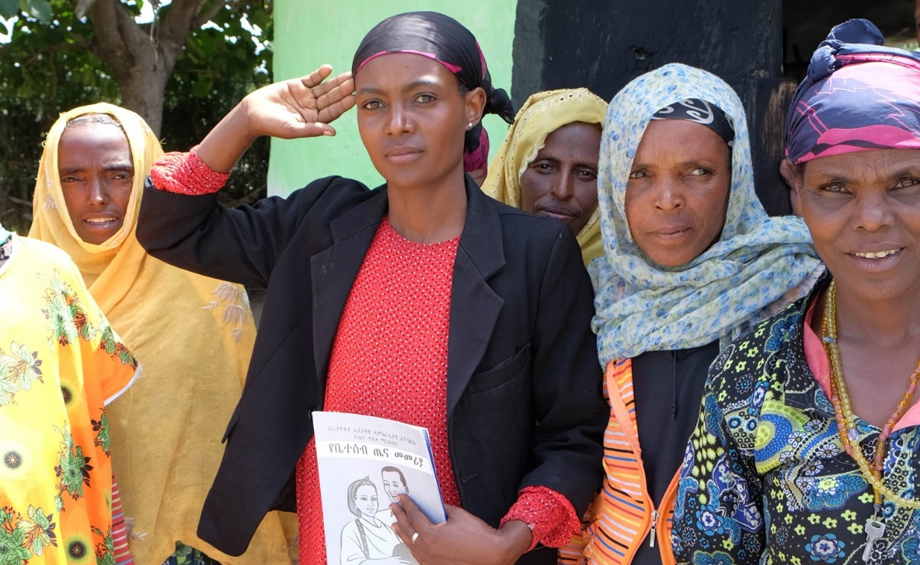
Study design and definitions

Slide 48
Aims
To understand how to catalyse scale-up of externally funded MNH innovations
To identify contextual and health systems factors influencing innovation scale-up
In-depth qualitative interviews
  150 (2012/13) and 60 (2014/15) in Ethiopia, Nigeria, India, UK, USA
  Stakeholders in MNH: government; development agencies; implementers; professional associations; academics/experts; frontline workers
Qualitative study design
ideas.lshtm.ac.uk

Slide 49
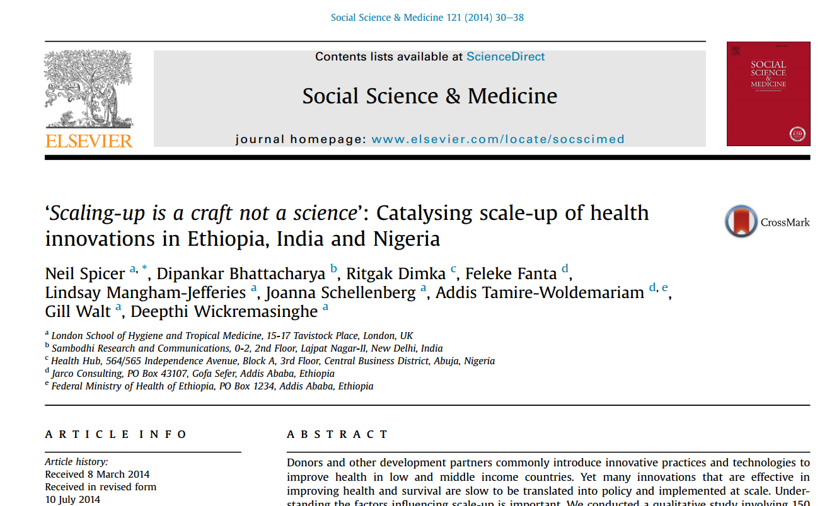
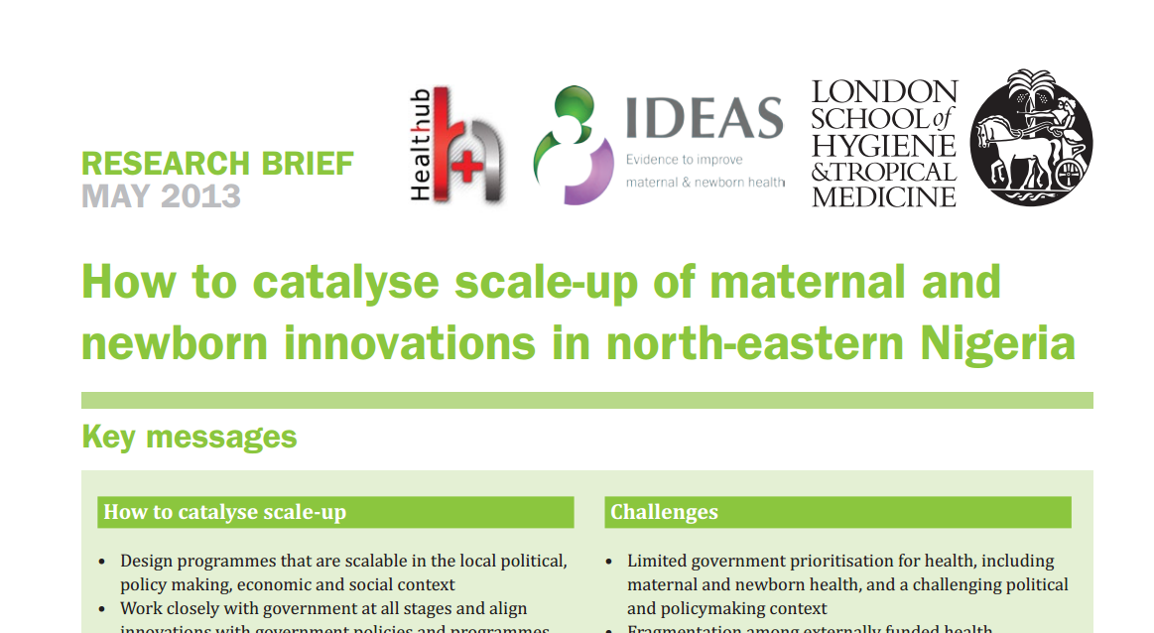
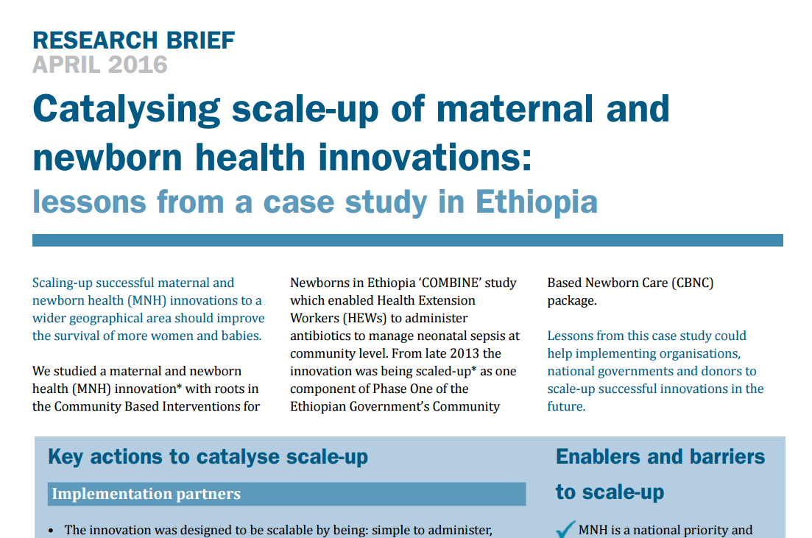
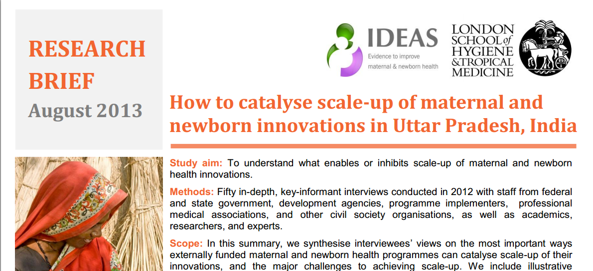
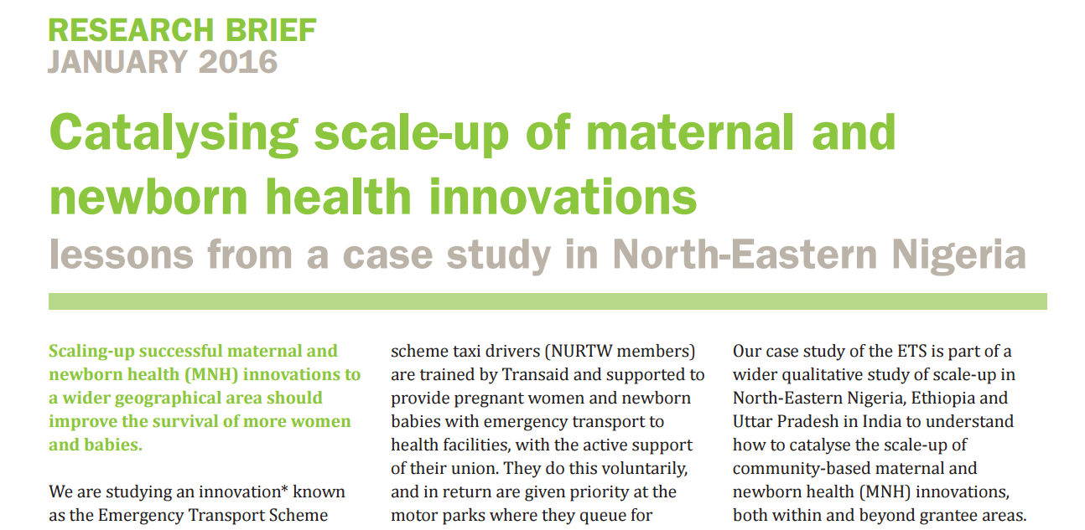
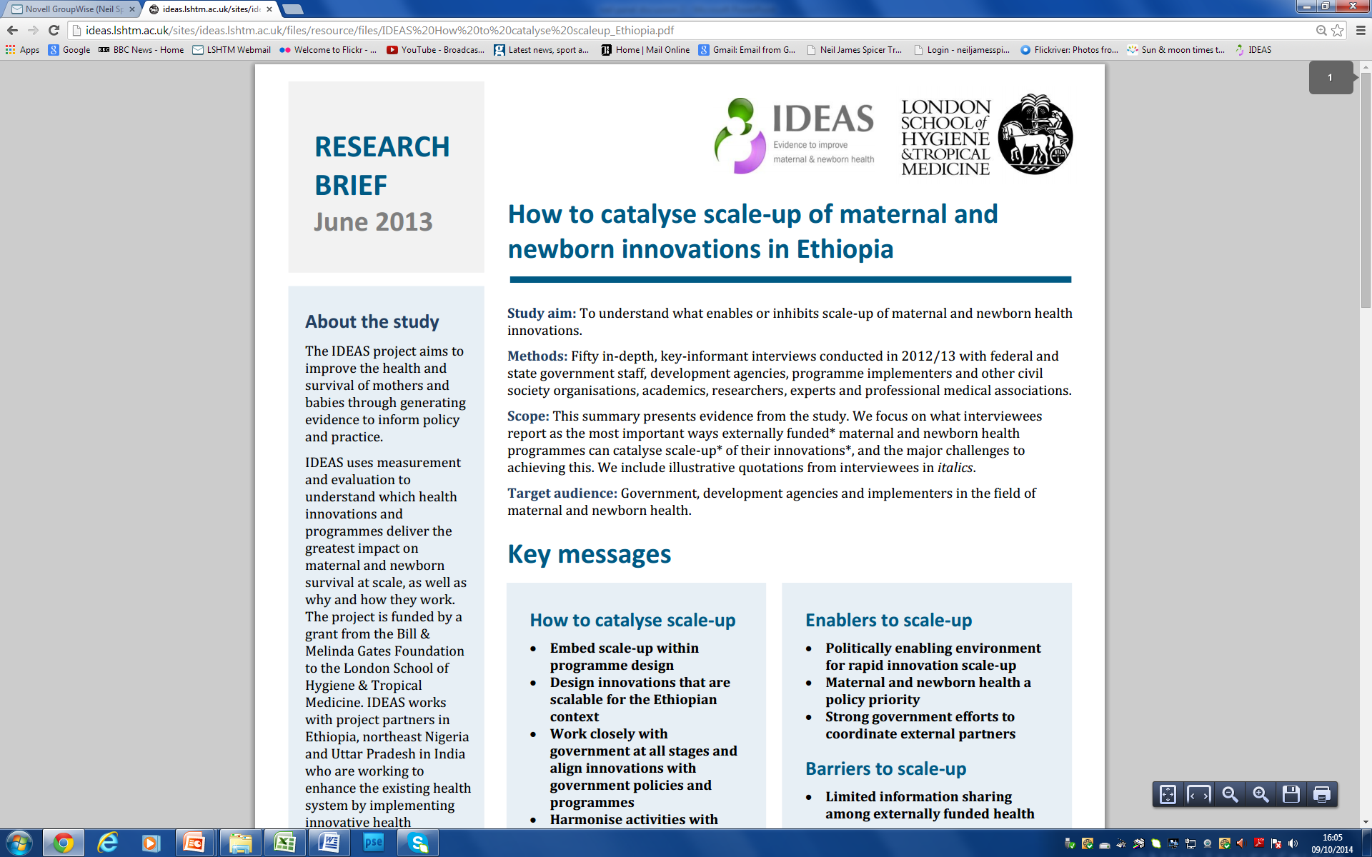

Slide 50
What do we mean by scale-up?
Adoption of externally-funded health innovations by government or other actors to increase geographical reach and to benefit a greater number of people beyond externally funded implementers’ programme districts
ideas.lshtm.ac.uk

Slide 51
What do we mean by scale-up?
Adoption of externally-funded health innovations by government or other actors to increase geographical reach and to benefit a greater number of people beyond externally funded implementers’ programme districts
ideas.lshtm.ac.uk

Slide 52
Gates-funded MNH
innovations successfully
scaled:
Ethiopia: Saving Newborn Lives sepsis case management by CHWs
  Scaled as: component of government flagship programme
  Funded at scale: donor contributions to government budget
NE Nigeria: Emergency Transport Scheme
  Scaled as: programme in additional state of Nigeria
  Funded at scale: UK charity Comic Relief
Uttar Pradesh: mSakhi smart phone app for CHWs
  Scaled as: influenced and informed state government m-health platform in 5 districts
  Funded at scale: state resources

Slide 53
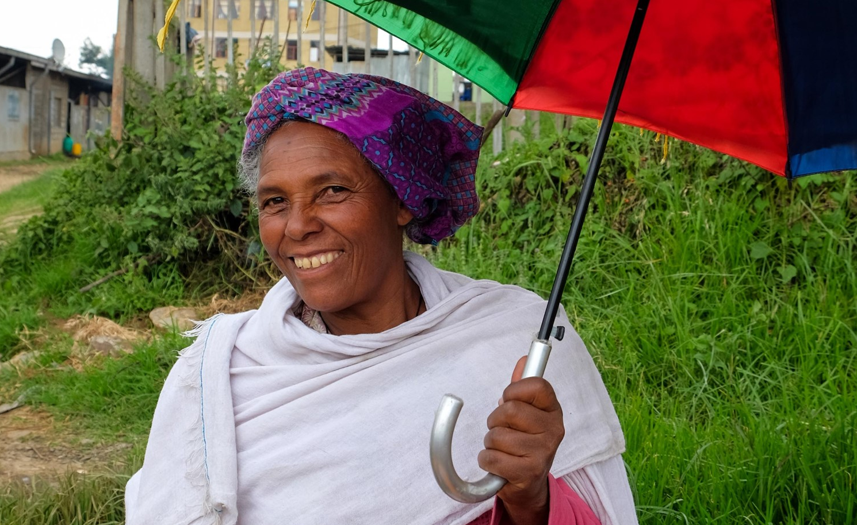
Key messages:
Implementer actions

Slide 54
Six ‘critical’ implementer actions to catalyse scale-up
1 Evidence: building a strong evidence base
Quantitative impacts data, qualitative operational lessons, cost/cost effectiveness data, synthesising secondary data
  Influence decision to scale-up
  Inform how to implement at scale
Decisions to scale not always based on quantitative impacts data – ‘experiential’ evidence powerful: ‘...take decision makers to the field...this way we get emotional buy-in’
2 Power of individuals: backing of well-connected advocates and government personalities more critical than formal government engagement: ‘If you ask me any single thing I think it’s [this person’s] vision, passion and belief - one [person] can make a difference!’
ideas.lshtm.ac.uk

Slide 55
3 Prepared and responsive: preparing for scale-up important - assessing context, developing advocacy plans but...
Flexibility to respond to changes in policies and officials
Acting when policy context is supportive – political support and systems readiness: ‘[Events came together] in a certain pivotal moment where the Ministry decided there’s going to be a policy shift...’
4 Continuity: implementer supporting transition to scale
  Participating in designing and developing scaled programme
  Feeding in operational evidence and project resources - training manuals, monitoring tools
  Harnessing experience of project staff: ‘…who else has any experience of these things? So obviously the implementer brings a lot to the consortium – a lot of on the ground experience...’
ideas.lshtm.ac.uk

Slide 56
5 Aid effectiveness:
Country ownership: government must fully own the innovation: ‘It’s not about ad hoc engagement. It’s government owning the programme… government accountability with partner support...’
Alignment: innovation closely fits with country priorities, programmes and targets
Harmonisation: coordination among donors/implementers
  Coordinating communication vs. fighting for government attention
  Exchanging learning to strengthen innovations: ‘Everybody talks of scale-up, of collaboration, of working in silos… But we do the opposite... if there are two donors and two projects they won’t share information…’
ideas.lshtm.ac.uk

Slide 57
6 Scalability: designing innovations to be scalable : ‘...if you plan scale-up when your pilot’s over there are many things you can’t go back and correct… if you have scale-up in mind from the beginning you plan for that…’
Effective
Observable effects/impacts
Comparative advantage over alternatives
Simple
Easy to use by health workers
Low cost/cost effective and low human resource inputs
Acceptable
Meets needs and priorities of health workers and communities
Incentivises health workers: non-burdensome, financial incentives, status, confidence, satisfaction
Culturally acceptable in context
Adaptable across diverse geographic contexts
Aligned
Builds on existing health policies and systems
ideas.lshtm.ac.uk

Slide 58
…but difficult to design innovation that is effective/ impactful and scalable: ‘Most innovations succeed in their pilot phase because of intensive resources and a determined view of recording a success story...’
ideas.lshtm.ac.uk

Slide 59

Key messages:
actions for donors

Slide 60
Six ‘critical’ donor actions to catalyse scale-up
    Evidence
    1. Support implementers to generate strong evidence
    Prepared and responsive
    Incentivise implementers to integrate scale-up within project plans
    Allow flexibility in implementer project plans to respond to policy change
    Continuity
    Support implementers through transition to scale period
    Aid effectiveness
    Embrace government-led donor coordination mechanisms
    Direct involvement in fostering country ownership and harmonisation: ‘Usually donors give money and you deliver the deliverables. But this was different – [the Program Officer] engaged in the MoH and in bringing grantees together...’
ideas.lshtm.ac.uk

Slide 61
Scaling-up is a art not a science….
‘The policy breakthrough is never the data, the findings themselves... it’s the trust, the relevance, it’s being at the table, being able to show you support implementation... you also need the right time – you cannot push a policy breakthrough when the system is not ready’
ideas.lshtm.ac.ukc

Slide 62
Acknowledgements
Research partners:
Sambodhi (Uttar Pradesh, India): Kaveri Haldar, Varun Mohan
Childcare & Wellness Clinics (northeast Nigeria): Yashua Alkali Hamza;
Alero Babalola-Jacobs; Chioma Nwafor-Ejeagba
Jarco (Ethiopia): Feker Belete, Feleke Fanta
IDEAS team including:
Deepthi Wickremasinghe
Dr Meenakshi Gautham
Dr Nasir Umar
Dr Della Berhanu
Interview participants in India, Nigeria, Ethiopia, USA and UK
ideas.lshtm.ac.uk

Slide 63
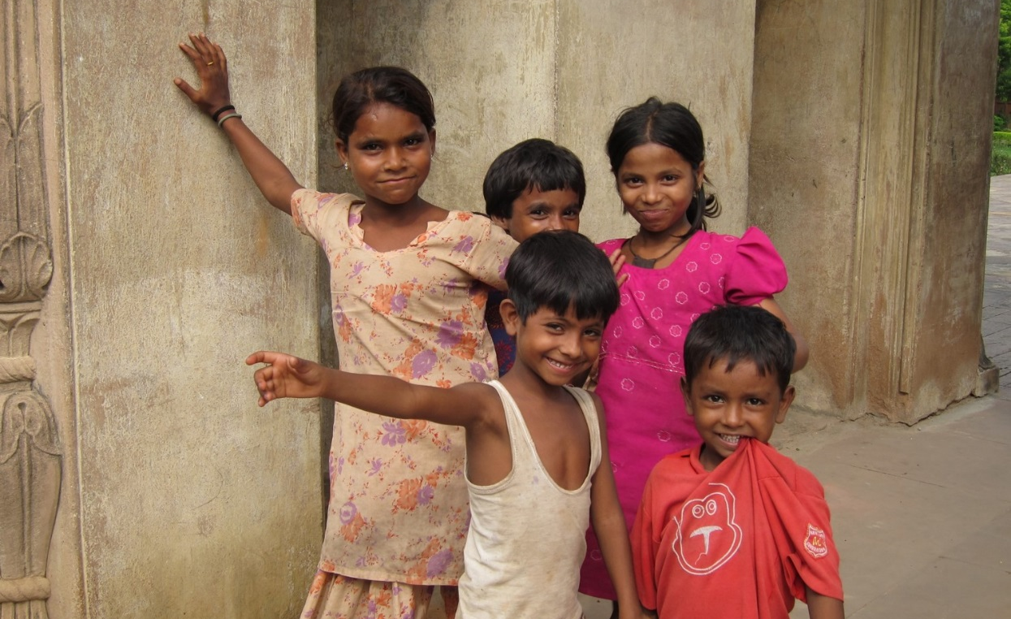
Thank you

Slide 64
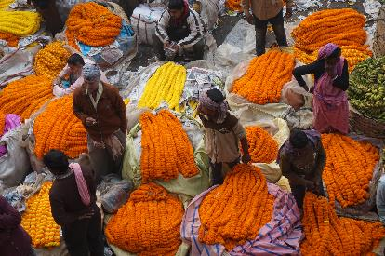
Scale up & district level decision making
Bilal Avan
Notes:
In the context of actionable measurement< Krystyna presented a framework to understand what being implemented, and what changes are expected as a result.
Tanya – once we know the details of what is being implemented we want to apply that knowledge to measure changes, and understand the mechanisms driving change.
Neil – building on characterising innovations and measuring change, we also need to understand how to enable scale up of innovations
Bilal – building on characterising innovations and enabling their scale up it is essential to think about how local systems can sustain implementation at scale.
Krystyna – for actionable measurement to work we first need to know what is being implemented, and what changes are expected as a result.
Tanya – once we know the details of what is being implemented we want to apply that knowledge to measure changes, and understand the mechanisms driving change.
Neil – building on characterising innovations and measuring change, we also need to understand how to enable scale up of innovations
Bilal – building on characterising innovations and enabling their scale up it is essential to think about how local systems can sustain implementation at scale.

Slide 65
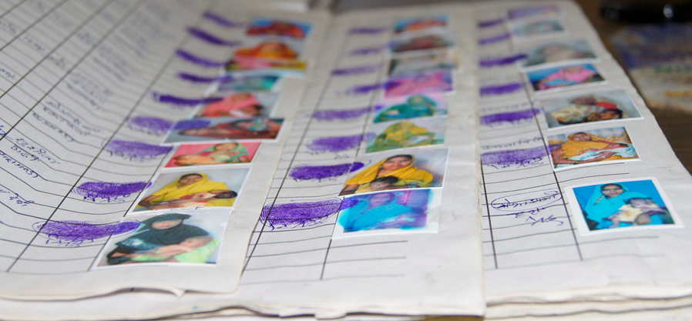
Presentation
Background work
Structured Decision Making
Data-Informed Platform for Health (DIPH): Proof-of-principle project

Slide 66
Background work

Slide 67
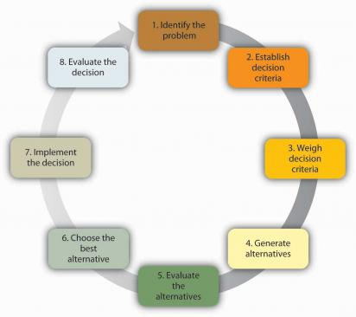
Structured decision making
Structured decision making and health system thinking?

Slide 68
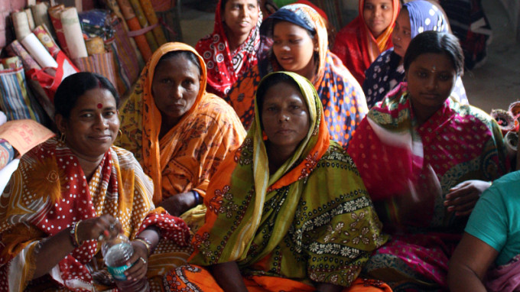
Data-Informed Platform for Health (DIPH)
Enhancing interaction among district-level health personnel and linkage of databases to improve coordinated decision making and planning
To strengthen health systems through capacity-building and effective use of data for decision-making
ideas.lshtm.ac.uk
Notes:
Emphasis integration across grants
Emphasis scale
Explain who the grantees are

Slide 69
DIPH in West Bengal, India
Formative
Pilot implementation
&
Evaluation
Scale-up
Evaluation
2015-17
IDEAS Phase-I
2017-20
IDEAS Phase-II
ideas.lshtm.ac.uk

Slide 70
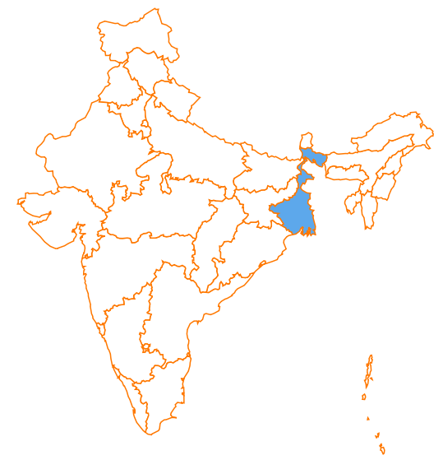
DIPH setting: West Bengal, India
Two districts:
North 24 Parganas South 24 Parganas
Population:
18 million
West Bengal State Government keen
to implement learning at scale
ideas.lshtm.ac.uk

Slide 71
Data-Informed Platform for Health
What were we trying to accomplish?
To test out and refine a standardised process of structured decision-making at the district level, including appraisal and course correction of MNH services
What did we do?
Form a core working team: district administration and Health Department
Facilitate district administration with:
  DIPH quarterly meetings at the District Health & Family Welfare Society
  Ongoing support on effective use of data for planning MNCH services and course correction
ideas.lshtm.ac.uk

Slide 72
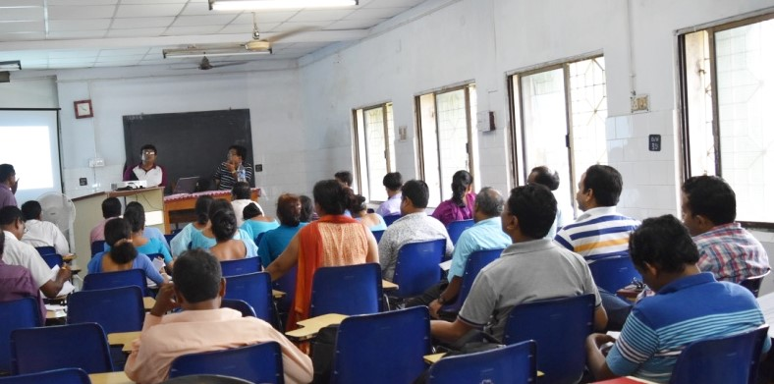
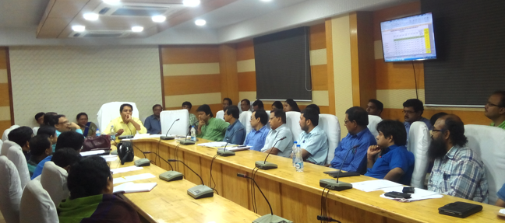
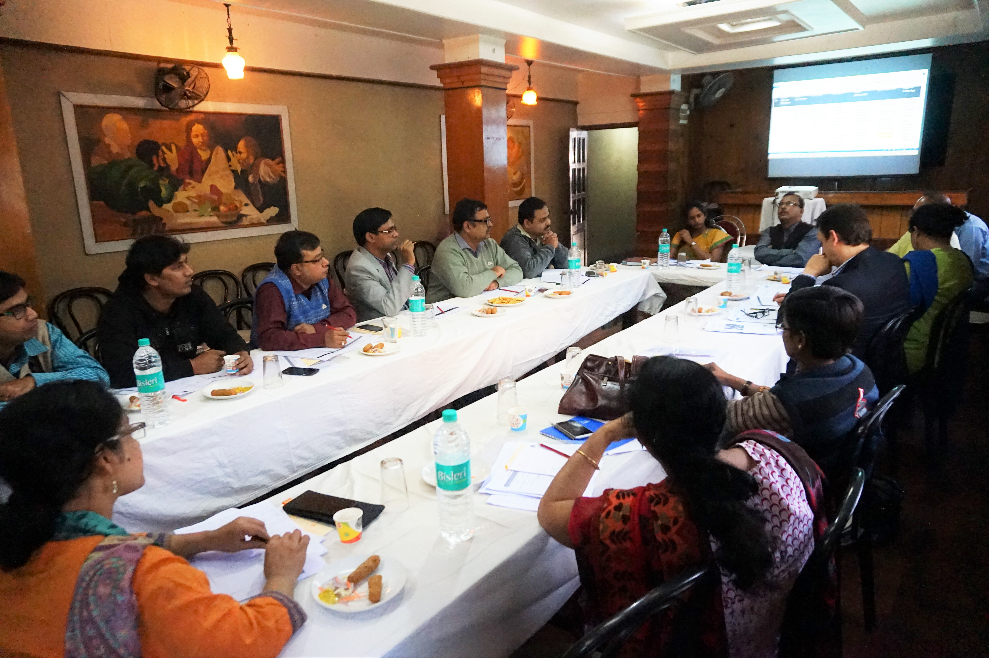
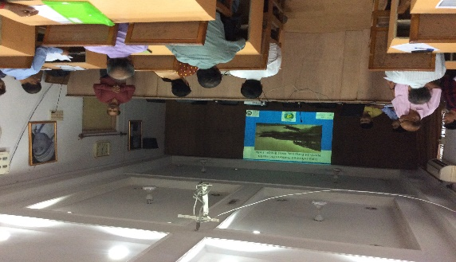
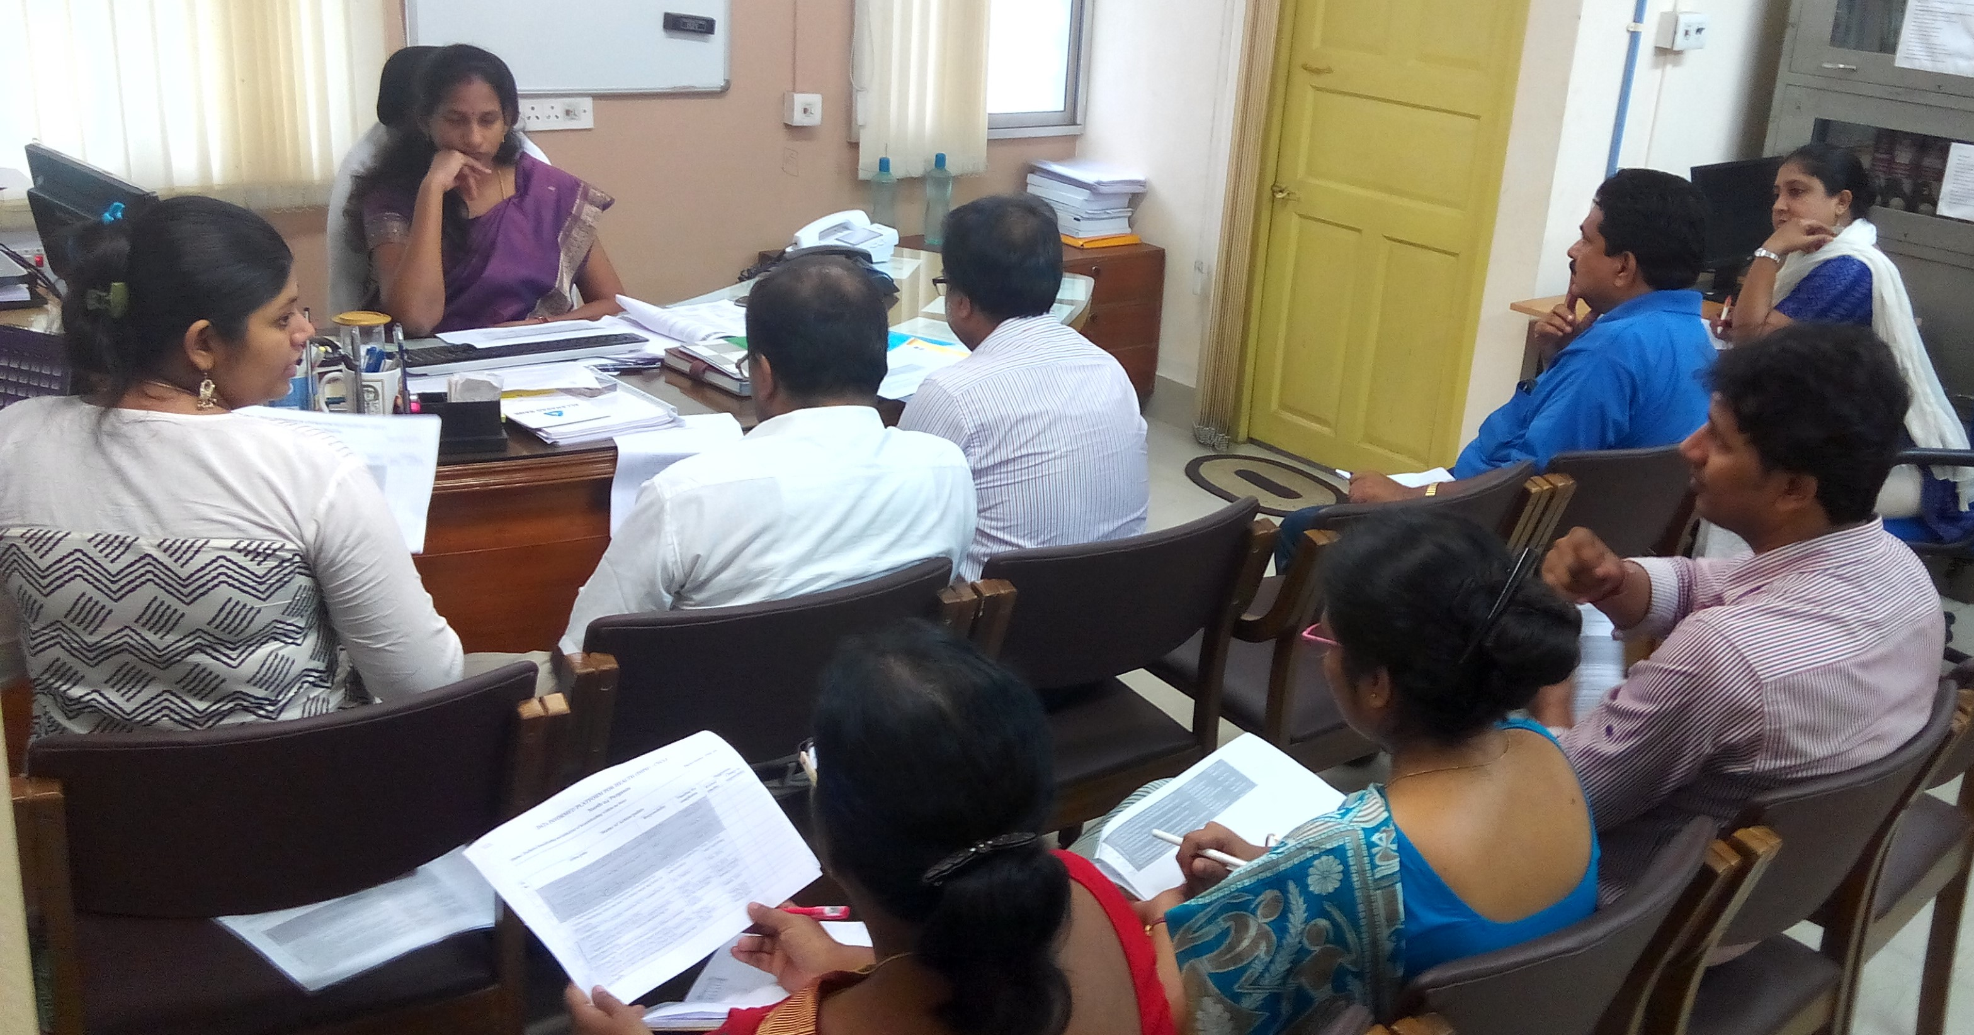
Steps of a DIPH cycle
1.Assess
2.Engage
3.Organise
4.Action
5.Follow-up

Slide 73
Operationalisation
Example of a DIPH cycle: IPH cycle (Apr – Jun 2016) Theme : Antenatal care
1.Assess
2.Engage
3.Organise
4.Action
5.Follow-up
- Situation analysis team
- Finalised theme objective: “Increase in 3 antenatal visits and improvement in tracking of 4th antenatal visits”
Total additional 4 meetings
- 13 action points:
7 completed,
3 on-going &
3 not started
- Multi stakeholder participation
- District Maternity & Child Health Officer selected as theme leader.
DIPH platform
Prioritize the action points
- Responsibilities assigned
-10 actions points
- 13 actionable solutions

Slide 74
Data-Informed Platform for Health
Web-based interface
ideas.lshtm.ac.uk

Slide 75
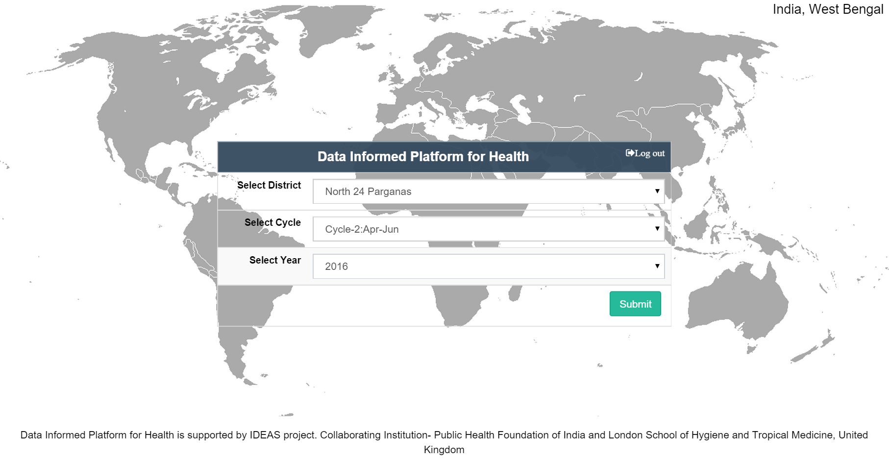

Slide 76
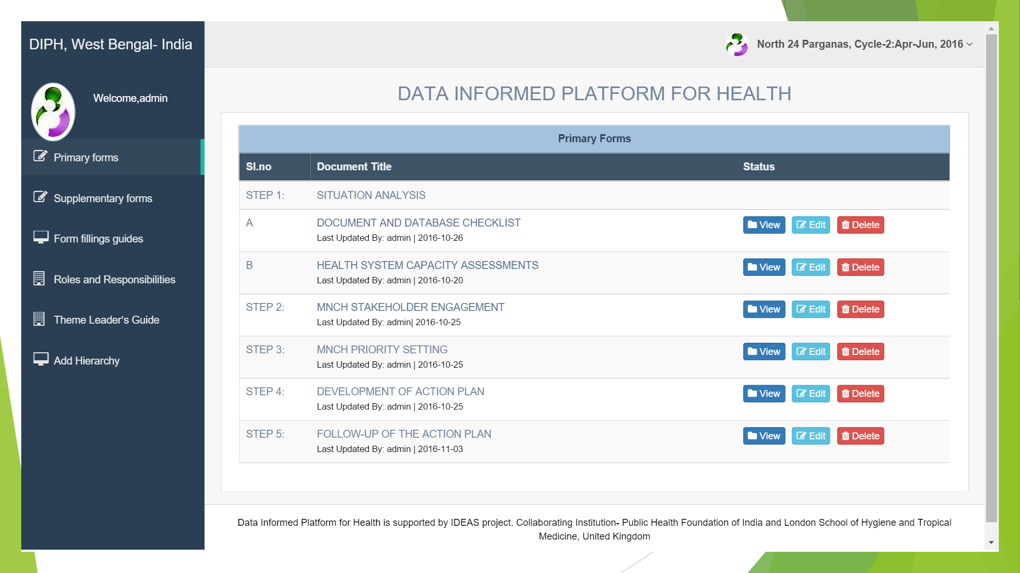

Slide 77
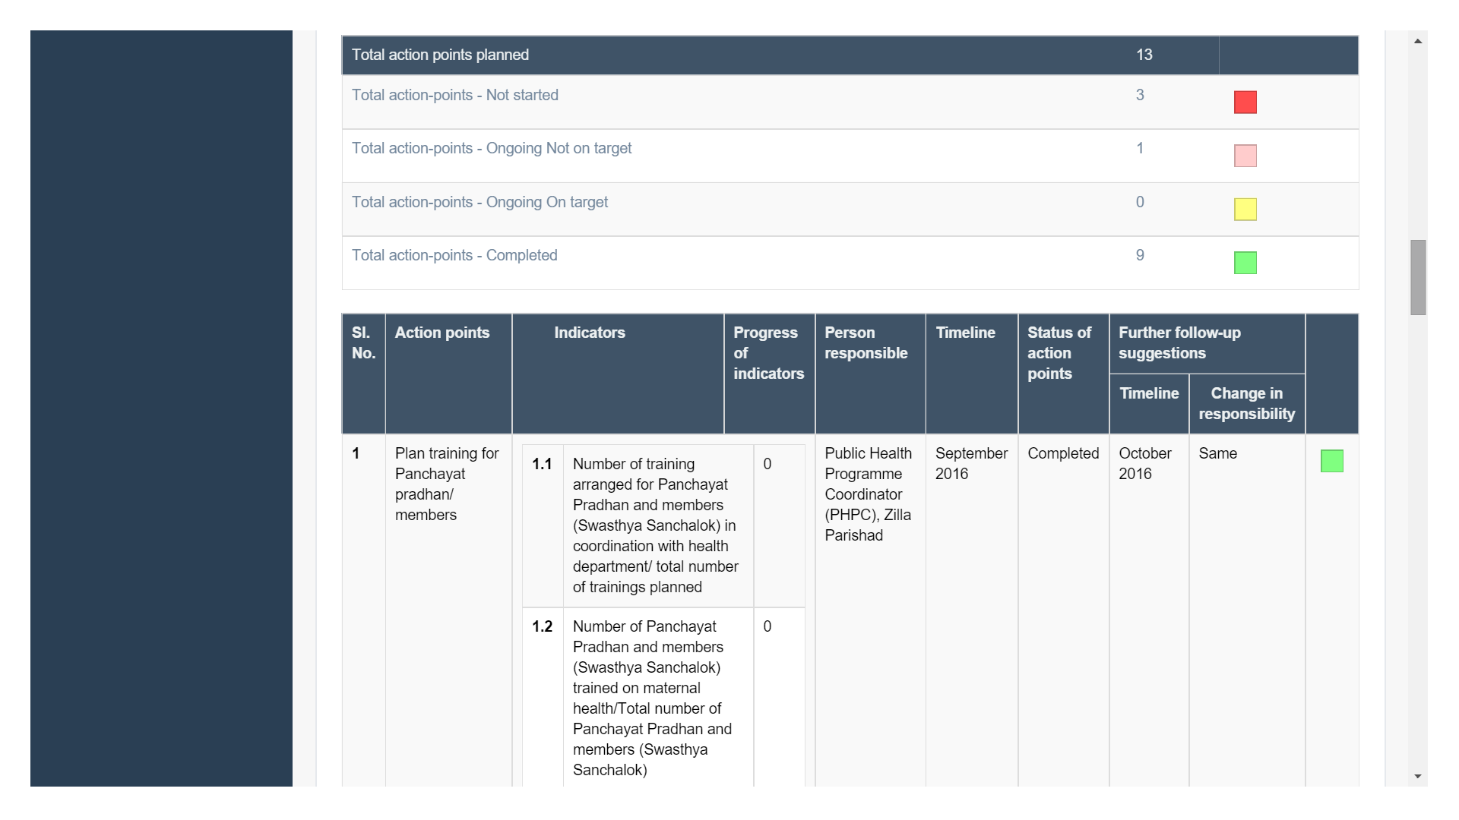

Slide 78
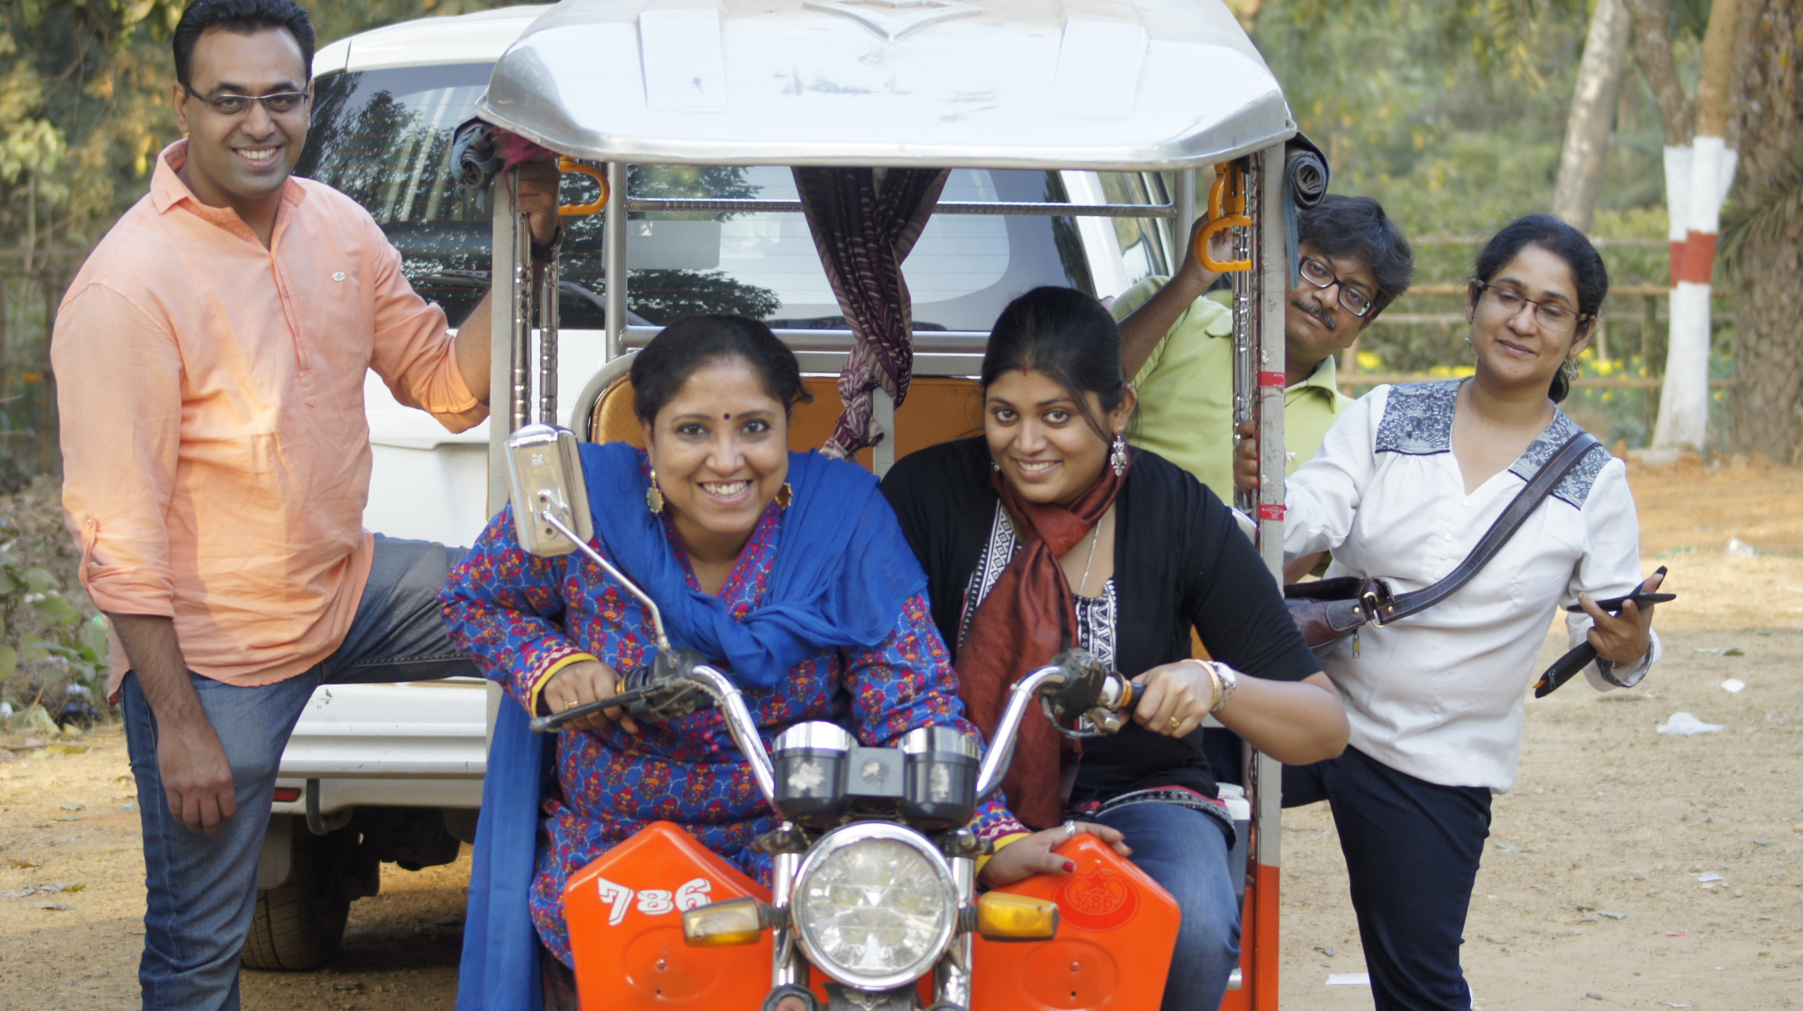
Acknowledgements
Country team (India – PHFI): Dr Sanghita Bhattachyra
State Partners (West Bengal): State Ministry of Health & University of Health Sciences
Digital interface team: Tattva Foundation
Notes:
Emphasis integration across grants
Emphasis scale
Explain who the grantees are

Slide 79
Thank you
Notes:
Emphasis integration across grants
Emphasis scale
Explain who the grantees are

Slide 80
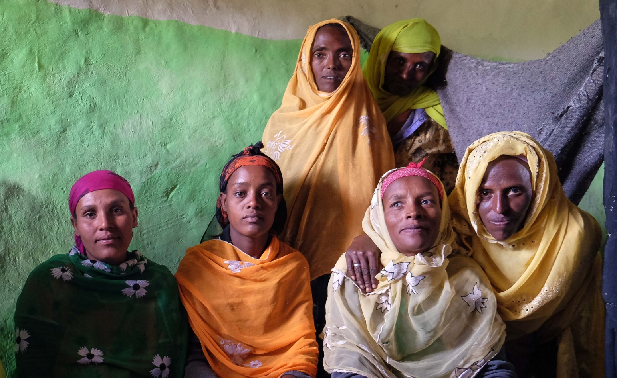
Panel discussion

