Slide 1

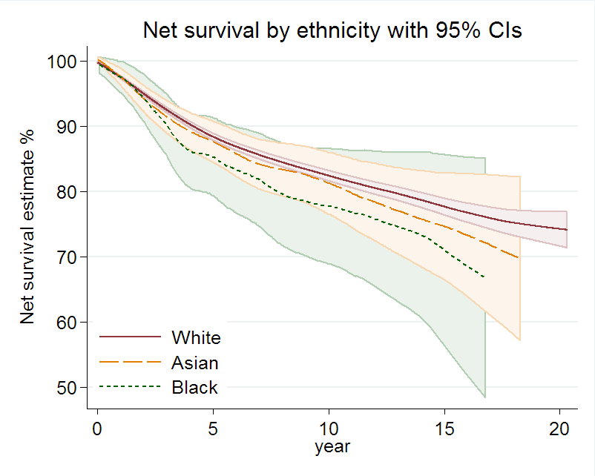
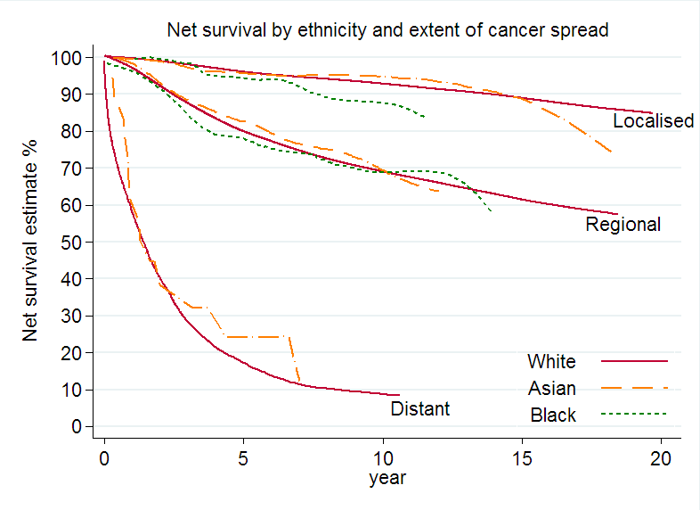
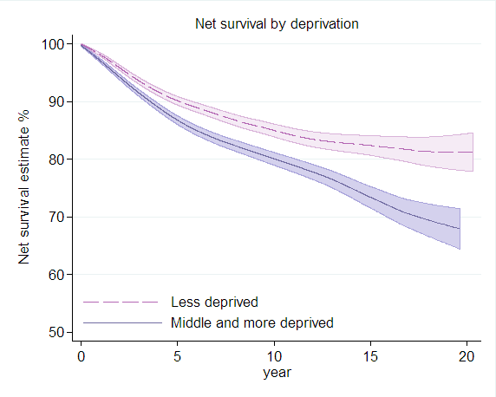
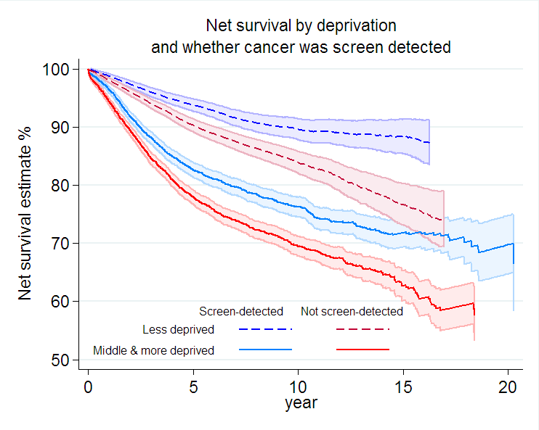
Ethnicity, deprivation and screening: an analysis of survival from breast cancer in the West Midlands
Melanie Morris¹, Laura M Woods¹, Nicola Rogers², Emma O’Sullivan², Olive Kearins², Bernard Rachet¹
¹Cancer Research UK Cancer Survival Group | London School of Hygiene & Tropical Medicine | London | www.lshtm.ac.uk
²West Midlands Breast Screening Quality Assurance Reference Centre, Public Health England
Introduction
There are social inequalities in breast cancer survival with those in more deprived and Black ethnic groups having lower survival.
These differences might be smaller when the cancer is
screen-detected.
We used linked data and new analytic techniques to investigate survival differences amongst women with screen-detected and non-screen-detected breast cancer, by ethnicity and deprivation.
Methods
Data
West Midlands Breast Screening Quality Assurance Reference Centre supplied linked data from the cancer registry, National Breast Screening Service, Hospital Episode Statistics and ONS:
  tumour factors (stage, morphology)
  patient characteristics (age, deprivation, ethnicity)
  treatment
  screening history
  inpatient stays up to 18 months before diagnosis
  vital status, date of death
Cohort
20,283 women diagnosed with breast cancer, aged 50 to 70 years
  continuously eligible for screening
  diagnosed between 1989 and 2011, followed up to 2012
  ethnicity 90% complete, last 10% imputed using name recognition software
Analyses
Net survival
  estimated using ‘stns’ command in STATA
  corrected for expected survival with deprivation- and
  ethnic-specific life tables
Estimates adjusted for lead-time bias and overdiagnosis
Results
Little evidence was found for differences in survival by ethnic group, and by extent of disease:
Screening gave a similar survival benefit to all women, regardless of their ethnic group:
Confidence intervals (shaded areas) are shown for illustration in the first graph. Where they fully overlap, it shows that there is no statistical difference between the groups. They are omitted from subsequent graphs in which they fully overlap, for clarity.
There was a clear difference in survival by deprivation. This was evident for both screen-detected and non-screen-detected women. The survival gaps widen with longer survival times.
At five years, there was a 16% difference in survival between the less deprived women whose cancer was screen-detected (94.1%) and the more deprived women whose cancer was not screen-detected (78.0%).
 | 5 year net survival (95% confidence interval)
 | Less deprived | Mid/more deprived
Screen- detected | 94.1% (93.1%-95.1%) | 90.2% (89.1%-91.4%)
Not screen- detected | 82.7% (81.4%-83.9%) | 78.0% (76.7%-79.3%)
Conclusions
There was a heartening lack of difference in net survival from breast cancer between the three main ethnic groups.
Screening conferred a survival benefit to all but there were still wide disparities in survival by deprivation.
Further research should examine how much of the observed
socio-economic survival differentials are explained by later diagnosis, and how much by less effective post-diagnostic management.
Contact: melanie.morris@lshtm.ac.uk
Project funded by the National Awareness and Early Diagnosis Initiative: a partnership between Cancer Research UK; Department of Health England; Economic and Social Research Council; Health & Social Care Research and Development Division, Pubic Health Agency, Northern Ireland; National Institute for Social Care and Health Research, Wales; and the Scottish Government. www.naedi.org.uk

