Slide 1
Impact evaluation of public health strategies in low and middle-income settings Measuring implementation strength: why and how?
Joanna Schellenberg, Catherine Goodman, Bilal Avan,
Calum Davey, James Hargreaves

Slide 2
Outline
Context
Problem
Three published examples
Evaluation design options
Logic models and implementation strength
Advantages and challenges
Summary

Slide 3
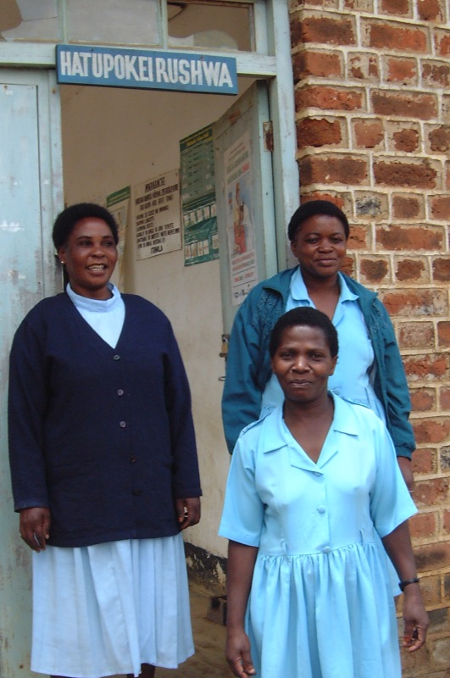
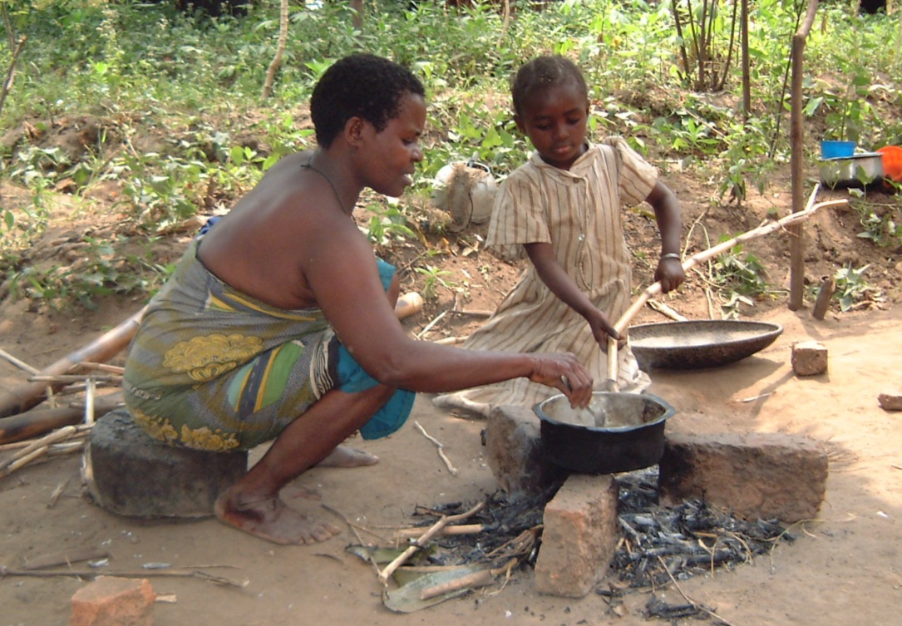
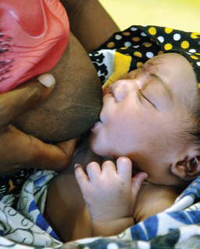
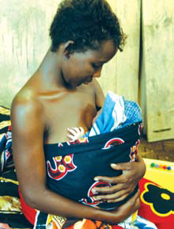
Context
Low-income settings
Essential behaviours and interventions are known, but how to deliver them at scale is not … examples:
Hygiene during childbirth
Breastfeeding within 1 hour of birth
Skin to skin care for low birthweight babies
Evaluation of public health strategies

Slide 4
Problem
Which packages of individual evidence-based interventions can be delivered at scale?
How to optimise these packages in a new setting?
To what extent do these result in public health gains?

Slide 5
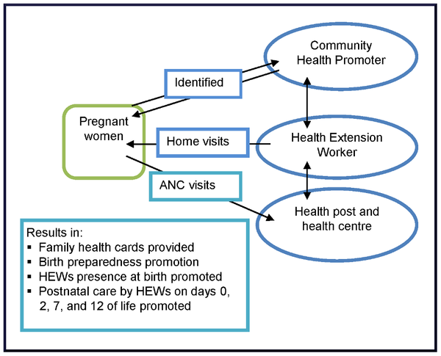
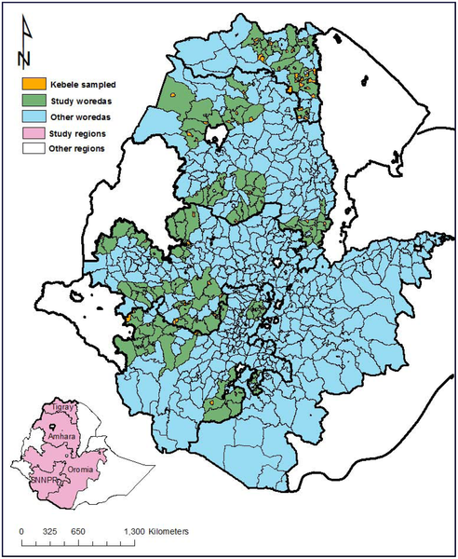
Example 1: Maternal & newborn care services provided through Ethiopia’s health extension programme
Karim et al http://www.plosone.org/article/info:doi/10.1371/journal.pone.0065160

Slide 6
Example 2: India’s Avahan HIV prevention programme
Aim: reduce transmission of HIV through increased coverage of preventive interventions in high-risk groups
2003 to 2008, $258 million from Bill & Melinda Gates Foundation
Female sex workers, clients and partners; Injecting drug users; Truck drivers.
Safe-sex counselling through peer outreach; treatment of sexually transmitted infections; distribution of free condoms; needle and syringe exchange; and advocacy and community mobilisation.
Delivered by non-governmental and community-based organisations, co-ordinated by seven state level implementing partners and a central capacity-building and quality assurance team
Ng et al. http://www.thelancet.com/journals/lancet/article/PIIS0140-6736(11)61390-1/abstract

Slide 7
Example 3: Affordable medicines facility for malaria (AmFm)
2010: Global Fund to Fight AIDS, Tuberculosis and Malaria launched 8 national scale pilots to increase access to and use of quality-assured artemisinin based combination therapies (ACTs) for malaria control
Ghana, Kenya, Madagascar, Niger, Nigeria, Tanzania mainland, Uganda and Zanzibar
Three key components
Manufacturer price negotiations
Factory gate price subsidies
Supporting interventions e.g. communications campaigns
Tougher et al, http://www.thelancet.com/journals/lancet/article/PIIS0140-6736(12)61732-2/abstract

Slide 8
Impact evaluation design options
Randomised controlled trial?
Relatively high internal validity & low external validity
Rarely feasible for large scale public health programmes
Plausibility* design?
Before/after, intervention/comparison (difference in differences)
Comparison areas may differ from intervention areas in important ways
Comparison areas may have other public health programmes ongoing that affect the outcomes
In reality, implementation varies over time and space…
Association between implementation strength and a change in outcomes may strengthen the evidence that a change in outcomes is due to the public health programme
Dose-response analysis
Adjust for confounders
*Habicht et al IJE 1999

Slide 9
Ethiopia health extension programme evaluation
Inputs | Processes | Outcomes | Impact
Health extension programme services | Home visits Health card ownership Model families | Initiating breastfeeding immediately after birth (and many others) | Newborn survival
Did changes over time in maternal and newborn care practices vary by the intensity of the health extension programme’s activities?
Before-after comparison in 101 woredas (districts)
Implementation strength expressed as ‘programme intensity’
Measure of exposure to the health extension programme services

Slide 10
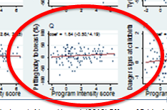
Ethiopia health extension programme evaluation: results
Mothers who initiated breastfeeding immediately after birth increased by 8 percentage points, from 46% to 54% (95% CI 5,12)
Secular trend? Other health programmes? (potential confounders)
Regression models suggested the increase was greater in areas with higher programme intensity score
Stronger case that the change was due to the programme
Kebele-level
correlation
between programme
Intensity and
breastfeeding initiation
Karim AM et al http://www.plosone.org/article/info:doi/10.1371/journal.pone.0065160

Slide 11
Avahan evaluation
Inputs | Processes | Outputs | Outcomes | Impact
Money | Contract and monitor organisations to deliver HIV prevention interventions | High quality prevention interventions accessible and acceptable | High quality prevention interventions used by high-risk groups Safer behaviours | HIV infections averted among high-risk populations HIV infections averted among the general population
Implementation strength: cumulative Avahan spend per HIV-infected person per year in each district: $24 to $433
Did trends in HIV prevalence in general population [antenatal-clinic based surveillance] vary by “Avahan spend”, adjusting for potential confounding factors
Southern states [HIV in high-risk sexual networks]
$100 increase associated with 18% reduction in odds ratio of HIV (95% CI 4 to 32)
Northeastern states [HIV in networks of people who inject drugs]
$100 increase associated with 4% reduction in odds ratio of HIV (95% CI -6 to 14)

Slide 12
AmFm evaluation
Inputs | Process | Outputs | Outcomes | Impact
Establishment and facilitation of the co-payment mechanism Funds for co-payments Funds for supporting interventions in-country | Price negotiations with ACT manufacturers Registration of manufacturers and importers Implementation of supporting interventions (communication, training and regulation) | Ordering and delivery of subsidised ACTs | Quality assured ACT availability, affordability, market share and use in the public and private sectors | Reduction in malaria morbidity and mortality Reduction in spread of artemisinin resistance
Before/after design
Added measures of implementation intensity later
Summarise implementation experience
Provide comparable estimates across countries
No formal statistical analysis
Implementation strength analysis increased plausibility that the large changes seen in some countries were attributable to AmFm

Slide 13
AmFm implementation strength dark green: highest – white: lowest
Country | Time from arrival of co-paid ACTs to endline survey (months) | Duration of communications campaign prior to endline survey (months)* | Private for-profit providers attending training on anti-malarials with AMFm logo (%) | Funding for supporting interventions (USD per capita) **
Ghana | 15.5 | 9 | 50.2 | 0.42
Kenya | 15 | 9 | 12.0 | 0.18
Tanzania mainland | 13.5 | 7 | 18.1 | 0.03
Zanzibar | 6.5 | 5 | 37.5 | 0.11
Nigeria | 9.5 | 3 | 13.5 | 0.10
Uganda | 9.5 | 0 | 16.6 | 0.17†
Madagascar | 14 | 1 | 2.2 | 0.06
Niger | 7 | 2 | 12.8 | 0.06

Slide 14
Advantages and challenges of implementation strength
Advantages
Challenges
Strengthen plausibility-type inference
Relatively robust
May pick up relatively small effects
Potential for link to implementers, developmental
No generic framework
And a lack of literature
Metric
Scaling
Evolving package
Time lags for outcomes
Interpretation

Slide 15
Summary
Implementation strength concept can enrich impact evaluation using plausibility designs
Recent diverse published examples
Intuitive and appealing concept yet no standard approach

Slide 16
Acknowledgements
IDEAS and the Centre for Evaluation
evaluation.lshtm.ac.uk
ideas.lshtm.ac.uk
Funding
Bill & Melinda Gates Foundation
Global Fund to Fight AIDS, Tuberculosis and Malaria

